Slide 1


Special Monthly Compensation Part 1:
SMC-K, S and L
Spring 2023 Professional Training Conference
Winter 2023 Professional Training Conference
Winter 2023 Professional Training Conference
June 2026 Training Conference
Presenters:
Katrina J. Eagle, Esq.
Jim Radogna, VA Accredited Agent

Slide 2

Overview and Framework

Slide 3
What Special Monthly Compensation Covers
Special Monthly Compensation (SMC) is a statutory benefit that supplements the basic disability compensation rates, which range from 10% to 100%.
It’s designed to provide additional financial support to veterans with service-related disabilities that result in anatomical loss or functional impairment, such as the loss of a limb or sensory function or necessitate aid and attendance.
Unlike basic compensation, which is based on reduced earning capacity, SMC compensates for non-economic factors like personal inconvenience and the severe impact of the disability.
The SMC benefit levels extend from K to T.
38 USC § 1114; 38 CFR § 3.350

Slide 4
38 U.S. Code § 1114(a)-(j)
Rates of Disability Compensation
38 U.S. Code § 1114(a) – Compensation rate at 10% disabling
38 U.S. Code § 1114(b) – Compensation rate at 20% disabling
38 U.S. Code § 1114(c) – Compensation rate at 30% disabling
38 U.S. Code § 1114(d) – Compensation rate at 40% disabling
38 U.S. Code § 1114(e) – Compensation rate at 50% disabling
38 U.S. Code § 1114(f) – Compensation rate at 60% disabling
38 U.S. Code § 1114(g) – Compensation rate at 70% disabling
38 U.S. Code § 1114(h) – Compensation rate at 80% disabling
38 U.S. Code § 1114(i) – Compensation rate at 90% disabling
38 U.S. Code § 1114(j) – Compensation rate at 100% disabling

Slide 5
38 U.S. Code § 1114(k)-(t)
Special Monthly Compensation
38 U.S. Code § 1114(k)
38 U.S. Code § 1114(l)
38 U.S. Code § 1114(m)
38 U.S. Code § 1114(n)
38 U.S. Code § 1114(o)
38 U.S. Code § 1114(p)
38 U.S. Code § 1114(q)
38 U.S. Code § 1114(r)
38 U.S. Code § 1114(s)
38 U.S. Code § 1114(t)

Slide 6
38 U.S. Code § 1114(k)-(t)
Corresponding Regulations
38 U.S. Code § 1114(k) - 38 CFR § 3.350(a)
38 U.S. Code § 1114(l) - 38 CFR § 3.350(b)
38 U.S. Code § 1114(m) - 38 CFR § 3.350(c)
38 U.S. Code § 1114(n) - 38 CFR § 3.350(d)
38 U.S. Code § 1114(o) - 38 CFR § 3.350(e)
38 U.S. Code § 1114(p) - 38 CFR § 3.350(f)
38 U.S. Code § 1114(q) - 38 CFR § 3.350(g)
38 U.S. Code § 1114(r) - 38 CFR § 3.350(h)
38 U.S. Code § 1114(s) - 38 CFR § 3.350(i)
38 U.S. Code § 1114(t) - 38 CFR § 3.350(j)

Slide 7
2026 SMC Rates (no dependents)
SMC Level | SMC Rate | Additional Amount
K | $139.87 | +$139.87 added to 0% to 100%*
S | $4,408.53 | +$469.95 >100% rate
L | $4,900.83 | +$962.25 > 100% rate
L1/2 | $5,154.18 | +$1,215.31 > 100% rate
M | $5,408.55 | +$1,469.98 > 100% rate
M1/2 | $5,780.19 | +$1,841.61 > 100% rate
N | $6,152.64 | +$2,214.06 > 100% rate
N1/2 | $6,514.55 | +$2,575.97 > 100% rate
O | $6,876.52 | +$2,938.55 > 100% rate
R-1 | $9,826.88 | +$5,888.30 > 100% rate
R-2/T | $11,271.67 | +$7,333.10 > 100% rate
*SMC-K amount is paid in addition to regular monthly compensation (ex. 100% @ $3,938.58 + $139.87), all other levels are in place of regular monthly compensation. **All SMC levels other than SMC-K pay additional $ for a veteran’s dependents.

Slide 8
Key SMC Principles and Practice Points
Special Monthly Compensation is addressed under 38 C.F.R § 3.155(d)(2), requiring VA raters to assess eligibility for SMC in all cases where medical evidence suggests potential qualification.
As established in Akles v. Derwinski, 1 Vet. App. 118 (1991), the question of SMC entitlement is inherently linked to claims for increased compensation.
While there’s no designated claim form for SMC, evidence may be necessary to support entitlement, as it’s not always apparent from medical records alone.
The foundational aspects of SMC, such as individual losses or loss of use of extremities, sensory impairments, and basic aid and attendance, need to be determined before considering eligibility for higher SMC rates. These are the building blocks.

Slide 9
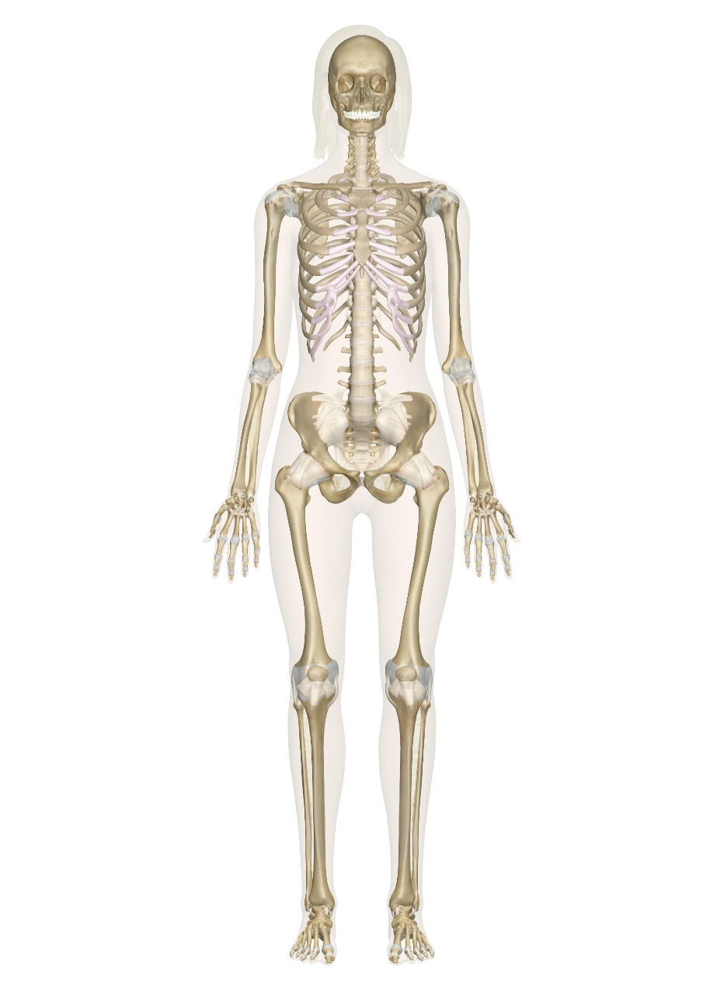
Body Systems and Losses Relevant to SMC
Traumatic Brain Injury
Deafness
Blindness
Loss of voice (aphonia)
Loss of breast tissue
Anatomical loss at shoulder level
Anatomical loss or loss of use at elbow level
Loss of use of creative organ
Loss of use of both buttocks
Anatomical loss at hip level
Anatomical loss or loss of use at hand level
Anatomical loss or loss of use at knee level
Anatomical loss or loss of use at foot level

Slide 10
SMC-K

Slide 11
SMC-K Qualifying Losses and Conditions
SMC-K offers additional compensation to veterans who have experienced anatomical loss or loss of use of specific body parts:
One foot
One hand
Both buttocks
One or more creative organs
Loss of 25 percent or more of the tissue from a single breast or both breasts in combination (including loss by mastectomy or partial mastectomy), or when breast tissue has been subjected to radiation treatment (female veterans only).
Blindness of one eye
Deafness of both ears
Complete organic aphonia (loss of voice)
38 U.S.C. § 1114(k); 38 C.F.R. § 3.350(a)

Slide 12
SMC-K: When a Foot Counts as Loss of Use
The normal functions of the foot, such as balance and propulsion, are crucial for walking.
If a veteran is unable to balance or propel themselves with their foot, it may impede their ability to walk.
The ability of the foot to support the veteran’s weight and facilitate walking is essential.
Should a veteran be unable to perform these functions, he or she might qualify for SMC.
Other factors that establish loss of use of a foot include:
  Extremely unfavorable* complete ankylosis of the knee
  Complete ankylosis of two major joints of an extremity
  Shortening of the lower extremity 3 1/2 inches or more
  Complete paralysis of the external popliteal (common peroneal) nerve and consequent foot drop, accompanied by characteristic organic changes.
  *Favorable ankylosis means the joint is frozen in a straight position; unfavorable ankylosis means the joint is frozen in a bent position

Slide 13
SMC-K: When a Hand Counts as Loss of Use
The concept of “loss of use” is recognized when the functionality of a hand or foot is equivalent to that of an amputated limb with a prosthesis.
Similarly, complete ankylosis of two major joints, rendering them immobile, also signifies loss of use.
The assessment focuses on the remaining practical function of the limb, particularly the ability to perform tasks involving grasping and manipulation.
For instance, if a veteran is unable to perform simple actions like picking up a coin, using a screwdriver, or buttoning a shirt, this could indicate loss of use.
Additionally, a veteran whose arm is immobile at the shoulder, even though they can move their fingers and hold objects, would qualify for SMC-K if they cannot perform actions like reaching their mouth with their hand.

Slide 14
SMC-K: Loss of Use of Both Buttocks
The condition of “loss of use of both buttocks” is recognized when significant damage from disease or injury to muscle group XVII results in the inability to stand up from a seated or bent position without help, as well as the inability to stand upright.
For SMC-K benefits due to loss of use of both buttocks, each must be assessed at a 50 percent disability level.
Even if a veteran needs to use their hands, arms, or a special device for stability, they may still qualify for SMC-K.
SMC-K for loss of use of both buttocks may be granted in addition to other SMC benefits for loss or loss of use of lower extremities, provided there is an additional loss demonstrated.

Slide 15
SMC-K: Loss or Loss of Use of a Creative Organ
The term “loss of use of a creative organ” encompasses conditions such as:
  Loss of reproductive organs: This includes the absence of one or both testicles or ovaries.
  Organ atrophy: Specifically, the shrinking of a testicle or testicles.
  Surgical removal: For male veterans, this refers to the removal of the epididymis or prostate gland; for female veterans, the removal of the uterus or fallopian tubes.
  Functional impairments: In males, this could be retrograde ejaculation or erectile dysfunction. In females, this could be Female Sexual Arousal Disorder (FSAD).
Entitlement to SMC-K is granted only once, regardless of the number of creative organs affected. For instance, the loss of both testicles or both the uterus and ovaries is counted as a single entitlement.
Additionally, loss or loss of use due to elective procedures post-service, such as vasectomy or tubal ligation, does not qualify for this benefit.

Slide 16
SMC-K: Blindness in One Eye
SMC-K is granted for loss of use or blindness in one eye if only light perception remains, no light perception, or if the eye is anatomically lost.
Light perception only (LPO) is defined by the inability to recognize test letters at one foot and the inability to perceive objects, hand movements, or count fingers at three feet.
No Light Perception (NLP) is defined as total blindness with the complete lack of form and visual light perception.
Essentially, if the functioning eye were to lose vision, it would result in total blindness.
Visual impairment evaluations are based on the best corrected vision. SMC-K is not applicable if the vision in the affected eye can be corrected to better than light perception.
If one eye’s total blindness is service-connected and the other eye is totally blind due to a non-service-connected condition not caused by willful misconduct, compensation is provided as if both eyes were service-connected (38 CFR § 3.383, more on this later).

Slide 17
SMC-K: Qualifying Deafness in Both Ears
SMC-K is awarded for complete deafness in both ears, characterized by the absence of both air and bone conduction.
This level of hearing loss is confirmed when a licensed audiologist’s examination*, based on current testing standards, indicates bilateral hearing loss at or above the threshold for the highest rating under the rating schedule.
A rating of “XI,” or 100%, in both ears is necessary for qualification; a rating below “XI” in either ear disqualifies one from SMC-K.
The deafness must be a permanent condition.
If one ear’s total deafness is service-connected and the other ear’s total deafness is due to a non-service-connected disability not caused by willful misconduct, both conditions are treated as service-connected for SMC-K purposes.
*M21-1 VIII.iv.4.A.4.h instructs adjudicators to base disability ratings only on an examination conducted in a VA-authorized audiology clinic using current testing criteria.

Slide 18
SMC-K: Qualifying Organic Aphonia
Complete organic aphonia is a condition where speech communication is persistently impossible due to a speech organ disability.
This typically arises from the loss or paralysis of a speech-related organ, like the tongue or larynx.
Unlike aphasia, which is a communication impairment caused by brain dysfunction and does not qualify for SMC-K, aphonia is rooted in physical organ issues.
To be eligible for SMC-K, a veteran must be completely unable to speak or whisper normally.
Loss of speech from a stroke does not qualify, as the aphonia must stem from a physical condition.
However, using other body parts or prosthetic aids to produce sound does not disqualify one from receiving SMC-K.

Slide 19
Functional Loss of Use Can Qualify
Loss of use attributed to functional hysteria or conversion reaction, characterized by unexplained neurological symptoms like paralysis or loss of sensation, can be recognized for SMC purposes if it is confirmed to be permanent.

Slide 20
Loss of Use: The Rater Decides, the Examiner Documents
According to the M21 manual, the responsibility for determining whether there is loss of use rests with the rater and cannot be delegated to the examining physician. (M21-1 VIII.iv.4.A.1.b.).
M21-1 VIII.iv.4.A.1.c. states:
When requesting an examination to determine LOU of an extremity, ask the examiner to furnish a
  Detailed objective description of remaining function
  Quantitative assessment of strength for each extremity involved
  Description of any pain that affects use

Slide 21
DBQ Limitation: The Missing Strength-and-Pain Inquiry
In the “Remaining Effective Function of the Extremities” section of DBQs, only one question is asked:
“Due to the Veterans condition(s), is there functional impairment of an extremity such that no effective function remains other than that which would be equally well served by an amputation with prosthesis.”
NO mention of strength for each extremity involved, or pain that affects use.
So, many examiners focus only on the “amputation/prosthesis” question and just check NO when the answer should be YES.

Slide 22
Functional Loss of Use and Supporting Medical Opinions
M21-1 VIII.iv.4.A.1.e. states:
“A determination as to LOU of a hand or foot is not restricted to organic loss; it includes functional LOU as well. The relevant inquiry concerning entitlement to SMC is not whether amputation is warranted. Instead, question whether the effective function remaining is other than that which would be equally well served by an amputation with the use of a suitable prosthetic appliance.”
In the “Remaining Effective Function of the Extremities” section of DBQs, there’s a note that corresponds with the M21 guidance above.*
A medical opinion from the Veteran’s personal healthcare provider or an Independent Medical Opinion (IMO) can be crucial, particularly if the rater rejects a claim for loss of use due to an incorrect assessment by the C&P examiner. This external medical perspective can provide essential evidence to support the Veteran’s claim.
*DBQ “Remaining Effective Function of the Extremities” section note: “The intention of this section is to permit the examiner to quantify the level of remaining function; it is not intended to inquire whether the Veteran should undergo an amputation with fitting of a prosthesis. For example, if the functions of grasping (hand) or propulsion (foot) are as limited as if the Veteran had an amputation and prosthesis, the examiner should check "yes" and describe the diminished functioning. The question simply asks whether the functional loss is to the same degree as if there were an amputation of the affected limb.

Slide 23
Useful “Loss of Use” Case Law
Tucker v. West, Aug 13, 1998, 11 Vet.App. 369 (1998)
The Court held that the relevant inquiry in determining entitlement to SMC based on loss of use of a foot under is not whether amputation is warranted, but whether the effective function remaining was other than that which would be equally well served by an amputation with the use of a suitable prosthetic appliance.
The Court held that the Board applied the incorrect standard and erred in concluding that because the veteran's situation did "not warrant amputation" that he was not entitled to SMC.
The Court also held that, pursuant to 38 C.F.R. 4.40, the Board was also required to consider the impact of pain in making its determination regarding loss of use of the lower extremities and articulate how pain was factored into that decision.

Slide 24
Additional SMC-K Rules on Stacking and Caps
SMC-K is compensation provided for the loss of use of a foot or hand, regardless of the loss occurring at the foot, knee, or hip or the hand, elbow, or shoulder.
However, veterans with an amputation above the knee receive a higher regular compensation rate of 60%, compared to 40% for those with loss of use of the foot.
SMC-K is considered a “rate payment variation” and can be added to any disability rating from 0% to 100%.
Veterans may qualify for multiple SMC-Ks if they meet the criteria for each condition, but the total compensation can’t exceed the amount of SMC-L.*
Multiple SMC-Ks can also be added to SMC-S but can’t surpass SMC-L in total.**
Additionally, veterans can receive multiple SMC-Ks on top of higher SMC levels (L, M, N), but the total compensation is capped at the SMC-O level.
*Theoretically up to 6 SMC-Ks **Theoretically up to 3 SMC-Ks

Slide 25
When SMC-K Stops Adding to the Award
Once SMC-O is reached, no additional SMC-K compensation is provided.
SMC-O is considered to be the “maximum” SMC level. (This seems counterintuitive because R-1, R-2 and T pay more, but we’ll explain why later).
Although SMC-K can’t be added to SMC-O, SMC-R or SMC-T*, the rating code sheet may sometimes still list SMC-K(s). But the monthly benefit paid will only reflect the SMC-O, R, or T amount).
The VA website indicates that a veteran may receive 1-3 SMC-Ks, but there is no statutory or regulatory support for the limitation of only 3 SMC-Ks.

Slide 26
SMC-S

Slide 27
SMC-S Eligibility: Statutory Housebound and Housebound in Fact
SMC-S, also known as “Housebound”, is unique in that it doesn’t serve as a building block to higher levels of SMC.
SMC-S is payable when there is a single 100% service-connected evaluation and EITHER:
The veteran also has additional separate & distinct service-connected disabilities rated at 60% or more (combined) involving different anatomical segments or bodily systems; (A/K/A “Statutory Housebound” or “S-1”) OR
The single 100% service-connected disability by itself or in combination with other SC disabilities, causes the veteran to be confined to the area of his/her dwelling or immediate premises, and it is reasonably certain that the disabilities will continue through his or her lifetime (A/K/A “Housebound in Fact” or “S-2”).
In both cases, there MUST be a single 100% evaluation.
38 U.S.C. § 1114(s); 38 C.F.R. § 3.350(i)

Slide 28
SMC-S: What Counts as an Anatomical Segment
The musculoskeletal system within the VA Schedule for Rating Disabilities is divided into anatomical segments which include:
  shoulder and arm
  wrist
  hand
  lumbosacral and sacroiliac joints
  thoracolumbar spine
  cervical spine
  hip and thigh
  knee and leg
  ankle
  foot
  skull
  ribs
  Coccyx
Each extremity includes separate anatomical segments. For example, the right hand and the left hand are separate anatomical segments.
Note: We’ll discuss anatomical segments in more detail later in the part 2.

Slide 29
SMC-S: What “Single Disability” Means
The 100% evaluation must be 100% schedular from a single disability or TDIU from a single disability.
The definition of “one disability” for purposes of TDIU* are NOT APPLICABLE for purposes of SMC-S (i.e., the TDIU rating must be a result of only one disability to qualify for SMC-S).
*For purposes of TDIU, 38 CFR § 4.16 states that the following will be considered as one disability: (1) Disabilities of one or both upper extremities, or of one or both lower extremities, including the bilateral factor, if applicable, (2) disabilities resulting from common etiology or a single accident, (3) disabilities affecting a single body system, e.g. orthopedic, digestive, respiratory, cardiovascular-renal, neuropsychiatric, (4) multiple injuries incurred in action, or (5) multiple disabilities incurred as a prisoner of war.

Slide 30
SMC-S: Why Combined 100% Ratings Do Not Qualify
According to a VA OGC legal opinion (VAOPGCPREC 66-1991), to qualify for SMC housebound benefits (SMC-S), a veteran must have one single service-connected disability rated at 100%. It is not enough for multiple disabilities to combine to a 100% rating, even if they share the same cause.
For instance, a veteran with Parkinson's Disease or Multiple Sclerosis would need a single 100% rating for that condition itself to qualify for SMC-S, regardless of its overall severity. (However, such a veteran may still be eligible for a different benefit, Aid & Attendance).

Slide 31
Statutory Housebound: The 100% + 60% Rule
For SMC-S-1, a veteran must have one single disability rated at 100% and additional service-connected disabilities that combine to at least 60%. The disabilities that make up the 60% can come from the same body system or anatomical area, or from different ones—they just cannot come from the same anatomical segment or body system as the 100-percent disability.
EXAMPLE: A veteran rated 100% for Lung Cancer and an additional 60% combined for knee conditions would qualify for S-1, even though both knees are part of the same anatomical segment. However, if that 60% were instead for asthma, it would not qualify, since asthma and Lung Cancer affect the same body system (respiratory).
The cause of the conditions does not matter; even if they all result from the same event, exposure, or illness, entitlement still applies as long as the 100% disability is separate from the disabilities that form the 60%.

Slide 32
Why IU Based on Multiple Disabilities Does Not Establish SMC-S
Example – IU award based on multiple disabilities:
Veteran is in receipt of IU based on two SC disabilities: ankylosis of the right shoulder evaluated as 50-percent disabling and residuals of a left radius fracture evaluated as 20-percent disabling.
Both disabilities are due to a motor vehicle accident (MVA) that happened during the Veteran’s active duty service.
He is awarded IU based on the disabilities caused by the MVA.
The Veteran’s separate issue of CAD is later SC and evaluated as 60-percent disabling. The CAD, by itself, does not render the Veteran unemployable. SMC (s) at the statutory housebound rate is not awarded.
Analysis:
The Veteran in this instance would not be entitled to SMC at the statutory housebound rate.
There is no single disability evaluated as totally disabling for the purposes of entitlement to SMC.
Although the evaluations for the MVA injuries to the shoulder and left radius are considered to be a single disability for purposes of IU entitlement, they do not represent a single disability evaluated at 100-percent disabling for purpose of awarding SMC at the statutory housebound rate.
SOURCE: M21-1 VIII.iv.4.A.10.b. Defining a Single Disability for Housebound Purposes

Slide 33
Housebound in Fact: Core Standard and Indicators
A housebound in fact determination requires a Veteran’s inability to leave his/her place of residence and immediate premises in order to earn any income.
However, it does not require a total inability to leave the place of residence and immediate premises for all circumstances.
Leaving home for medical purposes cannot, by itself, serve as the basis for finding that a Veteran is not substantially confined for purposes of SMC housebound benefits.
The limitations must be the result of the Veteran’s SC disabilities.
Non-medical indicators of housebound status may include, but are not limited to:
  Inability to walk substantial distances
  Leaving the home with assistance only occasionally for appointments, grocery shopping, or church
  Inability to mow one’s lawn
SOURCE: M21-1 VIII.iv.4.A.10.f.

Slide 34
Housebound in Fact: M21 Example
A Veteran is SC for multiple disabilities including CAD, which is totally disabling. His wife drives him to all medical appointments.
If the Veteran experiences a good day, they may run some minor errands while out of the home.
The Veteran is entitled to SMC based on housebound in fact status as leaving his home for medical visits does not preclude a finding of substantial confinement to his dwelling or immediate premises.
Furthermore, the other visits where the Veteran’s activity is limited to minor errands does not preclude a finding of substantial confinement since the Veteran is not shown to be able to leave his place of residence and immediate premises in order to earn income.
SOURCE: M21-1 VIII.iv.4.A.10.f.

Slide 35
SMC-S Permanency Rules
For Statutory Housebound status, neither the 100% rating nor the 60% rating needs to be permanent.
Temporary SMC-S may be awarded in cases like active cancer with an additional 60% rating, but it may be discontinued once remission is achieved. Similarly, a 100% convalescent rating with a 60% rating may be granted temporarily and then withdrawn once the convalescent period concludes.
Housebound in Fact status is granted when a veteran has a single disability rated at 100% and is factually determined to be permanently housebound due to service-connected disabilities. This confinement is to their home or immediate surroundings, or to a specific area if institutionalized.
Unlike Statutory Housebound SMC-S, which can be temporary, Housebound in Fact is a permanent designation and is not awarded on a temporary basis.

Slide 36
SMC-S Advocacy Tip: Preserve Single-Disability TDIU
When applying for Total Disability Individual Unemployability (TDIU), it’s important to note that TDIU based on multiple disabilities is not considered for SMC-S. Therefore, if a veteran’s 70% PTSD rating alone makes them unemployable, it’s advisable not to include additional minor disabilities in the TDIU application.
Also be aware that if TDIU is initially granted based on multiple conditions and later a single disability worsens to the extent that it independently justifies TDIU, the veteran might become eligible for SMC-S. The VA is obligated to assist claimants in fully developing their claims and to grant all benefits that are legally supportable, as per 38 CFR § 3.103(a).

Slide 37
SMC-S Advocacy Tip: Using Buie v. Shinseki
Buie v. Shinseki, 24 Vet. App. 242 : "Whenever a veteran has a total disability rating, schedular or extraschedular, based on multiple disabilities and the veteran is subsequently awarded service connection for any additional disability or disabilities, VA's duty to maximize benefits requires VA to assess all of the claimant's disabilities without regard to the order in which they were service connected to determine whether any combination of the disabilities establishes entitlement to special monthly compensation under section 1114(s).“
Cite to this case when requesting that VA consider a single disability to entitle the veteran to TDIU so that he/she can receive SMC-S.

Slide 38
SMC-L and Aid & Attendance

Slide 39
SMC-L Eligibility Overview
The following combinations of loss/loss of use for lower and upper extremities and vision loss will entitle a veteran to SMC-L:
Anatomical loss or loss of use of both feet.
Anatomical loss or loss of use of one hand and one foot.
Blindness in both eyes with vision 5/200 or less or the visual field restricted to 5 degrees or less.
SMC-L is also available to a veteran who is:
Permanently bedridden, or
In need of aid and attendance (A&A)
38 U.S.C. § 1114(l); 38 C.F.R. § 3.350(b)
Since Aid and Attendance is the most common way to qualify for SMC-L, let’s focus on that…

Slide 40
Aid and Attendance: Basic Qualification Standard
To qualify for Aid and Attendance (A&A) benefits as per 38 CFR § 3.352(a), a veteran must be significantly incapacitated, either physically or mentally, to the extent that they require another person’s help for daily personal functions.
The level of disability necessary for A&A is higher than that for the housebound rate or a 100-percent schedular evaluation.
According to the M21 manual, the need for A&A must generally be due to a single disability rated at 100% (although there are exceptions to this rule discussed later).
A&A can be granted even if the disability is not permanent.
Aid and Attendance is considered an inferred issue if evidence supports eligibility, as stated in 38 C.F.R § 3.155(d)(2). However, it is often necessary to provide evidence of the need for A&A, as medical records may not include this detail.

Slide 41
Aid and Attendance: Regulatory Factors Under 38 C.F.R. § 3.352(a)
The following will be accorded consideration in determining the need for regular aid and attendance:
  Inability of claimant to dress or undress himself (herself), or to keep himself (herself) ordinarily clean and presentable.
  Frequent need of adjustment of any special prosthetic or orthopedic appliances which by reason of the particular disability cannot be done without aid.
  Inability of claimant to feed himself (herself) through loss of coordination of upper extremities or through extreme weakness.
  Inability to attend to the wants of nature.
  Incapacity, physical or mental, which requires care or assistance on a regular basis to protect the claimant from hazards or dangers incident to his or her daily environment. SOURCE: 38 CFR § 3.352(a)
A veteran doesn’t have to show a need for aid and attendance for all these tasks; inability in even one area may suffice.
This list is not comprehensive—it only shows examples. More examples are included on the next slide.

Slide 42
Additional Activities of Daily Living Relevant to A&A
  Meal Preparation: Needing assistance with cooking or preparing meals.
  Housekeeping: Requiring help with cleaning, laundry, or other household chores.
  Medication Management: Needing assistance with organizing and taking medications.
  Transportation: Requiring help with getting to medical appointments or running errands.
  Ambulation: Needing help with walking, using a walker, or getting in and out of a wheelchair.
  Transfers: Requiring assistance with moving from one surface (e.g., bed, chair) to another.
  Monitoring: Needing someone to ensure safety and prevent accidents or falls.
  Wandering Control: Requiring supervision to prevent wandering or getting lost.
  Memory Assistance: Needing help with memory tasks, reminders, or orientation.
  Decision-Making: Requiring assistance with making informed choices.
  Companionship: Needing social interaction and emotional support.
  Anxiety or Depression Management: Requiring assistance with managing emotional well-being.
Advocacy Tip: If a mental health DBQ indicates the symptom “Intermittent inability to perform activities of daily living, including maintenance of minimal personal hygiene,” it is advisable to build a case for Aid & Attendance benefits.

Slide 43
Examples of Disabilities That May Cause A Need For A&A
Disabilities that hinder bending over to put on shoes or socks. These disabilities can arise from various conditions, including spinal issues, muscle weakness, or chronic pain.
Upper extremity disabilities that necessitate assistance for putting on a shirt due to an inability to raise the arms above shoulder level.
Hand disabilities that hinder buttoning shirts or pants.
Lower extremity or back disabilities that prevent safely accessing or exiting a shower or bathtub.
Lower extremity or back disabilities that prevent getting on or off a toilet.
Upper extremity disabilities impeding the capability to perform daily tasks such as washing hair, face, brushing teeth or shaving.
Disabilities in hands or arms that inhibit the ability to feed oneself.
Memory issues that require assistance in such areas as managing medication or remembering to turn off the stove.
Cognitive issues that hinder safety such as impaired decision-making, wandering off, or reduced awareness of potential hazards.
Disabilities that increase the risk of falling such as impaired balance, muscle weakness, vision problems, or mobility limitations.

Slide 44
Aid and Attendance: What Counts as a Single Disability
Aid and Attendance eligibility requires the veteran to demonstrate a regular, though not necessarily constant, need for assistance.
Typically, A&A is linked to a single service-connected disability, with some exceptions. For SMC-L, a “single disability” may encompass multiple disabilities arising from one disease process, like diabetes mellitus or Parkinson’s disease, or a primary disability and its secondary conditions, provided there’s evidence of regular A&A necessity.
This is distinct from SMC-S, where multiple disabilities from a single disease process or a combination of primary and secondary conditions aren’t considered a single disability.
The other definitions of a single disability for TDIU under 38 CFR § 4.16 don’t apply to A&A determinations; it’s limited to a single disease process or a combination of primary and secondary conditions.

Slide 45
Aid and Attendance: The M21 100% Schedular Rule
The M21 manual states that a single disability evaluated as 100% disabling under a schedular evaluation is generally a prerequisite for entitlement to A&A. This implies that a single disability TDIU rating doesn’t allow for A&A.
Per M21-1 VIII.iv.4.A.8.b:
A single disability evaluated as 100-percent disabling under a schedular evaluation is generally a prerequisite for entitlement to A&A. There is not a statutory or regulatory requirement for a 100-percent disability to qualify for A&A. However, any lesser disability would typically be incompatible with the requirements of 38 CFR 3.352(a).
Explanation: Both the nature of the impairment (being in need of regular A&A) and the compensation indicate that a greater level of disability is required for entitlement to the additional allowance for A&A than for
entitlement to SMC at the housebound rate, or
a 100-percent schedular evaluation.

Slide 46
Aid and Attendance: Limits of TDIU and Temporary 100% Ratings
Per M21-1 VIII.iv.4.A.8.b (continued):
The single disability rated as totally disabling must be the sole or partial cause of the need for A&A.
38 CFR 4.16 applies only to IU determinations. It does not permit decision makers to apply 38 CFR 4.16 guidelines on what constitutes a single disability to A&A determinations.
Temporary 100-percent evaluations under 38 CFR 4.28, 4.29, and 4.30 qualify for the single schedular evaluation needed for entitlement to A&A. However, grants of entitlement to A&A are not routine in these circumstances.
To establish entitlement to SMC (t), the need for A&A must be due to traumatic brain injury (TBI) or multiple disabilities due to TBI that combine to a 100-percent evaluation.

Slide 47
Aid and Attendance: M21 Definitions of a Single Disability
Per M21-1 VIII.iv.4.A.8.b (continued):
The following fact patterns represent a “single disability” for purposes of establishing entitlement to SMC (l):
Evaluations of facets or multisystem effects of a single disease entity (including, but not limited to, multiple sclerosis, Parkinson’s disease, or diabetes mellitus) combine to 100 percent without regard to other conditions and A&A is required as a result of SC disability. Multisystem diseases are rated under a primary DC or by separate ratings of residuals under multiple DCs when more advantageous to the claimant.
Evaluations of primary and secondary SC disabilities combine to 100 percent and A&A is required as a result of SC disability.

Slide 48
Aid and Attendance: M21 Examples of a Single Disability
Per M21-1 VIII.iv.4.A.8.b (continued):
Example 1: A Veteran is SC for Parkinson’s disease and has multiple disabilities related to the disease that result in a combined 100-percent schedular evaluation. If the evidence shows that the disabilities related to the disease are so severe that the Veteran requires A&A, entitlement to SMC (l) must be awarded.
Example 2: A Veteran is SC for amputation of right leg at the hip at 90-percent disabling. Pursuant to 38 CFR 3.310(c), SC is subsequently established for ischemic heart disease secondary to the amputation of right leg evaluated as 60-percent disabling. If the evidence shows the Veteran requires A&A due to the heart condition and right leg amputation, entitlement to SMC (l) is warranted.

Slide 49
Aid and Attendance Below 100%: Extraschedular and BVA Pathways
The M-21 also states that if a disability is rated less than 100% but a recent examination shows that the disability is so severe as to demonstrate a need for regular A&A, the VA regional office is obligated to submit the claim to the Director, Compensation Service for an advisory opinion (i.e., extraschedular A&A). (M21-1 VIII.iv.4.A.8.c)
In Many BVA decisions, it has been observed that the statute (38 USC § 1114(l)) and the regulation (38 CFR § 3.350(b)(3)) do not mandate a service-connected disability to be rated 100% disabling for a veteran to qualify for A&A. Consequently, there have been a number of cases where the BVA has approved A&A benefits for disabilities rated less than 100% when the evidence justifies entitlement.
So, if the AOJ denies a claim for A&A because the veteran has less than a 100% rating or is receiving TDIU for a single disability, it’s recommended to seek an advisory opinion or appeal to the Board.

Slide 50
Aid and Attendance: Bedridden Not Required
A veteran applying for SMC due to the need for regular aid or attendance is not required to prove the need to be bedridden; it is sufficient to show the need for personal assistance from others.
VA’s decision on aid and attendance is based on valid medical evidence. The assistance can be provided by a spouse, family member, or neighbor, and doesn’t need to come from a professional. In other words, payment for assistance isn’t a factor in determining eligibility.
A&A benefits are available to veterans who have either physical or mental disabilities. For instance, a veteran with a service-connected mental health condition that renders them incapable of safeguarding themselves from daily environmental risks may be eligible for A&A.

Slide 51
SMC-L Through Bedridden Status
“Bedridden” will be that condition that, through its essential character, which actually requires that the claimant remain in bed.
The fact that the claimant has voluntarily taken to bed or that a physician has prescribed rest in bed for the greater or lesser part of the day to promote convalescence or cure will not suffice.
When a veteran is hospitalized for an extended period at the VA’s expense, their Aid and Attendance benefits are typically reduced to the housebound rate (SMC-S). However, if a veteran receives care in a facility at their own expense and not the VA’s, the A&A benefits will not be decreased.
But, if a veteran is bedridden as a result of service-connected disabilities, their benefits won’t be reduced due to hospitalization at the VA’s expense.

Slide 52
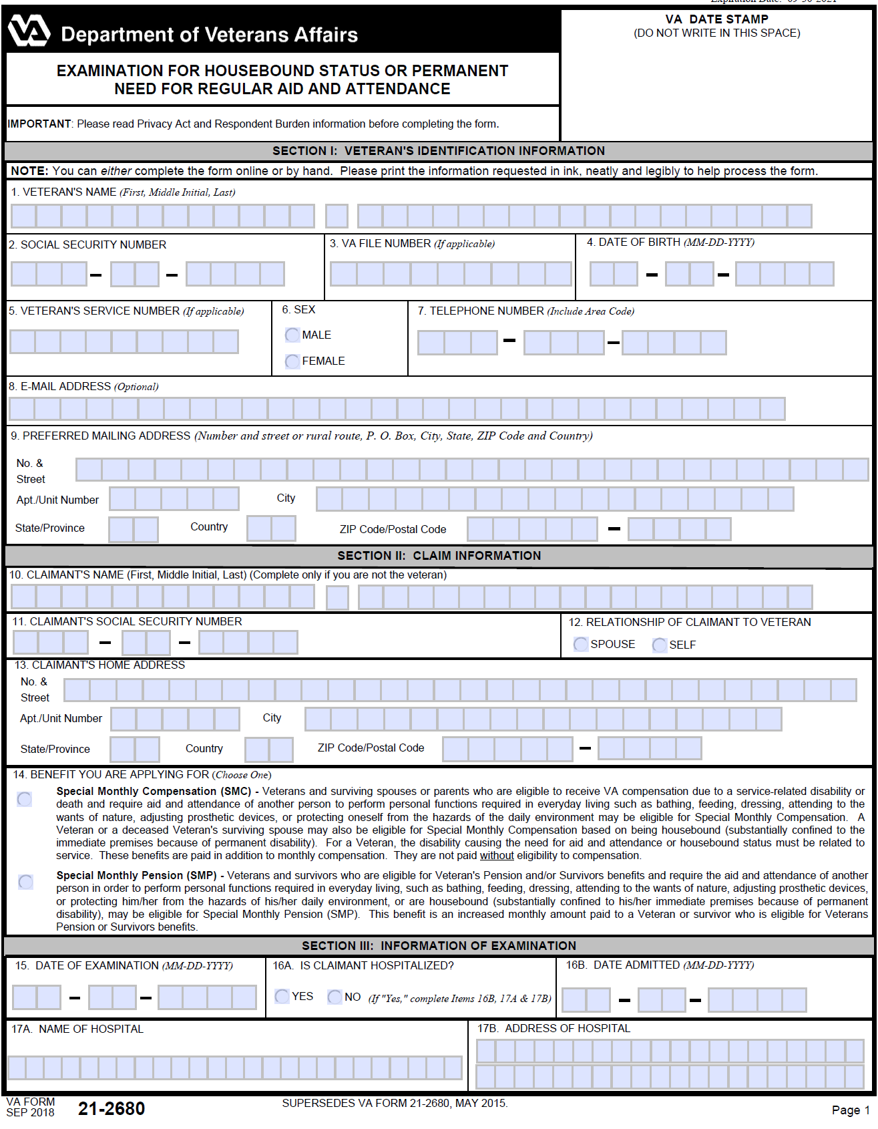
VA Form 21-2680 as A&A Evidence
Per M21-1 VIII.iv.4.A.1.i., Medical providers within or outside VA may complete VA Form 21-2680 and “Although VA Form 21-2680 may be accepted as a prescribed form adequate to claim entitlement to SMC, this form is not required to develop a claim for or grant entitlement to SMC. Additional development for VA Form 21-2680 should not be routinely undertaken when the form is not received with a claim.”
If possible, have the veteran’s health care provider complete the 21-2680 as it can be excellent evidence in support of the claim for A&A.
In addition, provide detailed statements from both the veteran and any caregivers regarding the restrictions caused by service-connected disabilities. Clearly detail which specific disability is responsible for each limitation.

Slide 53
SMC Practice Tips

Slide 54
SMC Practice Tips: Inferred Issues and Progressive Conditions
Remember that entitlement to SMC is an inferred issue, and the VA’s failure to correctly award SMC could constitute a clear and unmistakable error in a final decision.
But also keep in mind that VA can only infer entitlement to SMC if they’re made aware of the veteran’s current medical condition.
Veterans with progressive conditions like Parkinson’s, Multiple Sclerosis, or Diabetes may very well become eligible for SMC as their diseases advance. Advocates should therefore ensure their clients inform them of any new developments such as loss of use or the need for Aid and Attendance (A&A).
Now that we’ve covered the fundamental building blocks of Special Monthly Compensation, we’ll be delving deeper into the intricacies of SMC by unraveling such topics as different levels of loss, intermediate SMC rates, Special Aid & Attendance, and strategies for achieving the highest possible degree of special monthly compensation for your clients.

Slide 55

QUESTIONS?

Slide 56
More Questions?
Feel free to contact us about questions from this training or ANYTIME you have a question about a claim:
CACVSO@eagleveteranslaw.com

