Slide 1
The Role of risk assessment in suicide prevention for veterans
JunE 2026
Presentation to Cal Vet Partners
Venée Hummel, LCSW
Senior Manager, Clinical Practice & Training
Notes:
Not a substitute for site level policies, procedures, and guidance
Engage in conversations with your supervisors and leadership for further implementation guidelines
Acknowledge the heavy nature of the material and empowerment to take care of oneself as needed

Slide 2
Agenda and Objectives
Create a framework for the importance of suicide prevention
To identify the disproportionate risk of suicide for veteran populations
Introduce the language of suicide prevention
To display increased comfort using clear and non-judgmental language
Explore the C-SSRS tool for risk assessment
To demonstrate the ability to administer the C-SSRS Recent

Slide 3
The Words We Use Matter
Suicidal ideation: thoughts about ending one’s life
Preparatory behaviors: acts of preparation for suicide (e.g., gathering means, giving away belongings, writing notes, practicing)
Suicide attempt: non-fatal, self-inflicted, potentially injurious behavior with any intention to die as a result of the behavior
Death by suicide: ending one’s own life intentionally
Note that the following language is omitted:
Committed suicide
Successful or failed suicide attempt
Completed or incomplete suicide
Notes:
Take a moment to acknowledge very specific language that will be used throughout the training and encourage the adoption and practice in your own use
An area of ongoing improvement and continual change as we reflect and learn more
Decreases stigma, removes judgemental language, uses language that is more precise and clear

Slide 4
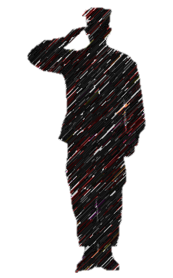
Suicide statistics
General Population (US)
Military and Veterans
10th leading cause of death in the US¹
2.2 million Americans attempted suicide in 2024¹
Males died by suicide 3.8x more often than females¹
Females were 1.3x more likely to attempt suicide¹
Populations at disproportionate risk of death by suicide include^{2, 3, 4}:
  LGBTQ+, especially transgender/nonbinary
  American Indian and Alaskan Native
  Older adults over the age of 75
  Living in rural areas
  Those with disabilities
2nd leading cause of death in US military populations ⁵
Suicide rate is 1.2x higher for veterans than non-veterans ⁶
Among Active Duty populations, suicide deaths primarily occur among enlisted white men, under 30 years old ⁷
Firearms are the means of suicide for approximately 2 in 3 Active Duty/Reserve/National Guard military and 3 in 4 veteran suicide deaths ^{6, 7}
Active Duty and post-9/11 war veterans die by suicide at 4x more than in combat⁸
Notes:
https://afsp.org/suicide-statistics/
https://www.cdc.gov/
https://www.cdc.gov/suicide/facts/data.html?CDC_AAref_Val=https://www.cdc.gov/suicide/suicide-data-statistics.htmlhttps://www.cdc.gov/nchs/products/databriefs/db509.htmhttps://www.cdc.gov/mmwr/volumes/73/su/pdfs/su7304a9-H.pdf https://www.cdc.gov/nchs/products/databriefs/db471.htm
https://www.cdc.gov/vitalsigns/prevent-suicide/index.html?utm_medium=email&_hsenc=p2ANqtz-88kjOiiunFGx90r8UqkwMmjgIPMdpcXnloBT5w_llrL1DrM4TSXwufYua2YVzjEyjf5EXjVvWqx0vwiTw4HEvnttRxCXvPhI72OTXXsxqvSkb24kg&_hsmi=328096804&utm_content=328096804&utm_source=h
https://www.thetrevorproject.org
https://www.thetrevorproject.org/survey-2024/
https://www.thetrevorproject.org/wp-content/uploads/2022/08/August-22-Research-Brief-LGBTQ-Youth-with-Military-Parents-August-22-Research-Brief-LGBTQ-Youth-with-Military-Parents.pdf
https://williamsinstitute.law.ucla.edu/press/transpop-suicide-press-release/
https://sgp.fas.org/crs/natsec/IF10899.pdf
https://www.mentalhealth.va.gov/docs/data-sheets/2024/2024-Annual-Report-Part-2-of-2_508.pdf
https://www.dspo.mil/Portals/113/2024/documents/annual_report/ARSM_CY23_final_508c.pdf
https://watson.brown.edu/costsofwar/papers/2021/Suicides

Slide 5
Poll: True or False
Talking about suicide will lead to and encourage suicide.​
Suicide only impacts those with mental health conditions.​
Someone who is suicidal is determined to die.​
Most suicides happen suddenly, without warning or “on a whim.”​
People who talk about suicide do not mean to do it.​
Notes:
Talking about suicide will lead to and encourage suicide.​
Talking about suicide reduces the stigma that often acts as a barrier to individuals seeking help​
Talking opening also can give an individual other options or time to rethink decision​
Suicide only impacts those with mental health conditions.​
54% of individuals who have died by suicide, did not have a diagnosable MH condition​
Just under 50% of military members who died by suicide had a MH diagnosis​
Other life stressors are also associated with suicidal thoughts and attempts​
Once someone is suicidal, they will always remain suicidal.​
​Heightened suicide risk is often short-term and situation specific​
While thoughts can return, they are not permanent​
An individual with a history of suicidal thoughts and/or attempts can live a long, successful life​
​Someone who is suicidal is determined to die.​
People are often ambivalent about living or dying​ and have reasons to want both
Many individuals act on impulse, even though they would have liked to live on​
Most suicides happen suddenly, without warning or “on a whim.”​
While the final act of suicide can happen in an impulsive moment, almost always evidence of prior planning​
Mental preparation is an essential characteristic​
In some cases, planning may be “shelved” for a period of time​. The acute suicidal crisis however is often 15 mins from initial thought to attempting behavior. For children and teens, impulsivity and undeveloped abstract thinking are additional factors.
​People who talk about suicide do not mean to do it.​
Often people are attempting to search for help or support​
Many people are experiencing anxiety, depression, burdensome and hopelessness and feel there is no other option.​

Slide 6

Assumptions About Clients
Clients who contemplate suicide are in intense psychological and emotional pain
Suicide is an attempt at problem solving an intensely emotional situation that feels impossible to solve, tolerate, or escape.
Clients want to improve
Clients are doing the best the can, given both their history and their current resources at any given point in time
And they will need more internal and external resources in order to do the hard work of experiencing change
Notes:
Several of these client assumptions are drawn from the Dialectical Behavior Model to treating suicide behaviors, but they aren’t unique to that treatment model. FOR CHILDREN: SEEKING CONTROL.
First and foremost, we have to understand in a global sense what drives people to contemplate suicide.
Clients who contemplate suicide are in unbearably intense emotional pain
In the last slide we noted the myth that people attempting suicide want only to die. More typically, they want an end to suffering and suicide feels like the only possibility for that. Even among people who do state a desire to die (not just end suffering), many ALSO state a desire to live. You can WANT to die and WANT to live at the same time. Those desires are not mutually exclusive, but of course the states of life and death are.
Clients want to improve. This doesn’t mean that they are all in all the time, but only that there must be some glimmer of hope to seek treatment
Clients are doing their best. If they could do better right now, with the resources they have, they would.
But to reduce suffering, they will need to learn to work harder and do better and fortify their resources. Thankfully, they don’t need to do that alone. That’s where we as providers come in.

Slide 7

Assumptions About Helping Professionals
Under optimal circumstances, helping professionals can only influence, not control, client suicide.​
Because we cannot control outcomes, we need to consider consistent and evidence-based approaches to care
Recognizing our limited control helps us better manage risk effectively
Like clients, we are doing the best we can. And need to actively work to do even better.​

Slide 8
Discussion
What makes you nervous about directly assessing for suicide risk with Veterans?

Slide 9
Why should we Assess everyone for suicide Risk?
Common to occur along with a mental health diagnosis (can be a symptom of some diagnoses such as depression)
Common to occur without a mental health diagnosis in response to a significant event
Higher prevalence amongst the military and veteran population
Death by suicide is a preventable cause of death
Improve access to the most appropriate treatment and services
Decrease stigma and barriers to speaking about suicidal thoughts and behaviors
Not outwardly observable and no exact presentation to predict
Unfair to expect that someone would directly tell us without being asked (especially within a warrior culture)

Slide 10
Risks, Signs, and Vulnerabilities
Known Risk Factors
Age
Gender (Including transgender)
Veteran status
Firearm owner/user
Race and ethnicity
Previous suicide attempt history
Death of a loved one by suicide
Possible Vulnerabilities
Mental illness
Substance use challenges
Recent significant stressor (break up, legal issues, eviction, layoff, etc)
Social isolation
Trouble sleeping
Chronic pain
Common Warning Signs
Feelings of hopelessness
Feelings of burdensomeness or haing no reason to live
Feeling a lack of purpose
Talking or posting (more) about death, dying, or suicide
Acting recklessly or engaging in risky behaviors
Increased withdrawal from friends, family, engagements
Appearing agitated
Increased use of drugs or alcohol
Extreme mood swings
Showing rage or seeking revenge
Trauma history

Slide 11
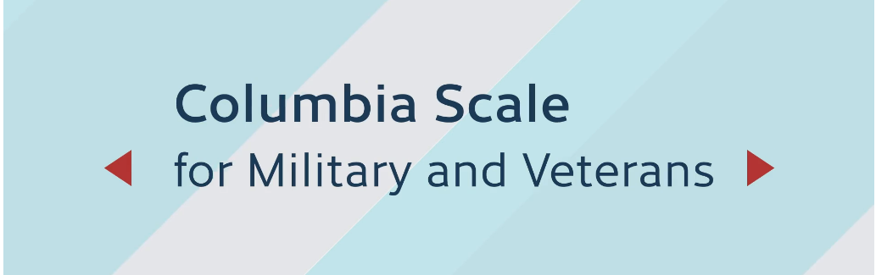

Video: PsychArmor
The Columbia-Suicide Severity Rating Scale
Notes:
Que pulling out CSSRS handout to follow along during the video
Acknowledge video is out of date in terms of the crisis line which is now 988.
https://learn.psycharmor.org/courses/take/columbia-scale-for-military-and-veterans/lessons/29740359-columbia-scale-for-military-veterans
TIME STAMP: 2:59
*Approx 10 min*

Slide 12
The C-SSRS Components
Everyone
Q1: Wish to be dead (morbid or passive thoughts of dying)
Q2: Thoughts of killing oneself
If Q2 is yes
Q3: Method (How)
Q4: Intention
Q5: Specific planning
Everyone
Q6: Suicidal behavior
If Q6 is yes
In the last 3 months

Slide 13
1. A veteran who has had morbid and/or suicidal thoughts, but no recent plans, intention. Has had lifetime behavior, but not recent.
2. A veteran who has recent suicidal thoughts with method and some intention but no lifetime behavior.
3. A veteran who has no recent suicidal thoughts but suicidal behavior in the last 3 months.
4. Your choice
Let’s Practice

Slide 14
Debrief and Reflection

Slide 15
Common Concerns and Barriers
Inconsistent answers
Based on other information (e.g. the PHQ-9 question 9, other provided information)
Guarded responses
”Not really” or “barely but I would never”
Annoyance or frustration
“I already said no”
Avoidant responses that go off track
“Yes because see what happened was…”
Fear of implication
“I don’t know, last time I talked about this…”

Slide 16

Their next steps
Based on the triage levels on the C-SSRS and your program’s standard operating procedures (SOP), next steps for referral will be outlined
While following that SOP, strive to provide facts with hope
Transparent information on the next steps in the process
Hope for improvement through access to appropriate services
Be mindful of statements that have good intention but can be minimizing
Self-disclosure
Coaching and advice giving
Silver-lining the problem “at least…”

Slide 17
Recommendations
Practice, practice, practice
Increases comfort and familiarity while maintaining fidelity
Decrease the discomfort of using the words and phrases common within this work
Improved ability to demonstrate warmth, validation, and unconditional positive regard despite the challenge of the work
Decrease personal anxiety
Maintain a reflective practice
Consider your own work: strengths and areas for improvement
Engage in additional learning
Seek supervision, mentorship, consultation, support
Remember that most people don’t want to die, they want to end pain and suffering
You are an important link and helping them create a way out of suffering and reconnecting with a life that feels worth living

Slide 18
Resources
Training
https://learn.psycharmor.org/collections
The Columbia Protocol
cssrs.columbia.edu (additional versions, languages, background info)
Crisis Line
Call or Text 988

Slide 19
Questions and
Discussion
Notes:
One thing you are taking away that either changes your outlook on your role in this process or solidifies your role?
How do you plan to navigate the heaviness, values conflict, or grey area of this work?

