Slide 1

Suicide Prevention
GREATER LOS ANGELES VA HEALTHCARE SYSTEM
Anne Cheever, LCSW
Suicide Prevention Coordinator

Slide 2
Agenda
Provide a history and overview of VHA Suicide Prevention
Overview of the GLA SPP team roles and responsibilities
Integral role of the Veteran Military Crisis Line (VMCL) 988 option 1
How the SPP program supports the VMCL calls, what happens after?

Slide 3
1956
2007
2009
2012
2019
Present
HISTORY
SUICIDE PREVENTION AT VHA
Key Milestones
1956
209
2012
VA Psychologists publish “Clues to Suicide”
Veterans Crisis Line established & Suicide Prevention Coordinator positions created
Suicide Prevention Applications Network (SPAN) established
Suicide Research Focus
PREVENTS task force developed
VA makes suicide prevention a top clinical priority
Early pioneers in the field, including VA psychologists Edwin Shneidman and Norman Farberow, developed groundbreaking theories about suicide prevention, emphasizing its preventability and the importance of early detection and intervention
a centralized database to track suicide attempts, deaths, and serious suicidal ideation to inform clinical care and case management
VA's Office of Research and Development (ORD) begins focusing on research relating to suicide among Veterans
The White House and VA launched a task force to develop a national roadmap to prevent Veteran suicide, the President's Roadmap to Empower Veterans and End the National Tragedy of Suicide (PREVENTS).
VA releases a comprehensive 10-year National Strategy for Preventing Veteran Suicide

Slide 4
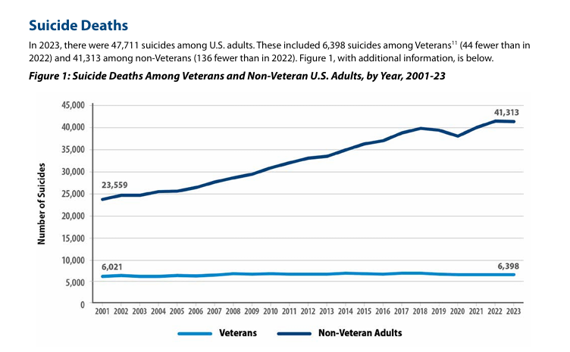

Slide 5
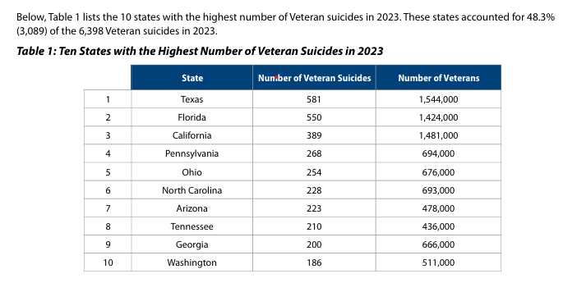

Slide 6
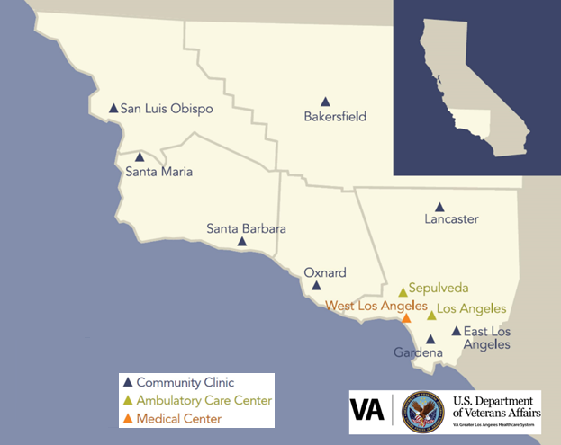
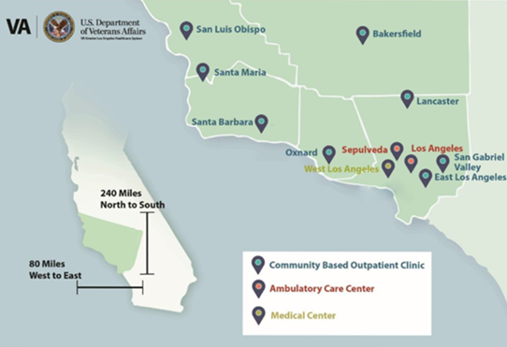
GLA Catchment Area

Slide 7
STAFF
SUICIDE PREVENTION TEAM
SUICIDE PREVENTION COORDINATORS
ADMINISTRATION
Sharon Birman, PsyD, Service Chief
Special Jones, Program Support Assistant
Barbara Chase, PhD, REACH VET Coordinator
RISK ID TEAM
Raul Barragan, LCSW
Jennifer Smock, LCSW
Sinea Schieber, LCSW
Marsh Allen Smith, ED.D, LMSW
Jeff Robey, PsyD
Matt Kaplan, LCSW, PhD
Anne Cheever, LCSW
VMET
VAPD
Everett Wong, LCSW
Brandon Hervey, LSW Community Care Liaison
Kerri Schutz, PsyD
Sgt. Alejandro Gonzalez
Officer Anabel Constable
Mental Health
Channing Credeur, LCSW, Deputy Chief
Danielle Schultz, PsyD
Colleen Thompson, LCSW
vhaglasuicideprevention@va.gov

Slide 8
OVERVIEW
SUICIDE PREVENTION TEAM
Roles & Responsibilities
Serve as VA facility subject matter experts
Ensure enhanced care for Veterans identified as high risk for suicide
Track and report suicide attempts and deaths
Provide clinical consultation to VA providers, including crisis intervention and care coordination
Conduct facility and community training outreach
Identify Veterans at high risk for suicide

Slide 9
CONSULTATION
ROLES & RESPONSIBILITIES
Assist VA providers with:
Suicide risk assessment
Conceptualization of suicide risk
Best practices for documentation
Strategies for how to engage Veterans at high risk
Provider support after suicide loss
Lethal means counseling

Slide 10
IDENTIFYING VETERANS AT HIGH SUICIDE RISK
ROLES & RESPONSIBILITIES
Avenues of identification
VHA RISK ID – universal suicide screening & evaluation
Veteran’s Crisis Line follow-up
VA's Recovery Engagement and Coordination for Health - Veterans Enhanced Treatment (REACH VET) program
Supporting Patients after Discharge from the Emergency Department (SPED)
Community Care Liaison

Slide 11
IDENTIFYING VETERANS AT HIGH SUICIDE RISK
RISK STRATIFICATION & THERAPEUTIC MANAGEMENT
ACUTE Risk
HIGH
FEATURES
INTERMEDIATE
LOW
FEATURES
ACTION
Suicidal ideation with intent to die by suicide
Unable to maintain safety independent of external support
Maintain 1:1 observation
Psychiatric hospitalization
Removal of lethal means
Current/recent suicidal ideation
Ability to maintain safety independent of external support
Consider hospitalization
Close outpatient treatment
Lethal means safety counseling
No current suicidal ideation
No specific and current suicide plan
No preparatory behaviors
Collective high confidence in Veteran’s ability to independently maintain safety
Routine primary care management
Mental health treatment, if indicated
FEATURES
ACTION
ACTION

Slide 12
IDENTIFYING VETERANS AT HIGH SUICIDE RISK
HIGH RISK FOR SUICIDE FLAGS
Clinical features
EXAMPLES
Suicide attempt or preparatory behavior
within past 30 – 90 days
Suicidal ideation w/ intent requiring hospitalization
Rated at high acute risk for suicide (per CSRE evaluation)
Unable to maintain safety from suicide without external support
Suicidal plan in the context of acute psychosocial stressors​
Suicidal ideation with unclear intent and access to lethal means

Slide 13
ENSURING ENHANCED CARE FOR HIGH-RISK VETERANS
ROLES & RESPONSIBILITIES
Monitored by SPCs for 90 days
ENHANCED CARE
Increased mental health visits (including post-discharge)
Suicide Prevention Safety Plan
Lethal Means Counseling
Evidenced-based Treatment for Suicide Prevention via telehealth
Caring Contacts

Slide 14
LETHAL MEANS SAFETY
U.S. VETERANS & SUICIDE METHODS(2023)
Veterans
Non-Veteran U.S. Adults

Slide 15
LETHAL MEANS SAFETY
WHAT IS IT?
In the context of suicide prevention, safe storage of lethal means is any action that builds in time and space between a person with thoughts of suicide and a suicide method.
Effective lethal means safety education and counseling is collaborative and Veteran-centered. It respects the important role that firearms and medications may play in Veterans’ lives and is consistent with their values and priorities.

Slide 16
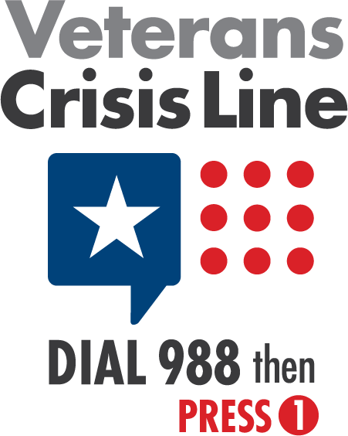
Veterans Military Crisis Line & Suicide Prevention

Slide 17
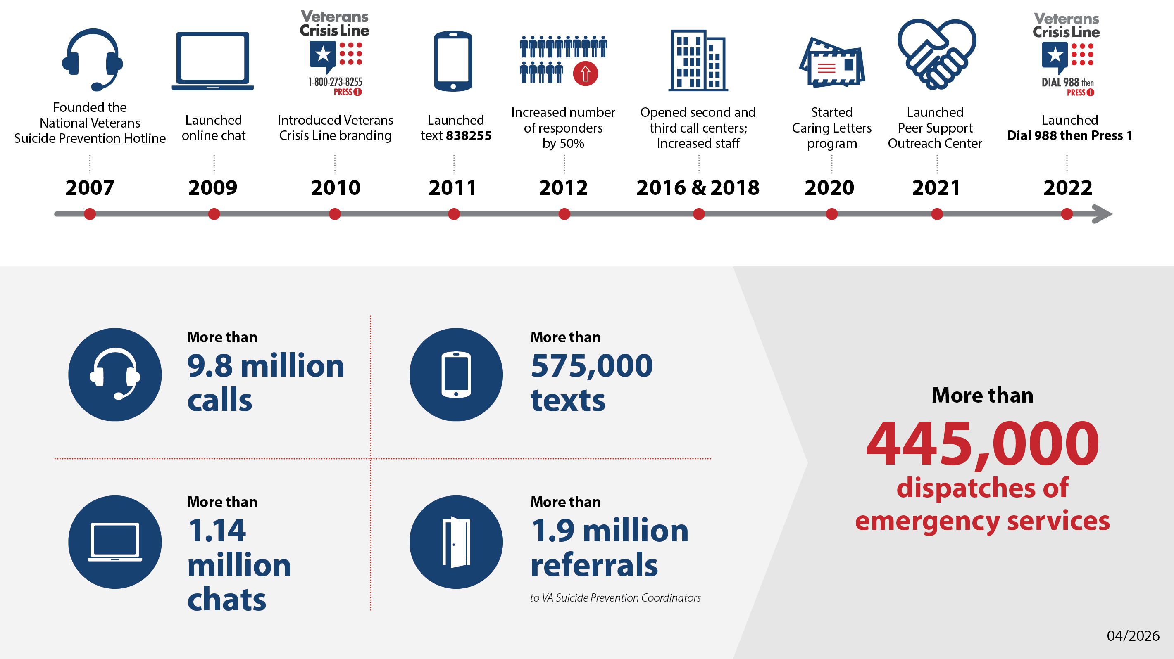

Slide 18
What happens when a Veteran calls 988 option 1
From initial outreach to care

Slide 19
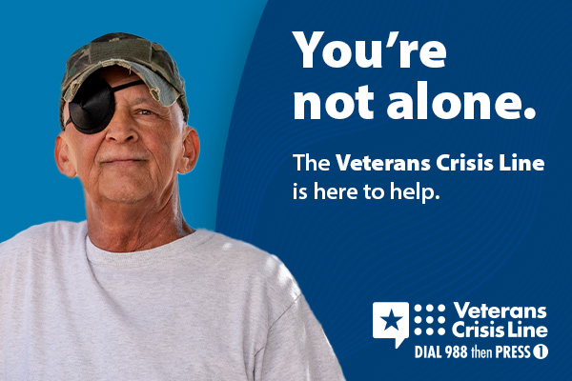
Dial 988 then Press 1
The Veterans Crisis Line is a toll-free, confidential resource that connects Veterans in crisis and their families and friends with qualified, caring U.S. Department of Veterans Affairs (VA) responders.

Slide 20
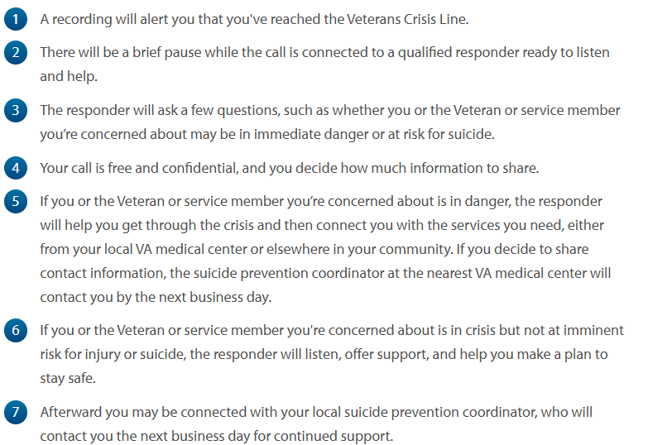
What happens next?

Slide 21

Next steps after the call:
Callers are referred to local Suicide Prevention Coordinators based on their VHA location or physical location of the call
SPC responds to VMCL referral by next business day
SPC will attempt to contact with Veteran within three business days of referral
SPC will reassess risk, referral for enhanced care for acute risk and assist Veteran with coordination of care through VHA or community resources if Veteran is ineligible for VHA based care

Slide 22
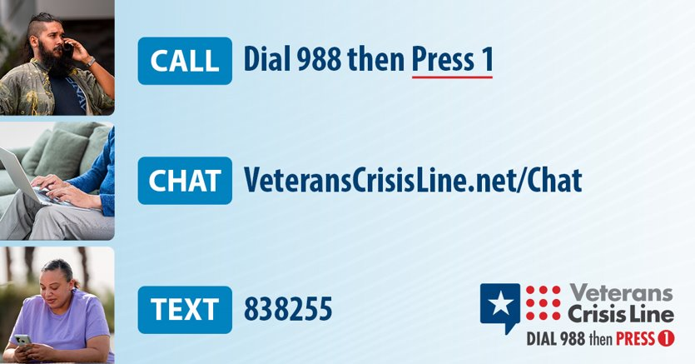
RESOURCES
VETERANS CRISIS LINE

Slide 23
QUESTIONS?

