Slide 1
County Veterans Service Office Audit
October 12, 2026

Slide 2
CalVet CVSO Audit
The Audit Cycle
Starting a County Audit
Reviewing Files
Completing the Audit Worksheet
Submitting Completed Audit
Audit Response
Post Audit
Appeals

Slide 3
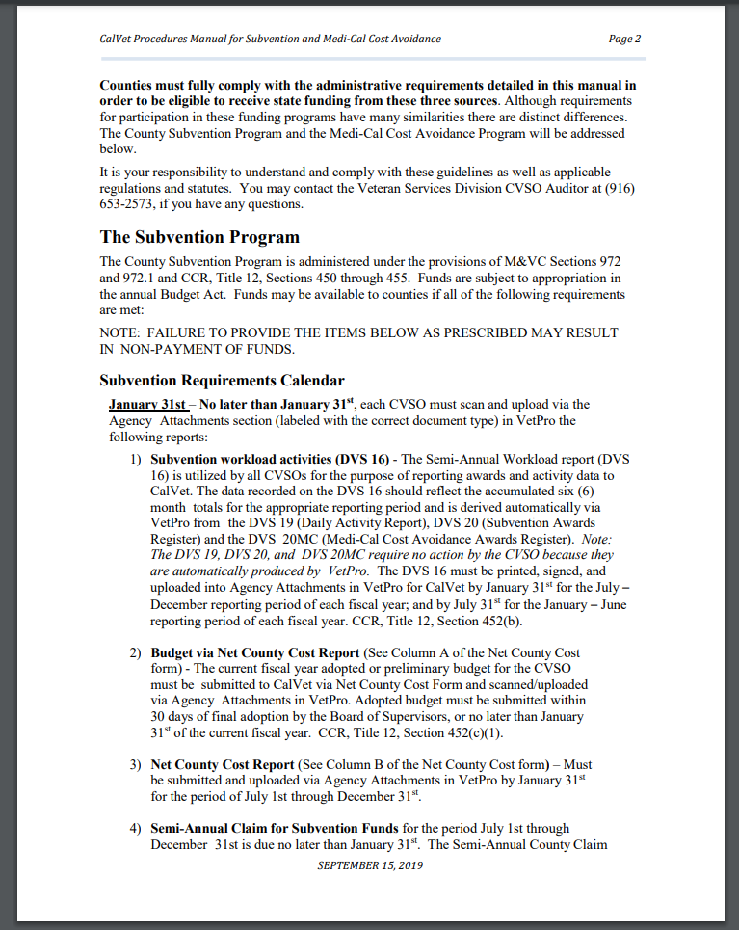
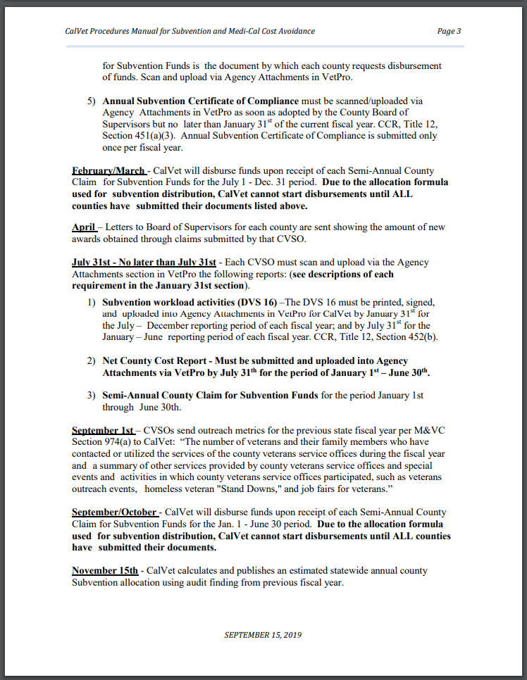
The Audit Cycle
(July 01, 2025 – June 30, 2026)
February 1st (7/1/25 – 12/31/25)
August 1st (1/1/26 – 6/30/26)

Slide 4
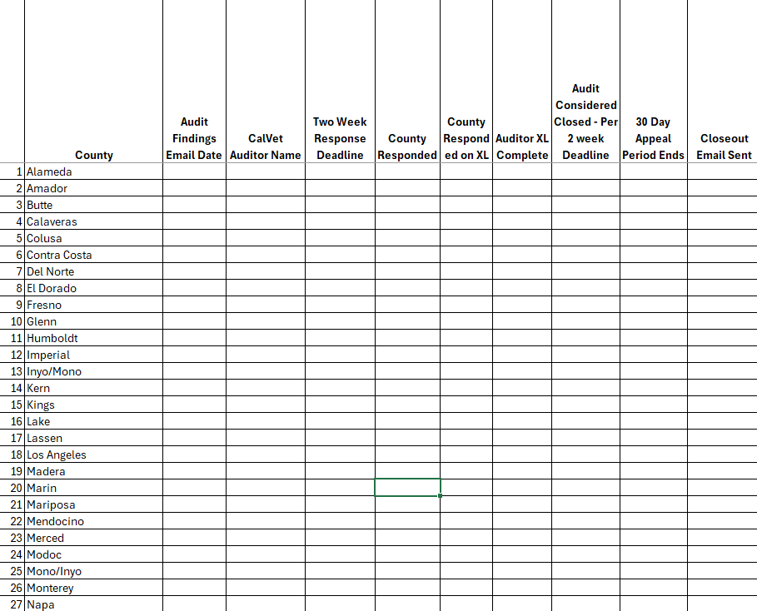
Starting a County Audit
We work from a Closeout Worksheet.
We are assigned Counties (as of right now, 3 auditors total). Usually top to bottom, bottom to top.
Your specific timeframe for an audit could vary based on how our audits are assigned.

Slide 5
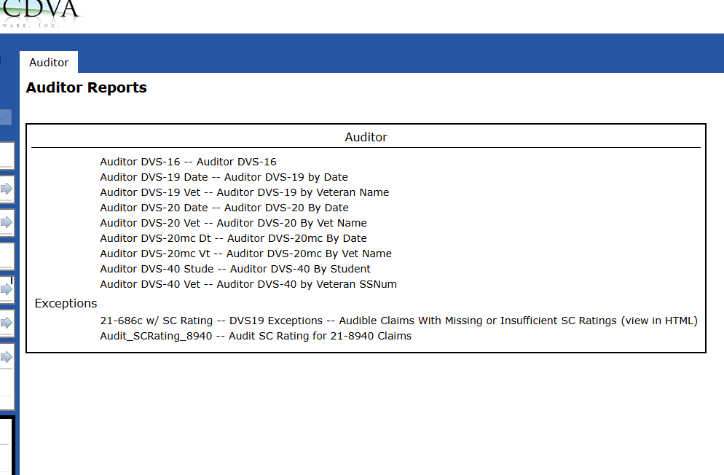
Reviewing Files
Once we have a County ready for audit, we pull all necessary VetPro reports:
DVS 16
DVS 19
DVS 20
DVS 20MC
Exception reports
Signed DVS 16 in attachments

Slide 6
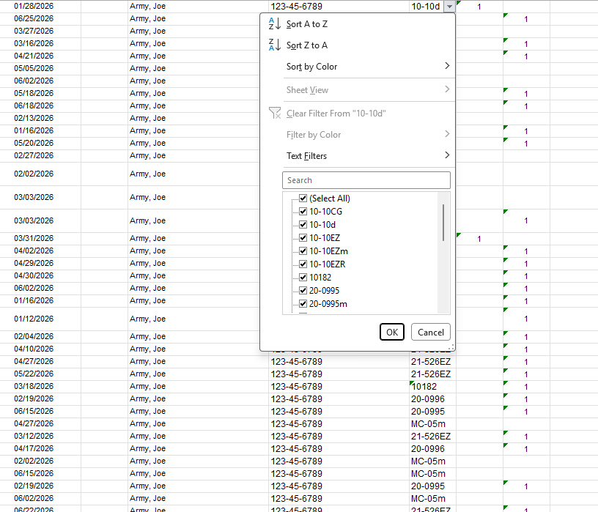
Reviewing Files
We sort our reports by file type, and look for duplicates or irregularities.
This screenshot is an example DVS-19 exported into excel.

Slide 7
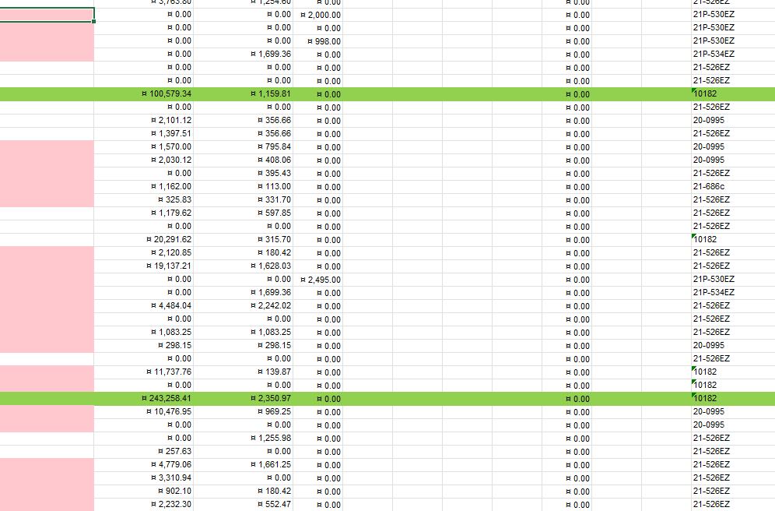
Reviewing Files
On the DVS-20 reports we look for high dollar figures, or numbers that do not add up (such as split awards).
This screenshot is an example DVS-20, you can see two dollar figures above $100,000 for retro. Does not mean a discrepancy, just something to look into.
Monthly above $5,000, also not unlikely but outside of the norm.

Slide 8
Reviewing Files – DVS-19
Is the form in VetPro?
Does the form date match?
Is the form signed?
Does the form have all required documents?
Are there any duplicates?
Are there any forms submitted within unauthorized windows (i.e: 8 week window)
Multiple workload units for one claim activity?

Slide 9
Reviewing Files – DVS-20
Was the claim submitted by the county claiming the award?
Is the award letter uploaded to VetPro?
Is the award letter within the previous 18 months?
Is there an amount listed to confirm the claimed amount?
Any split awards?
Do the VetPro amounts match the DVS report?

Slide 10
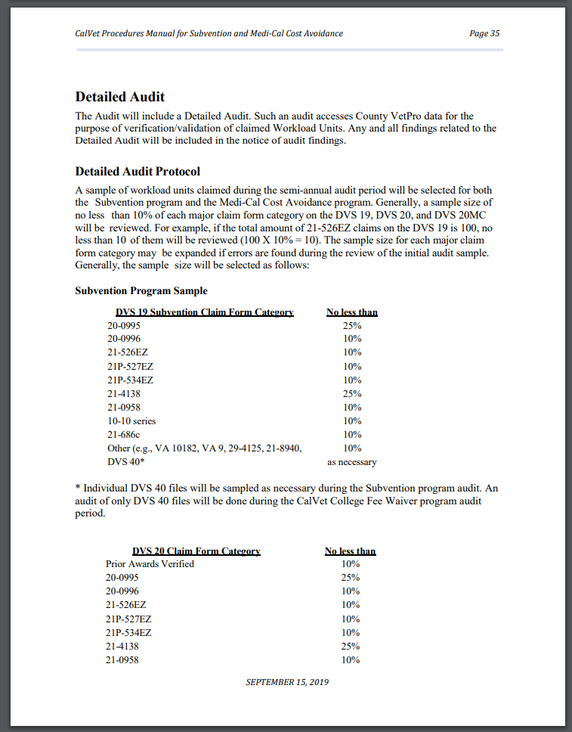
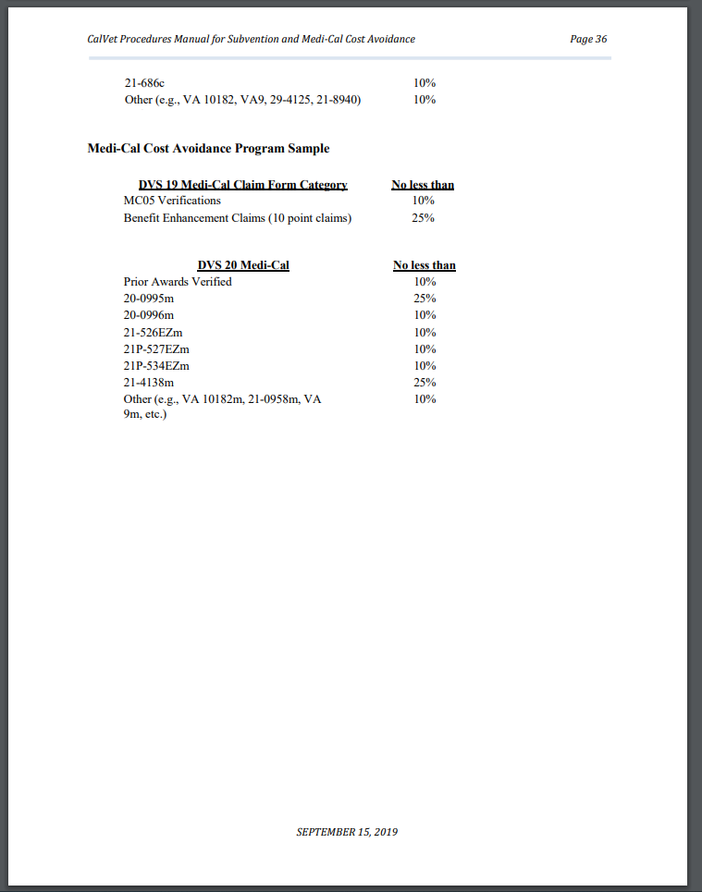
CalVet CVSO Audit – Audit Sample Size
Subvention Program Sample
Medi-Cal Cost Avoidance Sample

Slide 11
Selecting files
Duplicates
High dollar values
Standalone forms (i.e: one single 21-4138 submitted)
Forms that do not make sense (21-526 and 21-530)
Selection based on audit sample size
Additional files selected based on found errors

Slide 12
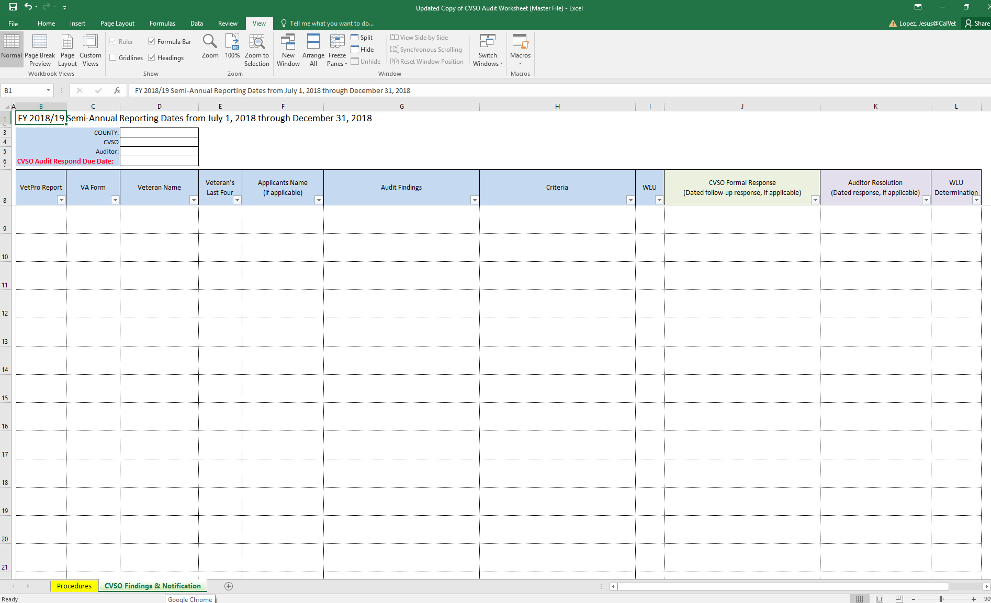
Audit Findings

Slide 13
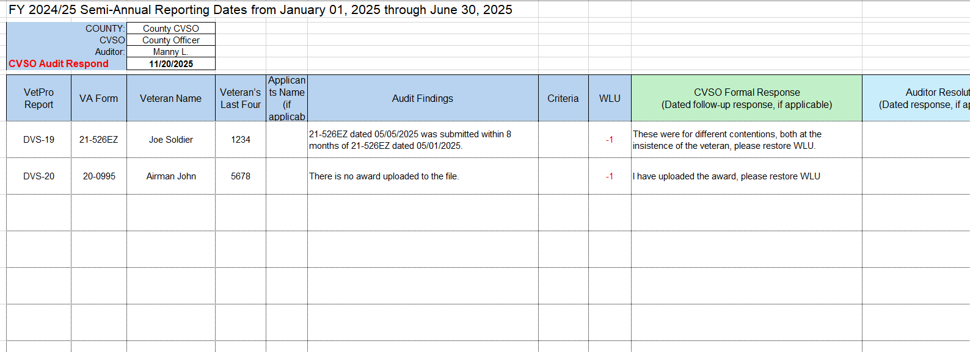
Audit Findings

Slide 14
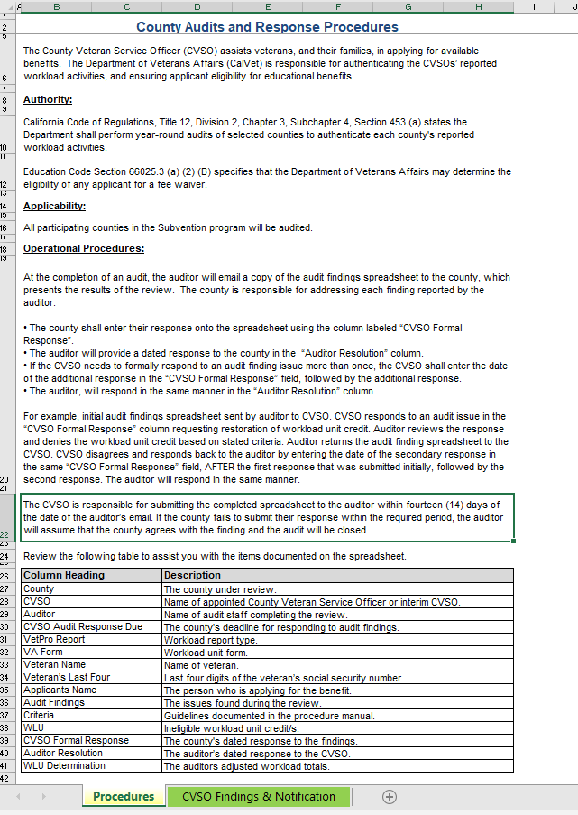
Audit Findings

Slide 15
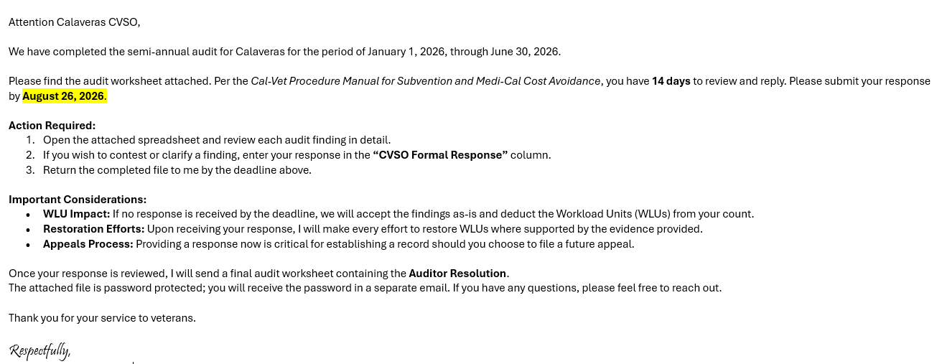
Audit Findings

Slide 16
Is a Perfect Audit achievable?
Yes!
So far this audit cycle (January 1 – June 30, 2026):
  Butte, Colusa, Del Norte, Orange, San Bernardino, Siskiyou, Tulare
Review your reports before audit cycle begins.
Reach out to our auditors, ask questions, respond.

Slide 17
Post Audit
We will review all reports again.
We deduct any necessary WLU’s.
We submit final numbers for payment.
We send our final audit worksheet via e-mail.
  If you do not get one, ask for one.

Slide 18
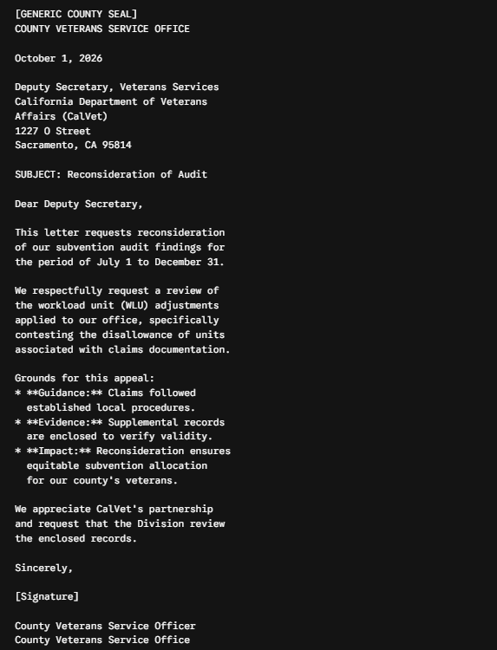
Appeals
If you are not in agreement with the final auditor resolution, you have the right to appeal.
The appeal must be received by CalVet within 14 days from the end of the two week audit findings email or 14 days from the CVSO auditors final decision, whichever is later.
Appeal will be on county letterhead and mailed in to the Deputy Secretary (address and instructions are in the subvention manual).

Slide 19
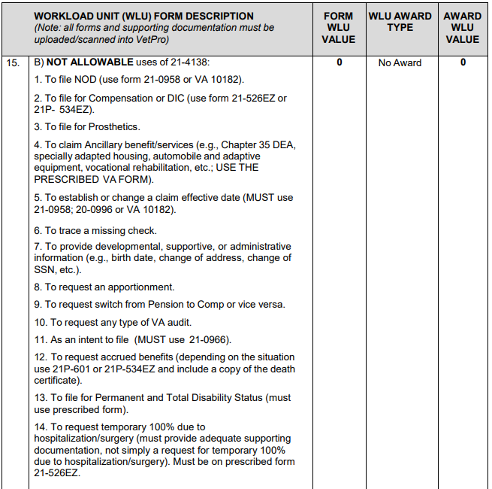
Most commonly found errors
21-4138’s not in compliance

Slide 20
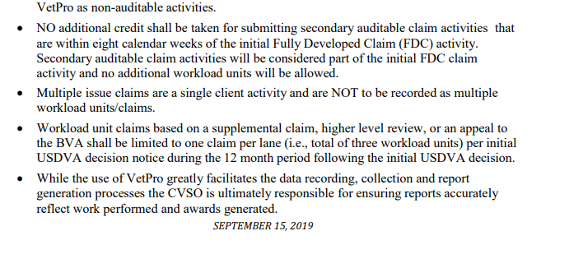
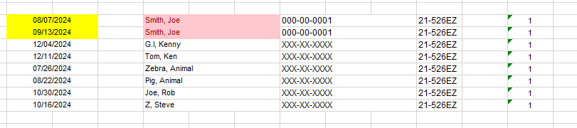
Most commonly found errors
Multiple 21-526EZ’s within 8 weeks

Slide 21
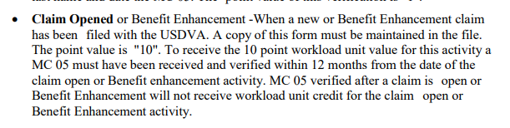
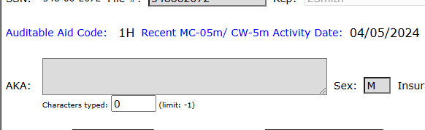
Most commonly found errors
Benefit Enhancement

Slide 22
Most commonly found errors
Appeals Modernization Act
20-0995
20-0996
10182
+1
Rating Decision 12/12/2024
+1
+1

Slide 23
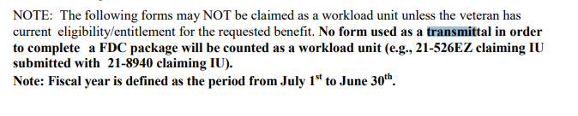
Most commonly found errors
Submitting a TDIU claim with a 21-526EZ and 21-8940

Slide 24
FAQ’s
What is each subvention point worth today?
Since some claims are completed in under 8 weeks can a CVSO post the award close out the claim and file a new 21-526EZ for new issue (s) not previously filed?
Has anyone ever received a 0 error from a CALVET Audit?

Slide 25
FAQ’s
The use of quick submit for claims, what needs to be uploaded to VetPro to be in compliance?
Is there training provided to new CVSO’s on what to look for during audits?
Where can we find the subvention manual?
What do we do if there is no ‘x’ form, such as a 21-686cX?

Slide 26
Questions?

Slide 27
Jesus Lopez –CVSO Auditor
(916) 503-8002
Jesus.Lopez@calvet.ca.gov
Manny Lavalle – CVSO Auditor
(916) 651-3040
Manuel.Lavalle@calvet.ca.gov
George Dixon – CVSO Auditor
George.Dixon@calvet.ca.gov

