Slide 1

Concurrent Retirement and Disability Pay (CRDP)
&
Combat Related Special Compensation (CRSC)
CALVET/CACVSO
October 2026
https://bmvetlaw.participoll.com/
Notes:
Today we are going to talk about Concurrent Retirement and Disability Pay, or CRDP, and Combat Related Special Compensation, or CRSC. Those names alone explain part of the problem. The federal government took a fairly simple question about earned benefits and answered it with two acronyms, three agencies, several statutory exceptions, and a payment statement that looks like it was designed to test our patience.
Our goal today is not to memorize every provision. I want us to leave with a practical framework. When a military retiree walks into your office and says, “VA granted my claim, but my retired pay changed,” you should know what questions to ask, which program may apply, which agency owns the next step, and which documents you need to review.
We will start with the history because it explains why the rules look the way they do. Then we will break down CRDP and CRSC separately, compare them, talk about the Soto decision and retroactive payments, and close with the Chapter 61 coverage gap and the Major Richard Star Act.
By the end, I hope the alphabet soup tastes slightly less terrible.

Slide 2
Polling Test Question
What percentage of military retirees receive some amount of both DoD benefits and VA disability compensation?
Under 5%
About 5%
About 10%
About 25%
About 50%
Over 50%
A
B
C
D
E
F
0
Notes:
Let us start with a quick poll.
What percentage of military retirees receive some amount of both DoD benefits and VA disability compensation?
Take a look at the choices and vote based on your best estimate. No searching. No quietly asking the smartest person at your table. We are testing instinct here.

Slide 3
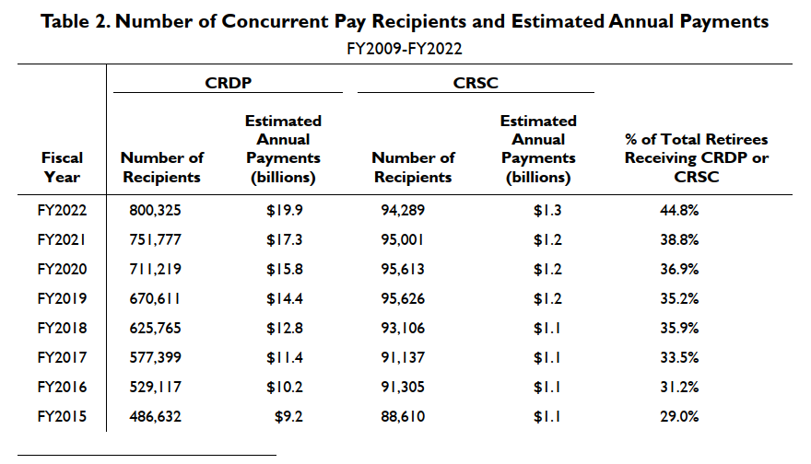
Polling Test Answer
About 50%
As of September 2022, about 47% (894,614) of all military retirees were receiving either CRSC or CRDP.
  Up from less than 30% in FY2015.
Annual cost is about $21 billion.
CRDP program is about eight times bigger than CRSC and costs about ten times more.
Source: Congressional Research Service, Concurrent Receipt of Military Retired Pay and Veteran Disability: Background and Issues for Congress (Updated June 16, 2025)
Notes:
The best answer is about 50 percent.
As of the data used in this slide, roughly 47 percent of military retirees, about 894,000 people, received either CRDP or CRSC. That was up from less than 30 percent in fiscal year 2015.
The trend is the real story. This is no longer a small corner of military retirement law. Nearly half of military retirees are touched by one of these programs, and that number has grown quickly.
CRDP is much larger than CRSC. That makes sense when we look at eligibility. CRDP reaches a broad group of military retirees with service-connected disabilities rated at 50 percent or higher. CRSC reaches a narrower population because the disability must also meet a combat-related standard.
The annual cost is about $21 billion in the source used for this deck. That number matters because every time Congress considers expanding concurrent receipt, the debate is not usually about whether injured retirees deserve fair treatment. The fight is about cost and where Congress finds the money.
So we are dealing with a large, growing program area that can change a retiree’s monthly income in a significant way. To understand why we have two programs instead of one clean rule, we have to go back to the original offset.
OPTIONAL ASIDE “Anytime Congress agrees something is unfair but attaches a multibillion-dollar price tag, fairness develops a very long waiting list.
.

Slide 4
History – From Ban to Benefit
Notes:
Everything complicated about this subject traces back to a basic assumption Congress made in 1891: military retired pay and disability compensation were viewed as overlapping federal payments.
Congress has never fully erased that assumption. It has softened it, created exceptions to it, and built programs around it. But the old rule is still running underneath the modern system.
That is why understanding the history actually helps. The current law is less like a new house and more like a century-old house with several additions. Some doors lead somewhere. Some doors open into a wall.

Slide 5

The Offset Begins
1891: Congress bans concurrent receipt of military retirement and disability pension.
  Retirement was not a normal part of life.
  The programs were considered overlapping.
1944: Congress allows VA disability compensation to offset military retirement pay.
  After federal income tax became law (1913), disability compensation exempted.
  Military retirement pensions generally higher, but taxable.
  Offset allowed disabled retirees to capture tax advantage of having a service-connected disability while preserving prohibition on true concurrent receipt .
Notes:
In 1891, Congress prohibited concurrent receipt of military retirement pay and a disability pension.
The context matters. Civil War pension spending had grown dramatically. Retirement itself was not a normal stage of life for most Americans. Congress looked at military retired pay and disability benefits and treated them as two versions of the same federal support.
Then, in 1944, Congress created the basic waiver system that still shapes what retirees see today. A retiree could receive VA disability compensation, but the retiree had to waive an equal amount of military retired pay.
That meant the total gross payment did not necessarily increase. The source of the money changed.
Why would a retiree do that? Taxes. VA disability compensation is generally tax free. Ordinary length-of-service military retired pay is generally taxable. By waiving a portion of retired pay and replacing it with VA compensation, the retiree could receive part of the same overall amount without federal income tax.
That was a real benefit, but it was not true concurrent receipt. The retiree surrendered one earned federal dollar to receive another. For roughly sixty years, that was the bargain.
This history also explains a phone call many of you have received. A veteran says, “VA increased my rating, so why did my bank deposit barely move?” Sometimes the answer is that VA compensation went up while retired pay went down because the offset absorbed the increase.
The veteran sees a win on the rating decision and almost no change in the household budget. That is usually the moment this area of law becomes very personal

Slide 6
How Offset Works
General Rule: Retirees may not receive both VA disability compensation and military retirement pay concurrently
Offset: Retirees may waive retired pay, dollar for dollar, to receive VA disability compensation.
Example: Veteran is eligible for $2,000/month in retirement and $1,500 in disability
  Expectation: $2,000 + $1,500 = $3,500/month (wrong)
  Offset: $2,000 (retirement) - $1,500 (disability) = $500 (retirement).
  Final: $500 (taxable retirement) + $1,500 (tax-free disability).
Notes:
READ OFF SLIDE FOR EXAMPLE:
Military retirement pay is usually taxable unless related to a combat disability;
Retirement pay based on age, length of service, or non-combat disability is taxable;
VA disability pay is tax-free
So, in the example, client is saving a little bit on taxable income, but still not receiving what is deserved.
If Veteran retires based on years of service and is later given a retroactive service-connected disability rating by the VA, their retirement pay is excluded from income up to the amount of the VA disability benefits they were entitled to receive. They can claim a refund on any taxes paid on the excludable amount by filling an amended return on Form 1040x for each previous year during the retroactive period. Most veterans have no idea about this tax advantage involving retroactive filing.
For detailed information on the interaction between retired pay and VA disability pay, see https://www.congress.gov/crs-product/R40589

Slide 7

A New Phase of Life
Prior to the Social Security Act of 1935, retirement was a luxury experienced only by the very wealthy.
After WWII, retirement became a common stage of life.
  The post-war boom and Korean War-era wage controls led to huge growth in private pension programs.
  Improved medicine extended lifespans.
Retirement without disability became a norm in the late 20th Century.
Notes:
The policy assumptions behind the offset started to weaken during the twentieth century.
Before Social Security and the growth of employer pensions, retirement was a luxury for many Americans. After World War II, retirement became a common stage of life. Private pension programs expanded. Medical advances helped people live longer. Workers increasingly understood retirement pay as something earned through years of service.
At the same time, disability compensation served a different purpose. It compensated for the effects of an injury or disease connected to service.
Those two payments began to look fundamentally different. One was earned through a career. The other addressed disability caused by service.
That distinction gave veterans organizations a much stronger argument. If the payments compensate different things, taking one away because the veteran qualifies for the other starts to look less like preventing duplication and more like penalizing disability.

Slide 8
The Offset Begins to Crack
As retirement became a normal part of life, pensions and disability compensation began to look fundamentally different.
VSOs argued that the offset deprived disabled veterans of retirement benefits that were earned separately like private pensions.
Pro-veteran sentiment driven by the Iraq War overcame Congressional budget resistance.
  FY2003 NDAA created CRSC for combat-related disabilities.
  FY2004 NDAA created CRDP and expanded CRSC.
CRSC and CRDP both restore money lost to the offset.
DoD runs both programs, and DFAS pays them—not VA.
A Veteran cannot receive both even if eligible for both!
Notes:
VSO framing that finally moved Congress: "the Disabled Veterans Tax." Advocates pointed out military retirees were the only federal employees subject to such an offset, and that the offset taxed the affected income at 100 percent.
The bills weren't unpopular — they were unfunded. H.R. 303 had more than 370 House cosponsors in 2003 and still never got a floor vote. Discharge petitions were filed. Cost was the only obstacle, and it still is.
(click for fly in) remember … DoD runs both programs and DFAS pays them — not VA. Wrong agency, wrong forms, wrong appeal path. And a veteran can never receive both, even when eligible for both.

Slide 9
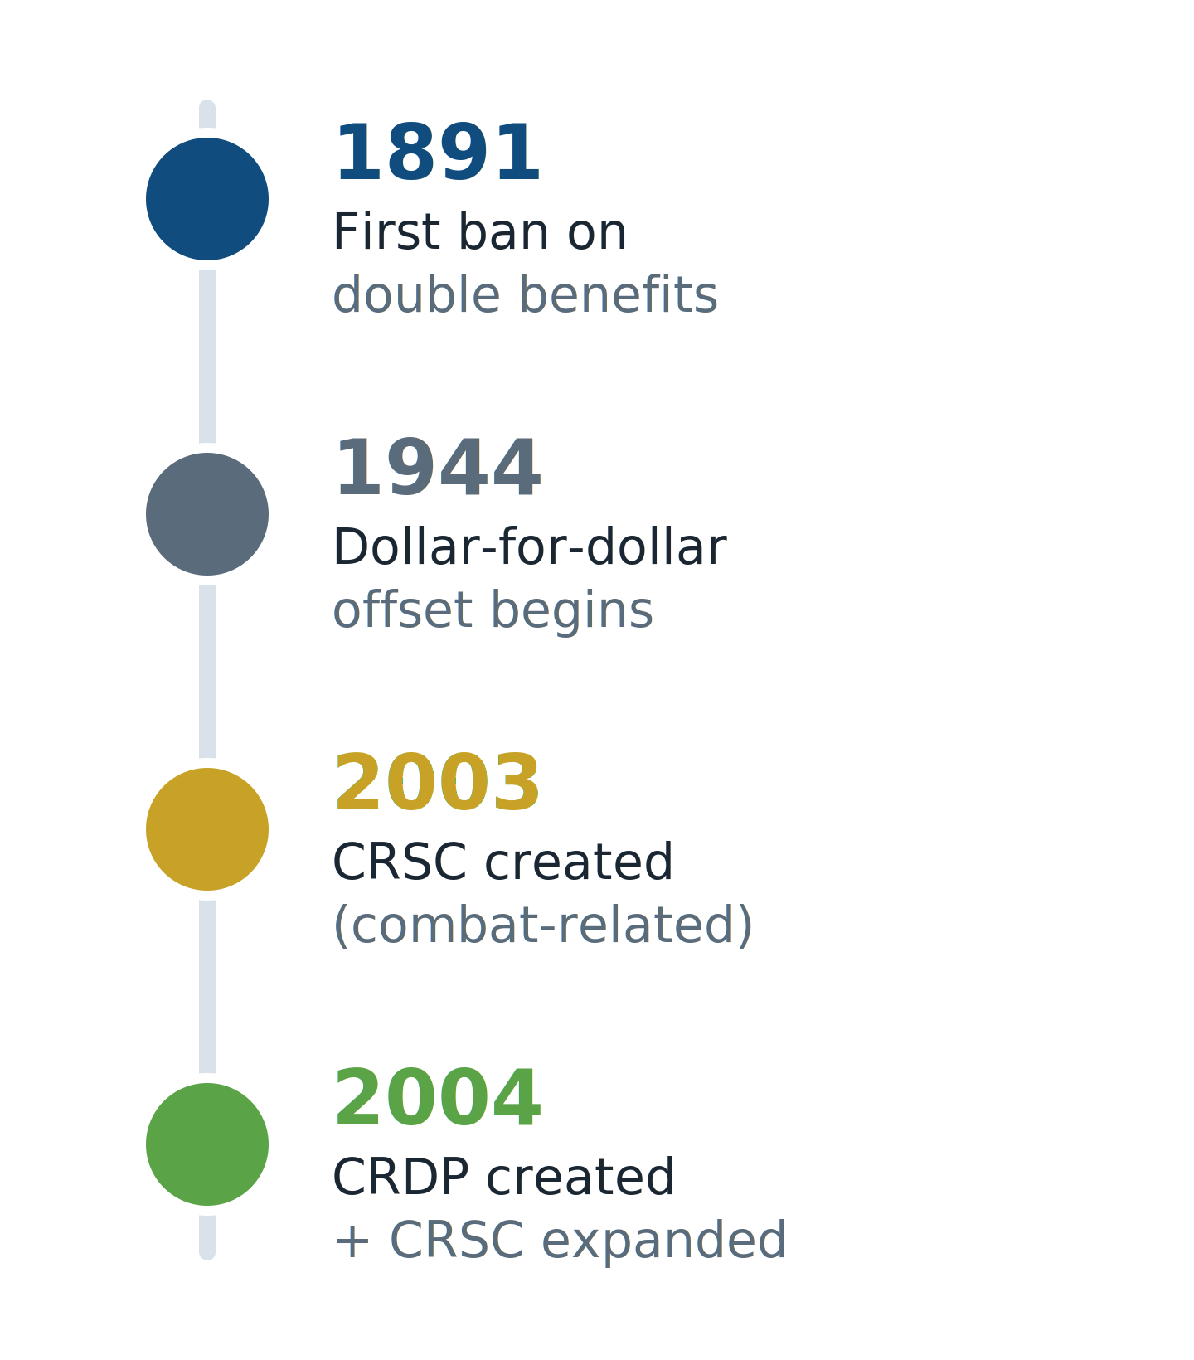
Expansion
CRDP phased in from 2004 to 2013.
  Retirees rated 100% disabled received concurrent receipt immediately in 2005.
  All offsets ended in 2014.
2008: CRSC expanded to Chapter 61 (medical) retirees.
Notes:
CRDP did not arrive fully formed. Congress phased it in from 2004 through 2013, with full implementation in 2014.
CRSC also expanded. In 2008, Congress opened it to eligible Chapter 61 medical retirees.
But Congress never repealed the original offset. It built two workarounds on top of it.
That is why CRDP and CRSC can produce similar totals while behaving differently for taxes, former spouses, deductions, and retroactive payments. The old waiver is still moving underneath the surface.
With that foundation in place, let us start with CRDP because it is usually the simpler program.

Slide 10
Concurrent Retirement and Disability Pay (CRDP)
Notes:
CRDP is best understood as restored retired pay.
For an eligible retiree, CRDP allows receipt of full military retired pay along with VA disability compensation. The offset that reduced retired pay is restored, either fully or to the extent allowed by the program.
The beauty of CRDP is that the retiree usually does not have to apply. The danger is that “automatic” sometimes causes everyone to assume nobody needs to check the math.
”

Slide 11

CRDP Basics
Concurrent Retirement and Disability Pay (CRDP): Allows Veterans with a 50% or higher VA disability rating to receive both VA disability compensation and full military retirement pay
Special rules apply to Chapter 61 disability retirees.
  Options based on either length of service or severity of disability.
Nothing to file—DFAS applies it automatically.
Notes:
Three basic elements:
Click
Click
click

Slide 12

CRDP Retroactive Payment
If VA disability rating changes after the Veteran begins receiving retired pay, they may be eligible for retroactive CRDP.
DFAS will audit the pay account upon receiving updated VA Disability Compensation information from VA.
May go back as far as January 1, 2004, but limited based on:
  Retirement date; or
  When disability first increased to at least 50%.
Notes:
The headline CRDP rule is a VA disability rating of 50 percent or higher.
But do not stop there. The retiree must also fit an eligible retirement category. A regular length-of-service retiree with at least 20 years and a qualifying VA rating is the cleanest example.
Special rules apply to reserve retirees and Chapter 61 disability retirees. A veteran can have a 100 percent VA rating and still face a CRDP problem because the retirement category does not fit.
So our screening questions should be:
What type of retirement is this? How many years of service? What is the VA rating, and when did it first reach 50 percent? When did retired pay begin?
CRDP is generally automatic. VA sends rating information to DFAS, and DFAS applies the program to the retired pay account.
That does not mean we tell the client, “Do not worry about it.” We ask for the retirement orders, the current VA rating decision or code sheet, and the Retiree Account Statement. Automatic systems are still operated by information, and information can be late, incomplete, or misunderstood.
OPTIONAL ASIDE “Automatic is a lovely word. It does not mean infallible. My garage door is automatic, and even it occasionally makes a terrible decision.”

Slide 13
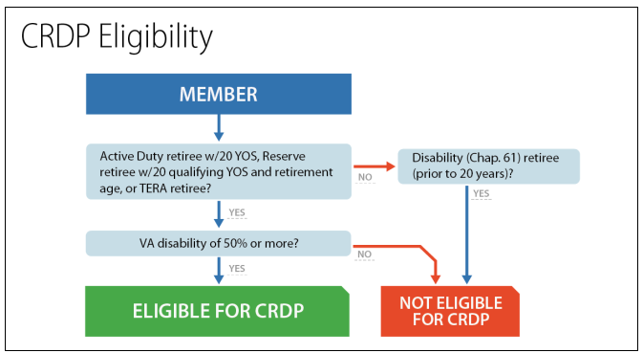
CRDP Example
Veteran is eligible for $2,000/month in retirement and $1,500 in disability based upon 60% disability rating
Expectation: $2,000 + $1,500 = $3,500/month (correct!).
Note that the benefits still receive different tax treatments.
Notes:
Now we return to the same numbers from the offset example.
The veteran has $2,000 in monthly retired pay and $1,500 in VA compensation. The veteran’s VA rating is 60 percent, and the retirement category otherwise qualifies.
With CRDP, the veteran receives the full $2,000 in retired pay and the full $1,500 in VA compensation. The total is $3,500 per month.
The tax treatment remains different. The VA compensation is tax free. The restored military retired pay is generally taxable.
Now change one fact. What if the VA rating were 40 percent?
CRDP disappears. The 50 percent threshold controls. The retiree returns to the offset unless another exception, such as CRSC, applies.
This is why the rating percentage is not just a number on a VA decision. At 50 percent, a military retiree may cross into an entirely different payment structure.
OPTIONAL ASIDE “In most VA cases, ten percentage points matter. Here, the difference between 40 and 50 percent can move an entire retirement check.”
.

Slide 14
Combat Related Special Compensation (CRSC)
Notes:
CRSC takes a different path.
CRDP restores retired pay by reducing the effect of the offset. CRSC leaves the offset in place and pays separate special compensation for qualifying combat-related disabilities.
That distinction may sound technical, but it drives nearly everything that follows: how the payment is taxed, who decides eligibility, whether the retiree must apply, and how the money is treated in other settings.

Slide 15
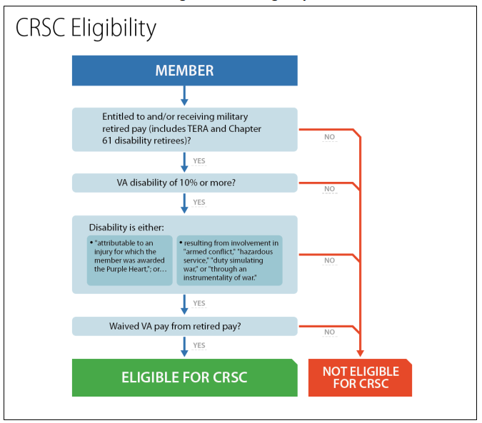
CRSC Basics
Combat Related Special Compensation (CRSC): A tax-free entitlement for Veterans with “combat-related” disabilities and a 10% or higher VA disability rating that is paid monthly along with any retirement pay. 10 U.S.C. § 1413a(g)
Additional, tax-free money to make up for the retirement pay lost because of VA disability offsets.
Calculated by the amount of VA disability compensation that has been determined to be combat-related.
Notes:
statutory keystone: 10 U.S.C. § 1413a(g) says CRSC is not retired pay.
CRSC is tax-free special compensation for eligible military retirees with disabilities that a military department determines are combat related.
The minimum qualifying VA rating can be as low as 10 percent. That is important because CRSC may help a retiree who does not meet CRDP’s 50 percent threshold.
But CRSC is calculated condition by condition. A veteran may have a 100 percent combined VA rating while the service branch recognizes only one 10 percent condition as combat related. CRSC is based on the approved combat-related portion, not automatically on the entire combined rating.
The service branch makes the combat-related determination. VA decides service connection and assigns the disability rating. VA records can support the CRSC claim, but VA does not award CRSC.
The retiree must apply. That is another major difference from CRDP.
CRSC is legally treated as special compensation rather than retired pay. That status explains why it is tax free and why it can be treated differently for former-spouse division and certain deductions.
Clients may also see two separate DFAS deposits, one for any remaining retired pay and one for CRSC. That can look like an error when it is actually the program working as designed.

Slide 16
“Combat Related”
Evidence must show the injury was incurred while:
Engaged in armed conflict, or …
Engaged in hazardous duty (e.g., demolition, flying, parachuting), or …
Participating in war simulation activities, or …
Exposed to instruments of war (e.g., weapons, chemicals, vehicles), or …
Engaged in an activity for which the Veteran received a Purple Heart.
Notes:
War Simulation activities: live fire exercises, obstacle courses, hand-to-hand drills
Instruments of war: chemicals includes Agent Orange exposure, burn pits, radiation
So if s/c based on presumptive exposure conditions, that disability would qualify as “combat-related” disability
Note: If denied, can file for reconsideration using the same process

Slide 17

CRSC Application
Submit copies of:
Retirement orders or DD Form 214;
Rating decision with relevant findings;
Service Medical Records (only those that reflect the injury is combat-related);
Relevant decorations and award recommendations;
Current VA ratings (full code sheet).
Notes:
A strong CRSC application is focused.
The retiree applies to the appropriate military department using the current service-specific form and instructions.
Start with the retirement orders or DD Form 214. Include the relevant VA rating decision and, whenever possible, the current VA code sheet. The code sheet helps identify each condition, diagnostic code, percentage, and effective date.
Then provide the records that prove the combat-related link. That may include service treatment records, line-of-duty findings, accident reports, award citations, deployment records, performance documents, or medical records created close to the event.
Do not submit 500 pages and hope the reviewer discovers the answer. A record dump transfers the work to the decision maker and hides the strongest evidence in a paper forest.
Instead, organize the application by condition. Identify the qualifying category. State the event or exposure. Cite the document and page that proves it. Then explain how the current VA-rated condition connects to that event.
If the service denies the application, read the reason carefully. Was the condition missing from the code sheet? Did the evidence establish an injury but not the qualifying category? Did the reviewer misunderstand the instrumentality?
Reconsideration works best when we repair the missing link. Sending the same packet again with a cover letter that says “please look harder” is rarely a winning legal theory.

Slide 18
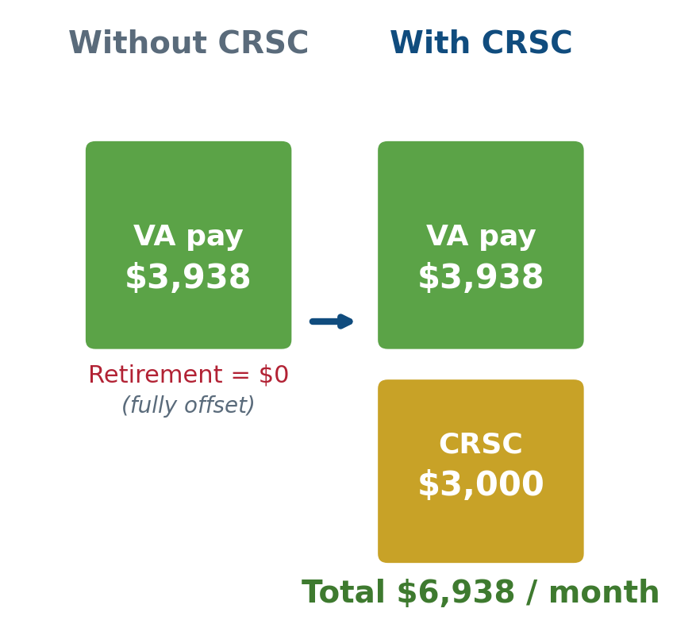
CRSC Example
Veteran has a 100% combat-related rating: $3,938.58 a month in VA compensation.
Retired pay of $3,000 is fully offset to $0.
With CRSC, the client also receives $3,000, tax-free.
New monthly total: $6,938.58.
  ALL TAX FREE!
Notes:
Here is the cleanest CRSC example.
The veteran receives $3,938.58 in VA compensation for a 100 percent rating. The veteran also has $3,000 in military retired pay, but the offset reduces that retired pay to zero.
If the service branch determines that the full qualifying disability amount is combat related, CRSC restores $3,000 as tax-free special compensation.
The veteran receives the VA compensation plus the CRSC payment, for a total of $6,938.58. In this example, the full amount is tax free.
Now change the facts. Suppose only one 10 percent condition within the veteran’s 100 percent combined rating is combat related. CRSC would be based on that approved combat-related amount, subject to the program’s payment limits. It would not automatically restore the entire $3,000.
If the same retiree qualified for CRDP, CRDP might restore the full retired pay, but that payment would generally remain taxable.
That sets up the election problem. CRSC can have better tax treatment, while CRDP can produce a larger gross payment. The correct choice depends on actual numbers, not the label.

Slide 19
CRSC Retroactive Payments
How far back?
Until 2025, those who applied for CRSC late would only be paid back for the last 6 years due to the Barring Act.
Soto v. United States, 605 U.S. 360 (2025)
  Holding: The CRSC statute supersedes the general 6-year statute of limitations of the Barring Act.
  Impact: Approximately 9,000 Veterans who are in receipt of CRSC but were limited to the 6-year time limit are now entitled to an earlier effective date for CRSC.
Notes:
For years, late CRSC applicants ran into the Barring Act.
The government applied a general six-year limit on claims for money against the United States. If a retiree had been eligible for CRSC much earlier but applied late, the government limited the retroactive payment to six years.
That changed with Soto v. United States.
Soto involved a Marine who had been medically retired for PTSD. He became eligible years before he applied. The government awarded CRSC but used the Barring Act to cut off older payments.
The Supreme Court held that the CRSC statute’s specific payment rule displaced the general six-year limitation. In plain language, Congress had already written the timing rule for CRSC, so the government could not layer the Barring Act on top of it to erase additional years.
That does not mean every CRSC recipient automatically receives payment back to 2003 or 2008. The retiree still has to establish the correct eligibility date. Retirement date, type of retirement, qualifying disability, effective date, and other statutory limits still matter.
But Soto removed the automatic six-year wall. For retirees whose prior CRSC award was expressly limited by that wall, the decision can be financially significant.
The practical screening question is simple: Do we have a CRSC recipient whose decision or payment history says the retroactive award was capped at six years? If so, get the full decision and payment history reviewed.

Slide 20
After Soto
Limits to Backpay
May go back as far as June 1, 2003, but limited based on:
  The start date for the award of CRSC
  Purple Heart eligibility
  Retirement date
  Retirement law (disability or non-disability)
  Disability retirees with less than 20 years of service are automatically limited to a retroactive date of January 1, 2008.
Information on implementation of Soto can be found in DoD Memorandums dated August 20, 2025 (interim guidance), and January 30, 2026 (clarifying guidance): https://www.hrc.army.mil/wcmt-api/sites/default/wcmtfiles/2026-04/Signed%20AM.pdf
Notes:
For some longevity retirees, the earliest possible date may reach June 1, 2003. For certain Chapter 61 disability retirees with fewer than 20 years, the earliest possible date is generally January 1, 2008.
Those are statutory floors, not promises. The correct date is the later date on which the retiree met every requirement. We have to look at the retirement date, the effective date of the qualifying disability, the basis for the retirement, and the service branch’s combat-related finding.
Implementation after Soto has moved quickly. The slide materials discuss DoD interim guidance, later clarification, related litigation, and a subsequent rescission of that guidance. Because this area has changed, I do not want anyone relying on a frozen slide as if it were the current instruction.
Before advising a client, confirm the operative DoD and service-specific guidance. For today, the durable point is this: the Barring Act’s six-year cap cannot simply override the CRSC statute, and retirees previously limited by that cap deserve another look.
The veterans most likely to have meaningful older-period claims include medically retired service members whose CRSC eligibility began years before they applied.
Our job is to identify the issue, preserve the documents, and avoid promising a dollar amount before DFAS and the service records establish the correct period.

Slide 21
Question
A Veteran is a military retiree with more than 20 years of service and a 30% VA disability rating, which is for a combat-related injury. Which program might help?
CRDP only
CRSC only
Both CRDP and CRSC
Neither
A
B
C
D
0
Notes:
Let us test the basic distinction.
Our veteran is a military retiree with more than 20 years of service and a 30 percent VA disability rating. The full 30 percent is for a combat-related injury.
Which program might help: CRDP only, CRSC only, both, or neither?
Vote first. Then I want someone who chose “both” and someone who chose “CRSC only” to walk us through the rule.

Slide 22

Answer
CRSC only
CRDP requires a 50% rating, so it does not apply here.
CRSC has no minimum rating
  A 10% combat-related injury qualifies.
CRSC often correct only when not eligible for CRDP.
Notes:
CRDP requires a VA rating of at least 50 percent, so the veteran’s 30 percent rating does not qualify.
CRSC has no 50 percent threshold. An approved combat-related disability rated at 10 percent or more can qualify, assuming the retirement and other requirements are met.
This is an important client-screening point. CRSC is often most valuable when CRDP is unavailable. A retiree below 50 percent may assume concurrent receipt is impossible. If the condition is combat related, CRSC may be the only open door.
The wording “might help” is deliberate. A VA rating for an injury described as combat related does not itself guarantee CRSC. The military department still makes that determination.

Slide 23
Summary Comparison
 | CRDP | CRSC
Classification | Military retired pay | Special compensation
Qualified disabilities | Service-connected disabilities | Combat-related disabilities
Claim Process | Automatic, initiated by DFAS | Must apply to Service Branch with supporting evidence
Minimum Disability Rating | 50% | 10%
Tax Liability | Taxable | Nontaxable
Backpay | May go back to January 1, 2004, for any month in which all eligibility requirements are satisfied | May go back to June 1, 2003, for any month in which all eligibility requirements are satisfied
Notes:
Let us put the programs side by side.
CRDP is military retired pay. CRSC is special compensation.
CRDP generally requires a VA rating of 50 percent or higher and an eligible retirement category. CRSC can begin with a 10 percent combat-related disability, but the service branch must approve the combat-related connection.
CRDP is generally taxable. CRSC is tax free.
CRDP is usually automatic. CRSC requires an application.
CRDP can potentially restore retired pay back to the applicable eligibility date, subject to the program rules and audit. CRSC retroactivity follows its own statute and the principles clarified in Soto.
Then we reach the issues that do not fit neatly into a simple benefit chart. CRDP is retired pay and may be divisible with a former spouse to the extent permitted by law and the court order. CRSC is not treated as retired pay for that purpose. Survivor Benefit Plan premiums and allotments can also operate differently.
Both payments may still be subject to certain garnishments, including support obligations.
This is where advocates should recognize the issue without drifting beyond their lane. When taxes, divorce orders, support, or survivor elections materially change the choice, bring in someone qualified in that field.
The comparison table gives us a screening tool. It does not replace the client’s actual DFAS numbers.

Slide 24
CRSC or CRDP?
Difference between face value vs. effect on taxable income.
Amount of disability that is combat related.
  For example, if only 10% of a Veteran’s combined 70%+ rating is combat-related, CRSC will pay much less than CRDP.
Can switch programs during Open Season
  Usually from January 1-31 (DFAS mail election letter).
CRSC can be better when all or nearly-all of a disability rating is related to combat.
Notes:
For a retiree eligible for both programs, the question becomes which election produces the better real-world result.
Start with the gross amounts. How much retired pay would CRDP restore? How much compensation has the service approved as combat related for CRSC?
Then compare net value. A smaller tax-free payment is not automatically better than a much larger taxable payment.
Here is the question I like to ask: Would you rather receive $1,000 tax free or $1,500 taxable?
The honest answer is, “I need more information.” We need to know the tax rate, deductions, family-law consequences, Survivor Benefit Plan premiums, allotments, and the retiree’s household situation.
Consider a veteran with a 70 percent combined VA rating but only one 10 percent condition approved as combat related. CRSC may pay only the amount associated with that combat-related condition. CRDP may restore far more retired pay, even after taxes.
On the other hand, if all or nearly all of the VA-rated disability is combat related, CRSC’s tax-free treatment may make it more attractive.
DFAS generally sends an annual open-season election notice to retirees eligible for both. Review the current notice and deadline. Do not rely on last year’s dates or assume the default election is best.

Slide 25
Major Richard Star Act
Notes:
Army Reserve combat engineer, Desert Storm, then route clearance and IED removal in Afghanistan and Iraq. Diagnosed with stage IV lung cancer in 2018 after his respiratory complaints in Kuwait were written off as asthma. Medically retired short of twenty years, learned about the offset during chemotherapy, spent his last months lobbying Congress. Died February 13, 2021, at 51.
So he fell within PACT Act eligibility.

Slide 26
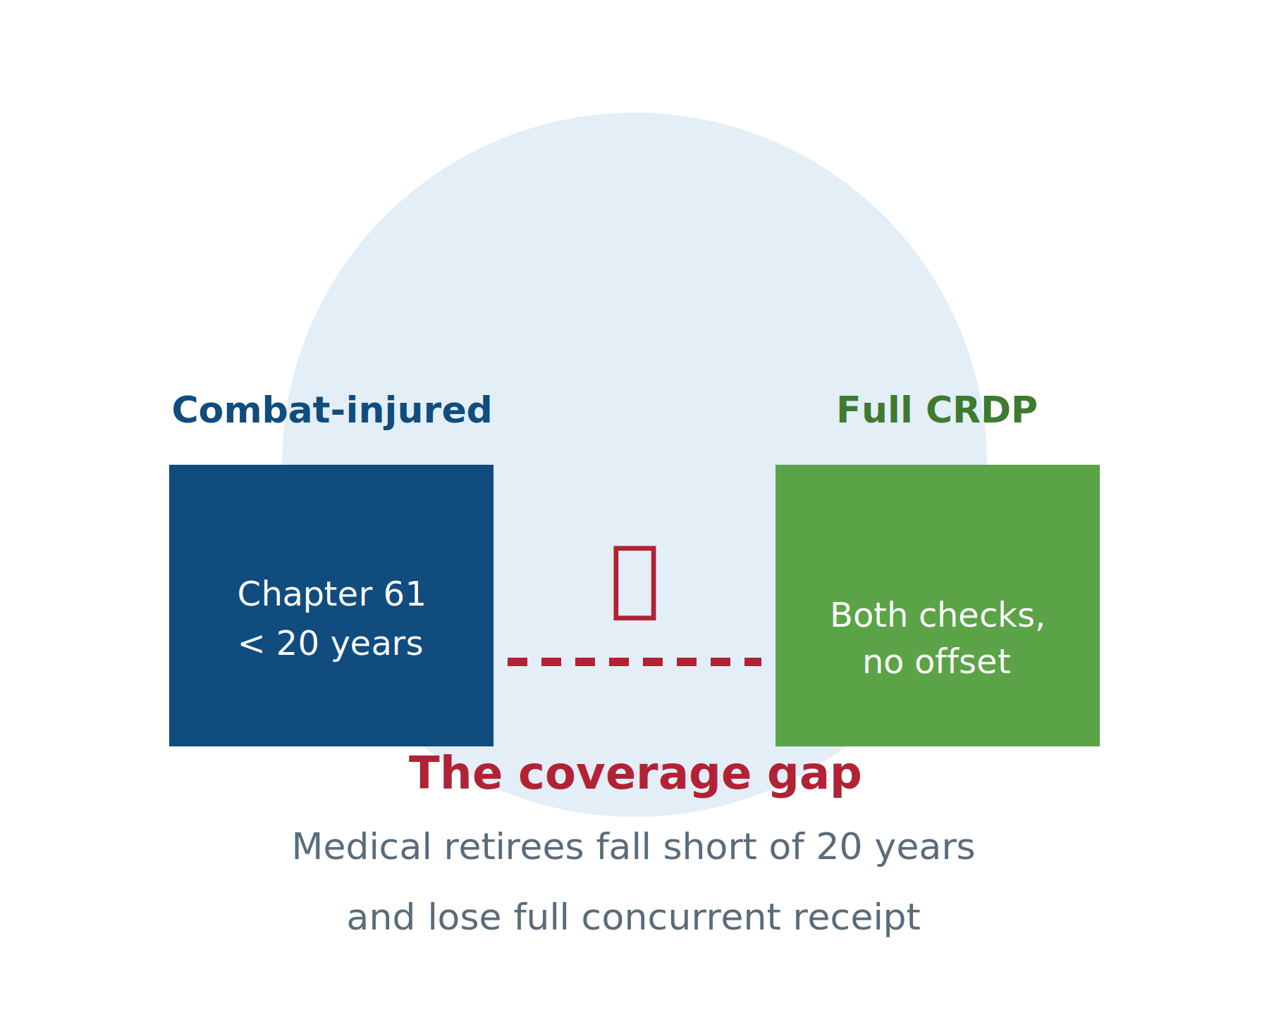
The Chapter 61 Coverage Gap
Chapter 61 retirees are medically retired with a 30%-or-higher DoD rating.
Those with fewer than 20 years cannot receive CRDP today.
Combat-injured retirees lose full concurrent receipt only because their wounds ended their careers early.
This gap is what the bill targets.
Notes:
Chapter 61 retirees are medically retired because a disability makes them unfit for continued service. A DoD disability rating of at least 30 percent generally results in disability retirement rather than separation.
For a Chapter 61 retiree with fewer than 20 years of service, CRDP generally is not available under current law.
That can produce a harsh result. The service member did not choose to leave at year 12, year 15, or year 18. A disability ended the career. Yet the retiree may lose access to CRDP because the disability prevented completion of 20 years.
CRSC can provide relief when the disability is combat related. But CRSC may cover only the approved combat-related portion, and it remains a different payment structure.
The policy argument is simple: combat injuries should not create a double penalty. The injury ends the career before 20 years, then the shortened career blocks the retiree from receiving full retirement and disability compensation together.
That is the gap the Major Richard Star Act seeks to address.

Slide 27
Major Richard Star Act
Currently, only veterans with at least 20 years of service are eligible to receive CRDP.
H.R. 2102 + S.1032 would permit Chapter 61 retirees—those medically retired before completing 20 years of service who were combat-injured—to receive CRDP.
Potential Impact: 50,000+ combat-injured retirees may become eligible for CRDP.
No retroactive pay. Effective January 1, 2027.
H.R. 9237 + S.4744 “Take Care of America’s Veterans Act” offsets by changing tinnitus and sleep apnea in the rating schedule.
Notes:
The Major Richard Star Act would expand concurrent receipt for certain combat-injured Chapter 61 retirees who were medically retired before completing 20 years of service.
The deck estimates that more than 50,000 combat-injured retirees could become eligible.
As reflected in the current slide materials, the proposal would operate prospectively and would not provide retroactive pay. The exact bill numbers, effective date, cost estimate, and legislative status must be checked before each presentation because those details can change.
The policy has broad emotional appeal. The difficult congressional question remains cost and how to offset it.
The slide also references the Take Care of America’s Veterans Act and proposed changes involving tinnitus and sleep apnea. That is a separate legislative debate and should not be allowed to blur the basic Star Act issue. One proposal expands concurrent receipt for combat-injured medical retirees. The other discussion concerns how Congress would pay for a larger package.
For the veteran sitting in our office today, pending legislation is not current entitlement. We should explain the existing CRDP and CRSC rules accurately, identify whether the client falls into the coverage gap, and avoid promising that Congress will act by a particular date.

