Slide 1
CalVet College
Tuition Fee Waiver
Manny Lavalle
California Department of Veterans Affairs
Veterans Services Division

Slide 2
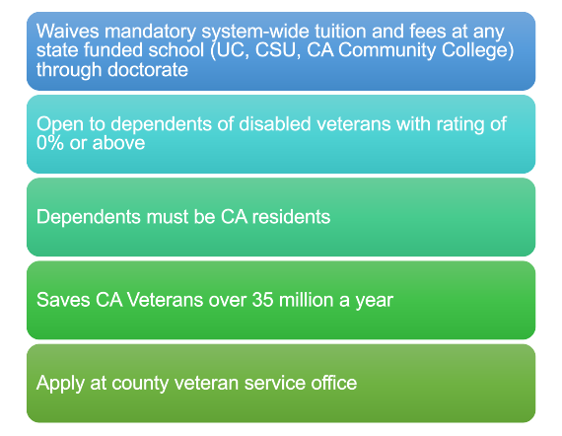
College Tuition Fee
Waiver for Veterans Dependents

Slide 3

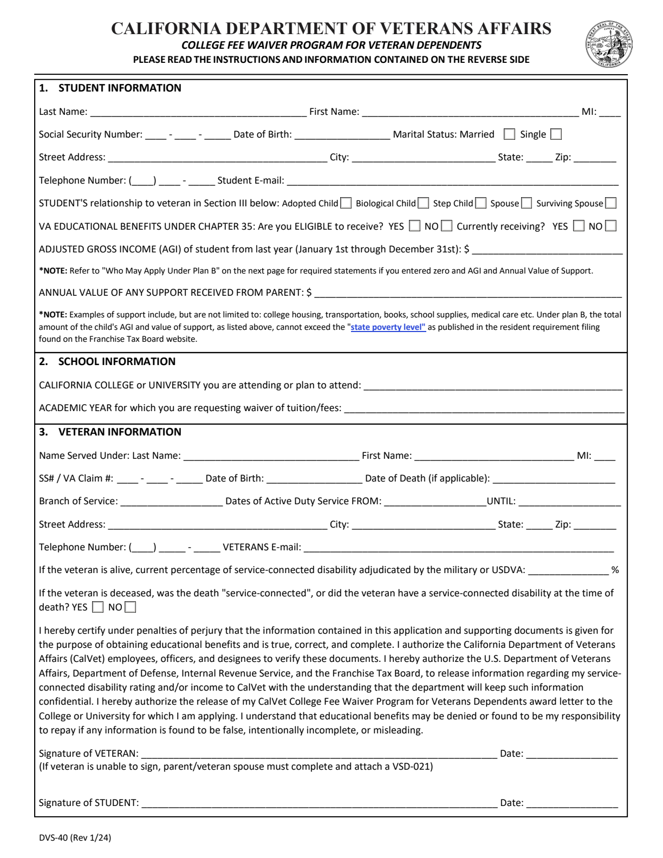
DVS-40 Application
Main application used for Plans A–D
When it is used
Required for every CalVet College Fee Waiver application
Where to get it
CVSO website or packet
Key reminders
Use the current academic year form; use a personal email; one application may be needed for each college
Signatures
Student and veteran sign the form; attach VSD-021 if the veteran cannot sign

Slide 4
Plan A: Qualifying Veteran Status / No Income Limit
Eligibility / purpose
What it covers
• For an eligible child, spouse, or unmarried surviving spouse of a qualifying veteran
• Veteran is rated 100% disabled or meets qualifying death/disability criteria
• Eligible child is generally age 14–27; veteran-student situations may extend to age 30
• No income limit
• Cannot receive VA Chapter 35 Dependents Education Assistance during the same period
Plan A waives mandatory systemwide tuition and fees at eligible California public colleges and universities. It does not remove school admission requirements or non-mandatory campus costs.
Notes:
Explain Plan A first, then move directly into the required documents. Stress that Plan A is the plan with the Chapter 35 conflict, so the VSD-020 election statement matters.

Slide 5
Plan B: Service-Connected Veteran / Student Income Limit
Eligibility / purpose
What it covers
• For eligible children of a veteran with a service-connected disability
• No age limit for Plan B
• Student AGI plus annual parental support is reviewed from the previous tax year
• AY 2026–2027 income limit: $22,941
• Plan B may be used with Chapter 35 when otherwise eligible
Plan B waives mandatory systemwide tuition and fees at eligible California public colleges and universities. The student must meet the income threshold for the academic year.

Slide 6
Plan C: California National Guard Line-of-Duty Criteria
Eligibility / purpose
What it covers
• For eligible spouse or child of a California National Guard member
• Applies when the member was killed, died of a qualifying disability, or became permanently disabled while on active service to the state
• Requires documentation tying the death or permanent disability to active service to the state
• Eligibility is reviewed through the CVSO process
Plan C waives mandatory systemwide tuition and fees when the California National Guard line-of-duty criteria are met. Documentation is critical because the qualifying event must be tied to active service to the state.

Slide 7
Plan D: Medal of Honor Recipient / Child of Recipient
Eligibility / purpose
What it covers
• For Medal of Honor recipients and eligible children of Medal of Honor recipients
• Benefits under Plan D are limited to undergraduate studies
• Children must meet the age and income requirements
• Chapter 35 conflict does not apply the same way as Plan A
Plan D waives mandatory systemwide tuition and fees for qualifying Medal of Honor-related eligibility. The student should verify age, income, and undergraduate-program requirements before applying.

Slide 8

How to Apply – Items Needed
Veterans VA Disability Letter
Photo Identification
School Information
Birth Certificate (Child)
Marriage Certificate (Spouse or Stepchild)
Adoption Documentation
Death Certificate (If Veteran is Deceased)
Copy of student's IRS tax form 1040 (Plan B Applicants)
Letter of Non-Filing (Plan B Applicants if student did not file taxes)
CalVet College Fee Waiver Application
Additional documents as needed (VSD-020, VSD-021, VSD-024, etc)
Where to apply:
County Veteran Services Office

Slide 9
Letters of Denial
&
How to Appeal

Slide 10
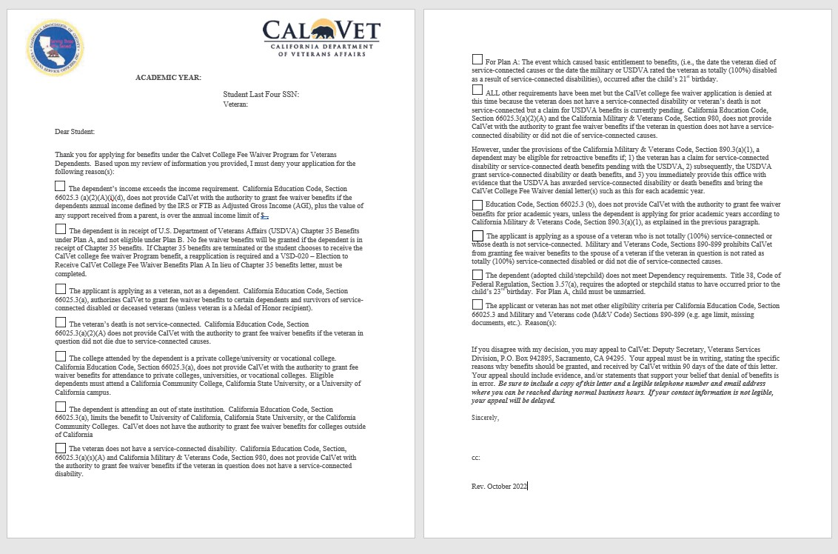

Slide 11
If You Disagree
If you disagree with my decision, you may appeal to CalVet: Deputy Secretary, Veterans Services Division, P.O. Box 942895, Sacramento, CA 94295. Your appeal must be in writing, stating the specific reasons why benefits should be granted, and received by CalVet within 90 days of the date of this letter.
Your appeal should include evidence, official documents, and/or statements that support your belief that denial of benefits is in error. Be sure to include a copy of this letter and a legible telephone number and email address where you can be reached during normal business hours.

Slide 12

How to Appeal a Denial
Start with the denial letter
Read the denial reason, deadline, and appeal instructions carefully before submitting anything.
Appeal package should include
Where appeals are directed
• Written explanation of why benefits should be granted
• Copy of the denial letter
• Evidence or statements supporting the appeal
• Phone number or email address where the student can be reached
CalVet Deputy Secretary, Veterans Services Division
P.O. Box 942895
Sacramento, CA 94295
Appeal must be received within 90 days of the date of the denial letter.
The appeal should clearly explain why the student believes the denial was in error and include any missing or corrected evidence.

Slide 13
Frequently Asked Questions
Is there a particular grade point average required to qualify/apply for the College Fee Waiver (CFW)?
If a student drops one or multiple classes, does the student have to reimburse CalVet?
Do students have to be enrolled in classes first, to apply/qualify for the CFW?
If the student is attending multiple schools, can the CVSO issue multiple grant letters?
What fees are waived? My local school does not want to waive XX fees.
Can I receive grants from public or private entities and the CFW at the same time?
Does the veteran have to have been stationed in California?
Does the veteran have to live in California for the student to qualify for the CFW?
Does the student have to be a California resident?
Does the student need to reapply every academic year?
What happens if the application is incomplete?
Can I attend online classes and use the fee waiver?
Can Plan A and Chapter 35 benefits be used during the same period?

Slide 14
Other Fees…
Mandatory system wide tuition and fees vary with each school and are based on each school’s own definitions and written guidelines. The law does not prohibit schools from charging “Campus-Wide or Campus-Based Fees” Self-Support Programs, Online Classes.
Encourage applicant to research their classes before enrolling.

Slide 15
California Department of Veterans Affairs
1-800-952-5626
www.calvet.ca.gov
Manny Lavalle
CFW@calvet.ca.gov

