Slide 1
District Offices
October 2026

Slide 2
CalVet Data
  Incarcerated Veterans Program
  District Office-Reviewed Claim Activities
  Public Contact and Hearings
  Board Data for CalVet Appeals
Reminders
  Change of Representation
  Higher Level Reviews
Last 6 slides provide current staff list and POC’s for District Offices

Slide 3
Incarcerated Veterans Program
 | Claims Filed | VAEs held | In-Person Interviews | Letters to veterans | Retro | Adjusted Monthly | Full Monthly Entitlement
State FY 22-23 | 364 | 288 | 223 | 1022 | $ 3,058,513 | $110,377 | $ 202,116
State FY 23-24 | 430 | 427 | 401 | 986 | $ 356,044 | $ 48,234 | $ 146,213
State FY 24-25 | 618 | 418 | 687 | 1387 | $ 377,005 | $ 59,097 | $ 130,197
State FY 25-26 | 1765 | 599 | 904 | 1583 | $ 771,441 | $ 78,078 | $ 171,522

Slide 4
Incarcerated Veterans Program
Elizabeth (Liz) Hargrove-Washington
Alberto Alpasan
Melaina Anker-Younberg
(Oak-1) Sofia Martin Del Campo
CA State Prison, Sacramento
Folsom State Prison & Women’s SP
High Desert State Prison
Pelican Bay State Prison
Mule Creek State Prison
(Oak-2)
Mary Donovan
CA Medical Facility
CA State Prison, Solano
San Quentin State Prison
(LADO-1) Chris Clark
CA Correctional Institute
CA Men’s Colony
Kern Valley State Prison
North Kern State Prison
Wasco State Prison
(SDDO)
Roberto Avila
Calipatria State Prison
Centinela State Prison
Ironwood State Prison
(Oak-3) Daryl Neff
Avenal State Prison
CA Health Care Facility
Correctional Training Facility
Pleasant Valley State Prison
Salinas Valley State Prison
(Oak-4) Tera Ireland
CA State Prison, Corcoran
CA Substance Abuse Treatment Facility
Central CA Women’s Facility
Sierra Conservation Center
Valley State Prison
(LADO-2)
Christopher Young
CA Institution for Men
CA Institution for Women
CA State Prison, LA County

Slide 5
Reviewed Electronic Claim Activities
 | Oakland DO | Los Angeles DO | San Diego DO
State FY 22-23 | 14,414 | 13,212 | 4,275
State FY 23-24 | 17,442 | 20,065 | 6,456
State FY 24-25 | 23,476 | 19,662 | 10,558
State FY 25-26 | 29,523 | 26,730 | 12,085

Slide 6
District Offices Public Contact
As VSOs co-located with VA, the District Offices also have direct contact with veterans/claimants.
State FY 25-26 | In-Person | Phone and Email | Claims submitted
Oakland | 550 | 9,134 | 625
Los Angeles | 523 | 6,860 | 545
San Diego | 670 | 5,203 | 341

Slide 7
Hearings – BVA and Due Process
 | Oakland DO | Los Angeles DO | San Diego DO
State FY 22-23 | 447 | 271 | 95
State FY 23-24 | 315 | 239 | 78
State FY 24-25 | 451 | 198 | 98
State FY 25-26 | 297 | 189 | 81
Notes:
Jul 2025 to Jun 2026 – Oakland did not get a 40-hearing month since BVA went into NWQ for assigning hearings based on docket order. Then we got a 50-hearing month in July and 45 for September.

Slide 8
Current Docket Dates
Hearing dockets (1,383 total)
Oldest docket dates waiting for a BVA Decision – two (2) from 2020, then it’s 2021 docket dates. Ahead of those are 105 AOD and CAVC Remand cases.
Hearings scheduled at the 3 district offices this October are for April 2023 docket dates.
Evidence Review docket (255)
Oldest docket dates from 2021-22 are VHA-related appeals (about 12 cases). Ahead of those are over 60 AOD and CAVC Remand cases
January 2023 is oldest afterwards
Direct Review docket (480) –
April 2021 for VHA-related appeals. Ahead of those are about 40 AOD and CAVC Remand cases
July 2022 for all others
* Data pulled 10/01/26.

Slide 9
Board Data for CalVet Appeals
Only appeals under the California dockets (Oakland, Los Angeles and San Diego):
VA FY is Oct-Sep | Full Grant | Partial Grant | Remand | Denied | Other | No Decision | Total Appeals
VA FY 25-26 | 31 | 5 | 18 | 11 | 10 | 372 | 447
VA FY 24-25 | 46 | 8 | 31 | 19 | 15 | 285 | 404
VA FY 23-24 | 48 | 11 | 47 | 17 | 19 | 255 | 397
VA FY 22-23 | 43 | 9 | 47 | 31 | 48 | 216 | 394
VA FY 21-22 | 141 | 50 | 104 | 51 | 66 | 76 | 488
VA FY 20-21 | 224 | 54 | 120 | 64 | 105 | 15 | 582
VA FY 19-20 | 204 | 79 | 154 | 73 | 76 | 0 | 586
 | (283) 48% |  | 26% | (149) 25%
* Data pulled 10/01/26.

Slide 10
Board Data for CalVet Appeals
Comparison non-California vs California dockets:
VA FY 19-20 | Full Grant | Partial Grant | Remand | Denied | Other | No Decision | Total Appeals
CA dockets (99.6% hearings) | 204 | 79 | 154 | 73 | 76 | 0 | 586
 | (283) 48% |  | 26% | (149) 25%
Non-CA dockets (93.7% D&E) | 178 | 78 | 212 | 179 | 53 | 0 | 700
 | (248) 36% |  | 30% | (232) 33%
* Data pulled 10/01/26.

Slide 11
Board Data for CalVet Appeals
Appeals granted, remanded and denied by the Board – disaggregated by docket:
 | Full Grant | Partial Grant | Remand | Denied | Other | Total Appeals
Direct Review | 52,028 | 16,216 | 61,078 | 45,656 | 21,146 | 196,124
 | 34.8% |  | 31.1% | 23.3% | 10.8%
Evidence Review | 22,769 | 9,611 | 23,113 | 13,652 | 10,004 | 79,149
 | 40.9% |  | 29.2% | 17.2% | 12.6%
Hearing | 32,150 | 13,214 | 26,660 | 13,785 | 20,518 | 106,327
 | 42.7% |  | 25.1% | 13% | 19.3%
* From 8/31/26 AMA Metrics - Appeals Modernization Act Comprehensive Plan and Reporting - Veterans Benefits Administration.
For California Dockets (which is 99.6% hearings) CalVet has:
48.3% full & partial grants rate for FY 19-20.
46% full & partial grants rate for all decisions rendered (FY 2019-26).

Slide 12
Reminders: Change of Representation
CalVet’s Veteran Representation Policy (July 2025) states the following on change of representation – Section III:
(f) If a claimant has representation through another service organization, attorney or agent, a change in POA shall not be accepted by CalVet in an appeal before BVA if the request is made after 90 days from the date of docketed appeal.
  A motion may be submitted to the BVA after 90 days of the appeal being docketed if there is a showing of good cause. (38 CFR § 20.1304).
  A similar statement of mutually agreed upon severance of services by an attorney or agent needs to be submitted before CalVet may accept a change in POA.
  A change in POA in this instance, may only be allowed once the BVA rules in favor of the claimant to allow such a change.
(g) A POA should be accepted by CalVet in a claim before the VA, at any point in the claim or appeal process, if the claimant is currently represented by another State Veterans Organization or if the claimant has had no representation.

Slide 13
Reminders: Change of Representation
This is the 38 CFR referenced by CalVet Representation Policy Section III (f):
38 CFR §20.1304
An appellant and his or her representative has a period of ninety (90) days following the Board’s receipt of a Notice of Disagreement to file a change of representation.
After 90 days, the Board will not accept a change in representation except when the appellant demonstrates on motion that there was good cause for the delay.
  If good cause is shown, the request for a change in representation will be honored.
  If good cause is not shown, the request for a change in representation will be referred to the VA for association with the appellant's file for any pending or subsequently received claims upon completion of the Board's action on the pending appeal without action by the Board concerning the request.

Slide 14
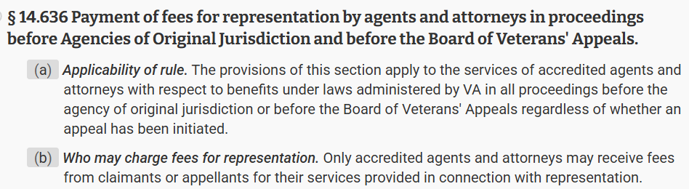
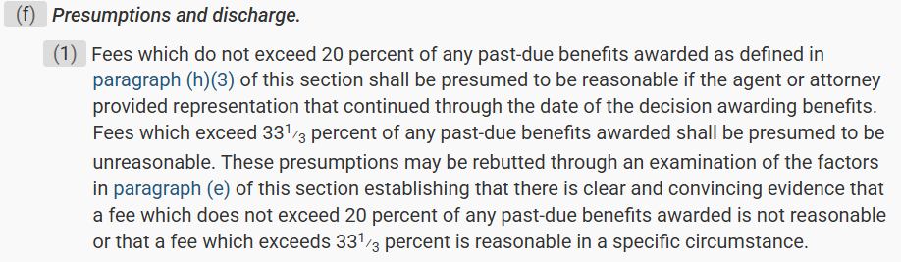
Reminders: Change of Representation
Accredited Attorneys and Agents are allowed to charge fees for their services when representing veterans/claimants before the VA and BVA.
Even when POA is switched mid-stream to a State or National Service Organization.

Slide 15
Reminders: Higher Level Review (HLR)
38 CFR 3.2601(f) – The evidentiary record is limited to the evidence of record as of the date the VA issued the notice of their decision.
Paragraph (h) notes the Informal Conference is for the sole purpose of allowing the claimant or representative to identify any errors of law or fact in a prior decision based on the record at the time the decision was issued.
Informal Conference (IC) is optional
What’s a more efficient alternative?
→ Use a VA Form 21-4138 to identify any errors of law or fact in a prior decision based on the record at the time the decision was issued.
→ On the first line, you can state that the VAF 21-4138 is for the VAF 20-0996 (HLR).

Slide 16
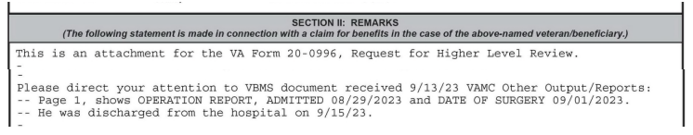
Reminders: Higher Level Review
Just to be sure the VA knows this is for the HLR.
Identify the error of fact or law.
No new evidence.
No introduction of facts not present at the time of the prior decision
If your statement on the 4138 is too long or not straight to the point, the VA can mistake it as new evidence.

Slide 17
District Managers
Alberto Alpasan
Los Angeles District Manager
Alberto.Alpasan@calvet.ca.gov
LADO@calvet.ca.gov
(213) 620-2755
Melaina Anker-Youngberg
San Diego District Manager
Melaina.Anker@va.gov
State.VBASDC@va.gov
(619) 857-5497
Zmae Raymundo
Oakland District Manager
Zheriemae.Raymundo@calvet.ca.gov
Oakland.Oakland@calvet.ca.gov
(510) 286-0627
Questions?
Note: POCs for each District Office begins on the next pages.

Slide 18
Oakland District Office: Current Staff
Zmae Raymundo, District Manager
Appeals team
Steven Smith, Supervisor
Leonora (Cora) Sarmiento
Elizabeth Grassetti
Connie Santos
Janice Suarez
Akeesha Barrett
Liam Williams (Rancho office)
Joseph Klabouch (Rancho office)
one vacant position
David Pham (front desk)
Incarcerated Veterans team
Liz Hargrove-Washington, Supervisor
Mary Donovan
Tera Ireland
Sofia Martin del Campo
Daryl Neff
Review team
Diane Susbilla, Supervisor
Daniel Vilhauer
Sangay Dorjee (new)
Renee Luis (new)
one vacant position

Slide 19
Oakland District Office General Information
Oakland DO Point-of-Contact (POCs)
Appeals team:
For decision review guidance, email Steven –Steven.Smith@calvet.ca.gov
For hearing schedule confirmations & inquiries, email Cora – Leonora.Sarmiento@calvet.ca.gov
Review team:
The DO Reviewer of your claim activity
Diane.Susbilla@calvet.ca.gov
CDCR team:
Elizabeth.Hargove-Washington@calvet.ca.gov
Oakland Office (Main):
1301 Clay St. Suite 1130N
Oakland, CA 94612
Open Tue, Wed & Thurs
9:00 AM to 3:00 PM
Phone (510) 286-0627
Fax (510) 286-0653
Rancho Office:
3046 Prospect Drive
Rancho Cordova, CA
Only for hearings & appointments
Phone (916) 364-6774
Corporate inbox (for inquiries): Oakland.Oakland@calvet.ca.gov

Slide 20
Los Angeles District Office: Current Staff
Alberto Alpasan, District Manager
Darlene Dunlap, Assistant District Manager
Heather Maciel (front desk)
Appeals team | Review team | Incarcerated Veterans team
Maria Alatorre, Lead | Esther Luna, Lead | Christopher Young
Babes Navarra | Porcia Andrada | Chris Clark
Delores McLemore | Sandra Matrecitos
Joberde Metellus | Eileen Dizon
Salvador Escobar | Isabella Alejandrino
Jonathan Martin

Slide 21
Los Angeles District Office General Information
11000 Wilshire Blvd. Ste. 506
Los Angeles, CA 90024
Open to the public:
Mon-Wed
8am to 3pm
(213) 620-2755
Corporate mail: CDVALA@va.gov
(you can send PII as long as you encrypt)
LA District Office POC
For issues relating to appeals(hearings or to discuss appeals issues), email:
Darlene.Dunlap@calvet.ca.gov
Darlene.Dunlap344@va.gov
For DO Review questions or concerns, email:
Esther.Luna@calvet.ca.gov
Esther.Luna@va.gov

Slide 22
San Diego District Office: Current Staff
Melaina Anker-Youngberg, District Manager
 | Claim Support-Appeals team
 | Tony Devore, Supervisor
Monica Flores | Angel Bribiesca
(Office Technician) | Judith Roach
 | Niki Sada
 | Justin Louie
Roberto Avila | Eugenia Agis
(Incarcerated Veterans Rep) | Aldrin Cordova
 | one vacant position

Slide 23
San Diego District Office General Information
San Diego District Office
8620 Spectrum Blvd. Rm 725
San Diego, CA 92123
Open to the Public:
Tue., Wed., Thur. 8am-3:30pm
Public Line: (619) 857-5497
Fax Line: (858) 268-1014
San Diego Corporate Email:
state.vbasdc@va.gov
San Diego Office Point of Contacts (POC)
Claim Guidance, AMA Decisions/Guidance, Board hearings & Board Appeals, email Tony Devore Tony.Devore@va.gov
CDCR (Incarcerated Veterans), email Roberto Avila Roberto.Avila@calvet.ca.gov

