Slide 1
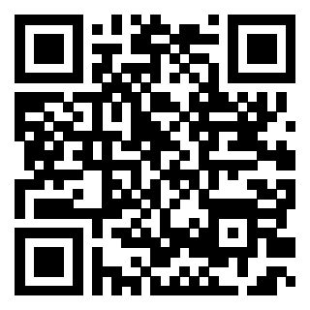
Earliest Possible Effective Date
California Association of County Veteran Services Officers
2026 Fall Training Conference
October 11-16, 2026
https://bergmannmoore.participoll.com/

Slide 2
Polling Test Question 1
Historically, what percentage of issues decided by the Board of Veterans’ Appeals (Board) are appeals for earlier effective dates?
20 to 30 percent
10 to 20 percent
5 to 10 percent
Less than 5 percent
https://bergmannmoore.participoll.com/
A
B
C
D
0
vote at bergmannmoore.participoll.com

Slide 3
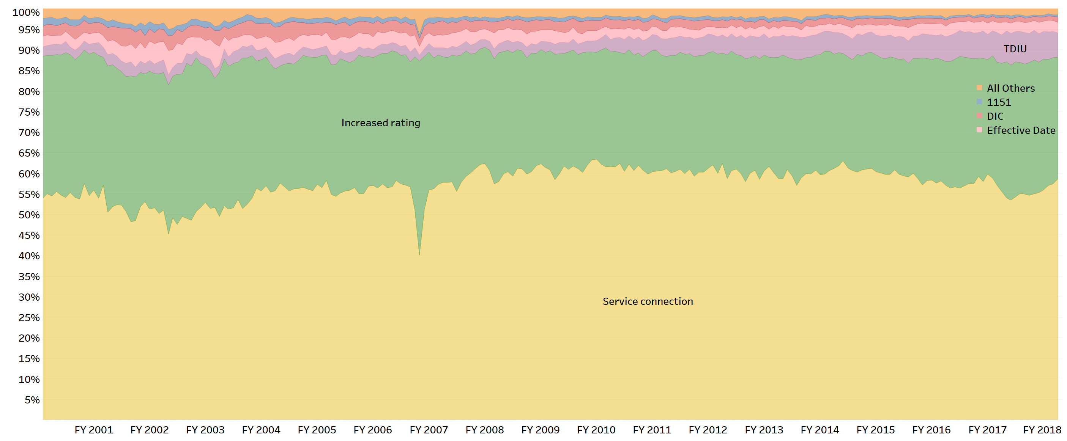
Polling Test Answer 1
D. Less than 5 percent
Historically, 55-60% of the issues adjudicated by the Board are service connection issues.
Increased ratings (including TDIU) account for 35% of the issues.
Approximately 2-3% of the issues are earlier effective dates, and 1-2% are Dependency and Indemnity Compensation.
All other issues account for less than 1% of issues adjudicated by the Board.
Service connection
Increased rating
TDIU
Effective date
DIC
1151
All others

Slide 4
Learning Objectives
Learn how to obtain the earliest possible effective date for a VA disability benefits claim.
  Learn the general rules for effective dates and the many exceptions.
  Learn how effective dates are impacted by the scope of the claim.
  Learn how the effective dates are impacted by earlier claims and appeals.

Slide 5

Effective Date Relevance
Effective date issues:
Historically make up 2 to 3 percent of appeals to the Board of Veterans’ Appeals (Board).
Earlier effective date appeals have a higher rate of success at the Board than service connection or increased rating appeals!
Success often results in months, years, and even decades of retroactive benefits.

Slide 6
Disputing Effective Dates
VA’s effective date for establishing payment must be disputed through:
  A review at a Regional Office (Higher-Level Review or Supplemental Claim), or
  An appeal to the Board (Notice of Disagreement).
There is no such thing as a claim for an earlier effective date.¹
Effective dates become final when the deadline to file a review or appeal has expired. After that, VA’s effective date may only be challenged through a motion for clear and unmistakable error (CUE).
¹Rudd v. Nicholson, 20 Vet.App. 296 (2006)

Slide 7

Staged Ratings
When filing a review or appeal, challenge the stages of a staged rating by disputing the rating, not the effective date!
When staged ratings are assigned throughout an appeal period, there is no need to challenge each individual effective date assigned.
Only argue the higher rating for each staged period.

Slide 8
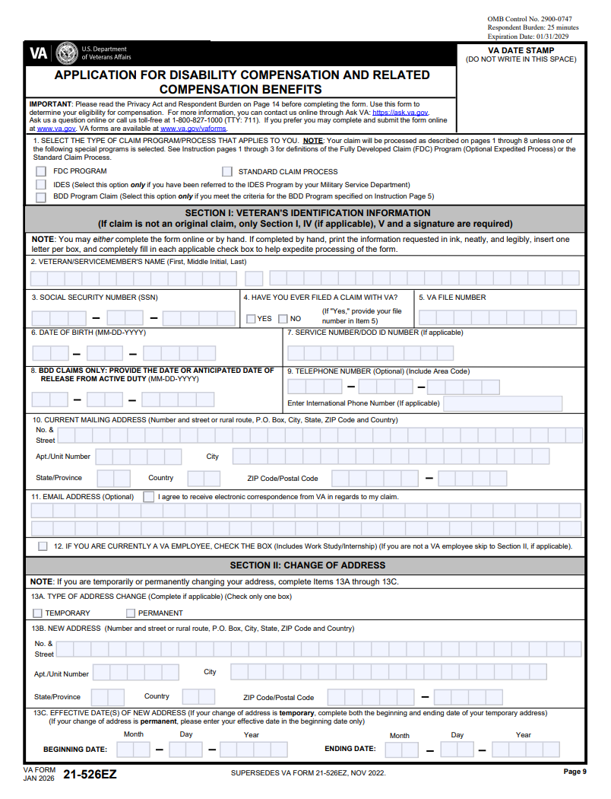
General Effective Date Rule
The effective date is the later of:
  The date the claim that resulted in the grant of benefits was submitted, or
  The date entitlement arose.
That is, the claim establishes the effective date.
The effective date is usually, but not always, the date that the claim was filed. The next slide discusses exceptions.

Slide 9
Exceptions – Look Back Rules
Exceptions often allow for an earlier effective date:
  Date of Intent to File (VA Form 21-0966) – Preserves effective date if formal claim filed within one year.
  One day after date of discharge from active duty for service connection¹ – If claim filed within one year of discharge.
  Date of death for Dependency and Indemnity Compensation (DIC)² – If filed within one year of death.
  Date of worsening for increased rating³ – If filed within one year of worsening.
¹ 38 C.F.R. § 3.400(b)(2)(i);
² 38 C.F.R. § 3.400(c)(2);
³ 38 C.F.R. § 3.400(o)(2).

Slide 10
Question 2
Roxanne served in the U.S. Air Force from May 1, 2016 to April 28, 2020. On March 2, 2021, she submits a claim of service connection for arthritis of the lumbar spine which service treatment records show was diagnosed on April 5, 2020. A March 15, 2021 VA x-ray study shows lumbar spine arthritis. VA granted service connection for Roxanne’s lumbar spine arthritis. What is the correct effective date?
March 15, 2021, because arthritis is first shown after service on that date.
March 2, 2021, because the effective date can never be prior to the date of claim.
April 5, 2020, because arthritis is first shown on that date.
April 29, 2020, because Roxanne filed her claim within one year of her separation from service, so the correct effective date is the day after separation.
A
B
C
D
0

Slide 11
Answer 2
D. April 29, 2020, because Roxanne filed her claim within one year of her separation from service, so the correct effective date is the day after separation.
  April 5, 2020, is incorrect because Roxanne was still in service on that date.
  March 2, 2021, is incorrect because 38 C.F.R. § 3.400(b)(2)(i) specifically provides an exception to the general “date of claim” rule if a claim is filed within one year of separation from service.
  March 15, 2021, is incorrect because arthritis of the lumbar spine (a chronic disease) was first shown during service.
Advocacy Tip: When reviewing VA’s effective date of a grant of benefits, always start with the date the Veteran filed the claim. From there, look to see if any of the exceptions apply.

Slide 12

Finality of VA Decisions
If VA’s denial or rating becomes final, then the effective date for future claims is usually limited.
  Reopened claims for service connection are generally limited to the date of reopening.
  Claims for a rating increase are generally limited to the date of claim for an increase.
A final decision can be revised upon a showing of “clear and unmistakable error,” or CUE.
  The effective date can be awarded back to date of original claim.
Notes:
Once a denial [click] or a rating becomes final, the effective date is no longer connected to the original claim.
The [click] effective date for a reopened claim for service connection generally can be no earlier than the claim to reopen.
A claim [click] for in increased rating does not relate back to the original claim.
However, [click] the effective date of an award can go back to a prior, final decision if you can show clear and unmistakable error in the decision.
But this is [click] very hard to show. The prior decision must be undebatably wrong based upon the evidence and law as it existed at the time of the original decision.

Slide 13

Exceptions to Finality
If a Veteran receives a grant of benefits from the date of the claim, then review the claims file for prior VA rating decisions and ask yourself the following:
  Was there a previously denied claim for these same benefits?
  Why was the claim granted now but not in the prior decision?
  Was the grant based on new evidence?

Slide 14

Exceptions – New Service Records
If VA lacked relevant service department records at the time of a prior final denial of benefits, but those records are subsequently obtained and result in a VA grant, then:
  The effective date will be based on the date of the original claim.
  The newly obtained service records must be “relevant.”
  The newly obtained service records must have existed at the time of the original decision.
38 C.F.R. § 3.156(c)
This scenario often happens in PTSD claims where records corroborating a Veteran’s stressor were not originally obtained by VA.

Slide 15
Exceptions – New Service Records
In 2006, 3.156(c) was amended to include a restriction that the Veteran had to have made VA aware of the existence of such service records in order for this exception to apply.
Very recently, the Court of Appeals for the Federal Circuit clarified that this amendment only applies if the “new” service records were received after the October 2006 effective date of the amendment. See Miller v. Collins, __ F.4th __ No. 24-1790 (Aug. 21, 2026).

Slide 16


Exceptions – New and Material Evidence
For VA decisions made prior to the Appeals Modernization Act (February 19, 2019), if “new and material” evidence was received prior to the expiration of the prior appeal period, the evidence will be considered as part of the prior claim.
  In other words, if VA receives new and material evidence within one year of a rating decision, then that VA decision does not become final until VA addresses the evidence.
38 C.F.R. § 3.156(b)

Slide 17
What is New and Material Evidence?
“New evidence is evidence not previously part of the actual record before agency adjudicators. Material evidence means existing evidence that, by itself or when considered with previous evidence of record, relates to an unestablished fact necessary to substantiate the claim.” 38 C.F.R. § 3.156(b).
New and material evidence must be related to some reason why the claim was denied in the previous rating decision. For example:
  What element of service connection was missing?
  What diagnostic code element was not satisfied?

Slide 18
Question 3
Veteran Orlando served in Vietnam and filed a claim for service connection for diabetes mellitus. The RO denied the claim and stated, “While you have confirmed service in Vietnam and exposure to Agent Orange is presumed, we do not have evidence of a diagnosis of diabetes.” What type of evidence would be “new and material” following the RO decision?
A letter from Orlando’s wife describing his problems with obesity.
A copy of the regulation listing the presumptive conditions (including diabetes) for Agent Orange exposure.
A copy of medical records from the hospital where Orlando’s diabetes is treated and his insulin is prescribed.
A letter from Orlando describing his activities in Vietnam.
A
B
C
D
0

Slide 19
Answer 3
The claim was denied because VA did not have a confirmed diagnosis of diabetes. Which item of evidence is relevant to this point?
  C. A copy of medical records from the hospital where Orlando’s diabetes is treated and his insulin is prescribed– Yes, this is medical evidence that confirms Orlando was diagnosed with diabetes.
  A letter from Orlando describing his activities in Vietnam – No, we already know Orlando deployed to Vietnam during the war.
  A letter from Orlando’s wife describing his problems with obesity – No, this is about his symptoms (and may or may not have anything to do with diabetes). Orlando’s wife is not a doctor and cannot confirm a diagnosis.
  A copy of the regulation listing the presumptive conditions (including diabetes) for Agent Orange exposure – No, copies of laws and regulations are never items of evidence.

Slide 20
The Effects of § 3.156(b)
If Orlando submitted that new and material evidence within one year of the denial, then the denial does not become final until VA addresses that evidence.
If neither VA nor Orlando follow up on the new and material evidence, then the claim could remain pending – even for several years or decades.
If, however, there is an intervening decision on the same claim that addressed the evidence, then the claim does not remain pending.
Notes:
Now we’re going to look closer at the impact of 38 C.F.R. 3.156(b).
[click] If Amanda had submitted that new and material evidence within one year of the denial, then the denial does not become final until VA addresses that evidence.
[click] If neither VA or Amanda follows up on that new and material, the claim could remain open and pending for many years.
If, however, [click] VA decides the claim and addresses that new evidence, the claim no longer remains open and pending.

Slide 21

Constructive Possession
The courts and VA have both decided that any records created by VA that are related to a claim are “constructively” part of the Veteran’s record for that claim.
This means that even if VA records are not physically or electronically part of the Veteran’s VA claim file, then they are legally considered to be within the file when VA possessed them somewhere outside the file, such as at a hospital or records center.
This idea was clear for records created before a VA decision, but what about records created after a decision?

Slide 22

When and How to Use 3.156(b) - 1
The Veteran has a past legacy VA rating decision.
There are VA treatment records from the one-year period after the decision that are new and material to the issue from the rating decision.
  These VA treatment records can be added at any time after the rating decision because VA “constructively” possessed them the entire time.

Slide 23
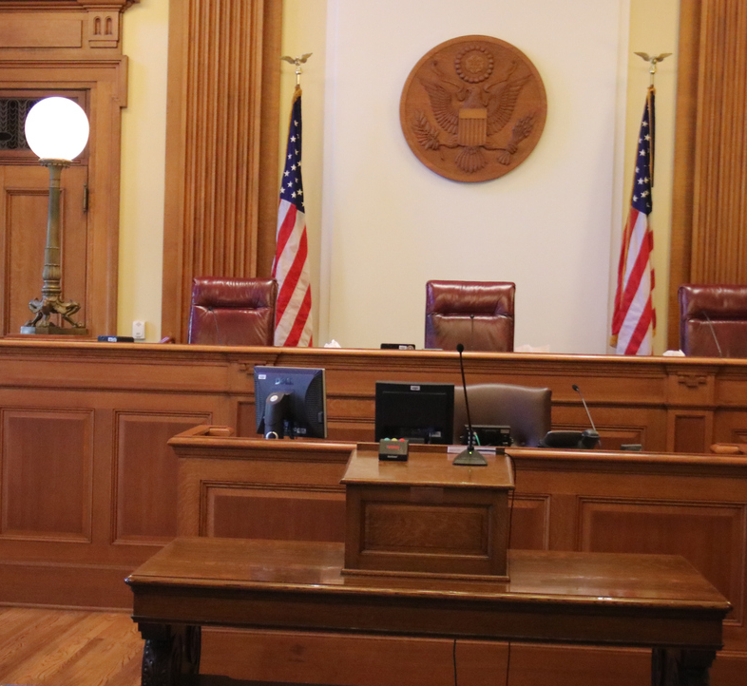
When and How to Use 3.156(b) - 2
If no subsequent VA rating decision has addressed the new and material evidence, then the previous rating decision remains pending.
If you have a present claim on the same issue, you can reach back to the previous VA decision for the effective date of that previous claim. When the present claim is granted, appeal the effective date and argue 38 C.F.R. § 3.156(b) to reach back to the earlier denial, and VA should pay the Veteran from the date of the original claim.

Slide 24
Question 4
Veteran Davey files for service connection for a mental health disability on April 14, 1994. On October 18, 1994, the RO denies the claim. On July 5, 1995, Davey attends a VA psychiatric evaluation where the doctor states, “He probably has major depression with onset possibly occurring while in the military.” This report was not sent to the AOJ. On May 17, 2005, Davey submits another claim and includes the July 1995 report. After a lengthy appeal, on December 31, 2012, the Board of Veterans’ Appeals finally grants service connection for major depression. What do you think the correct effective date is?
May 17, 2005
April 14, 1994
October 18, 1994
July 5, 1995
A
B
C
D
0
vote at calvets.participoll.comvote at calvets.participoll.com

Slide 25
Answer 4
B. April 14, 1994, is the correct effective date.
VA’s October 18, 1994, decision did not become final because VA was in constructive possession of the July 5, 1995, VA psychiatric report that was new and material evidence to VA’s October 18, 1994, decision.
From a legal standpoint, VA was always in possession of the July 5, 1995 report, even though the RO did not actually receive it until 2005.
Because the claim has been pending from April 14, 1994, the effective date for service connection could potentially go back to April 14, 1994.

Slide 26

Scope of Claim
Claims are defined by the symptoms, not the diagnoses.
An incorrect diagnosis does not limit a claim.
A Veteran’s lay diagnosis does not limit a claim.
Advocacy Tip: Read the Veteran’s statements (VA Form 21-4138, or “correspondence”), and look carefully to see how problems are described by the Veteran.
Clemons v. Shinseki, 23 Vet. App. 1 (2009)

Slide 27
Question 5
Veteran Josie files a claim requesting “service connection for PTSD” due to her service in Iraq. A VA examiner states that “she does not meet the diagnostic criteria for PTSD” and diagnoses Josie as having “generalized anxiety disorder.” Has Miguel raised a claim for service connection for generalized anxiety disorder?
Yes
No
A
B
0

Slide 28
Answer 5
A. Yes.
These facts are similar to those in Clemons v. Shinseki, 23 Vet. App. 1 (2009).
  In Clemons, the Court held that although a Veteran claims service connection for PTSD, he had a different diagnosis. Because a Veteran is not competent to provide a diagnosis, VA should have also considered the issue of service connection for the diagnosed psychiatric disability.
Notes:
[

Slide 29

Pending Unadjudicated Claims and Appeals
In the case of Ingram v. Nicholson, the Court held, “[A] claim remains pending – even for years – if the Secretary fails to act on a claim before him.”
Important Reminder:
If a Veteran’s claim does not become final, then a future application for the same benefit simply becomes correspondence on the Veteran’s pending claim.
Ingram v. Nicholson, 21 Vet. App. 232 (2007) (emphasis added).

Slide 30

Informal Claims
Informal claims could be filed prior to March 24, 2015.
An informal claim required three elements to be valid:
  Communication to VA in writing;
  Identification of specific issue or benefit sought; and
  Intent to seek benefits
Brokowski v. Shinseki, 23 Vet. App. 79 (2009)

Slide 31

Informal Appeals – Before 2015
An informal, hand-written note could be filed prior to March 24, 2015, and be considered by VA as a “Notice of Disagreement,” or NOD:
  VA’s new and mandatory forms became effective in 2015.
An informal NOD required three elements:
  Communication to VA in writing;
  Dissatisfaction or disagreement with the RO decision; and
  Desire to contest the result.
In these situations, a subsequent VA rating decision does not bring finality to a pending appeal. VA must also issue a Statement of the Case.

Slide 32
Question 6
Veteran Alex has a service-connected hearing loss and in a March 1995 rating decision is granted a higher rating effective as of May 1994. Alex replied to VA’s March 1995 rating decision with an April 1995 letter to VA asking why his hearing loss wasn’t allowed back in 1984 when he filed his first claim. Is that a valid NOD under VA rules prior to 2015 as to the effective date for his increased rating?
Yes
No
A
B
0
vote at calvets.participoll.com

Slide 33

Answer
A. Yes.
  These facts are similar to Anderson v. Principi, 18 Vet. App. 371, 375 (2004).
  Alex’s statement, “wonder why it wasn’t allowed back in 1984” was an expression of disagreement with the effective date assigned.
  The April 1995 letter was an informal Notice of Disagreement.

Slide 34
Review
Remember, when a Veteran receives a grant of benefits from the date of the claim, always review the claims file for prior VA rating decisions or unadjudicated claims or appeals for the same benefit.
  Was there a previously denied claim for these same benefits?
  Why was the claim granted now but not in the prior decision?
  Was the grant based on new evidence?
  Was there an unadjudicated claim – formal or informal? A formal or informal NOD?

