Slide 1
Behavioral Health Act Grant Program
Samuel Griffin
Chief, Outreach & Operations

Slide 2
Program Overview
The Behavioral Health Services Act (BHSA) was passed by California voters in 2004 and is funded by a one percent income tax on personal income in excess of $1 million per year. It is designed to expand and transform California's behavioral health system to better serve individuals with, and at risk of, serious mental health issues, and their families.
$1.27M in grant funds available
2 YR Grant Cycle (next RFA is Nov 2027)
https://www.calvet.ca.gov/VetServices/Pages/Behavioral-Health-Grant-Program-For-Counties.aspx

Slide 3
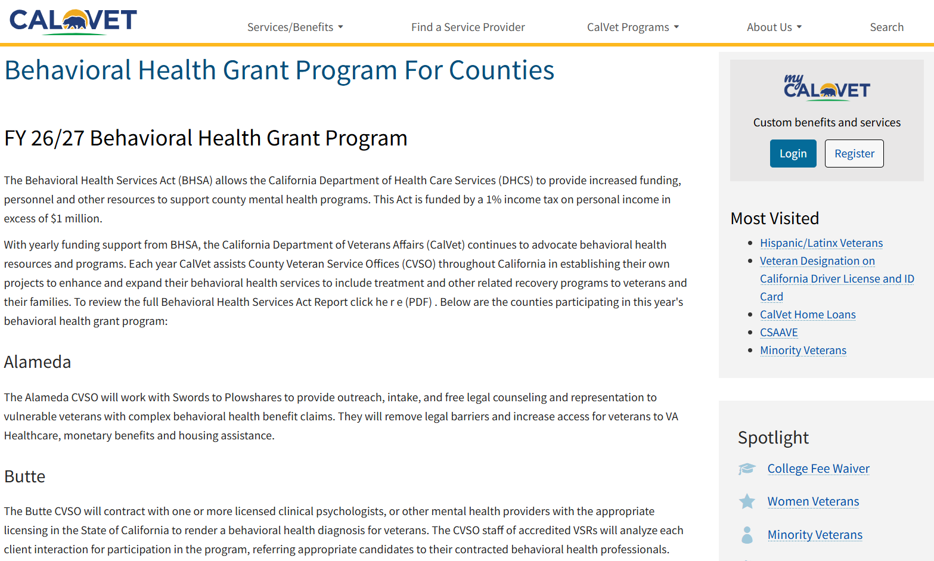

Slide 4
Participated Counties
Alameda
Butte
Calaveras
Fresno
Monterey
Nevada
Orange
Placer
Riverside
San Bernardino
San Francisco
San Luis Obispo
Santa Clara
Sonoma
Stanislaus
Tuolumne

Slide 5
Services
Legal services
Behavioral health diagnosis
Community outreach
Substance abuse
Family counseling
Equine-assisted psychotherapy
Social work
Housing assistance
Transportation
Justice-involved

Slide 6
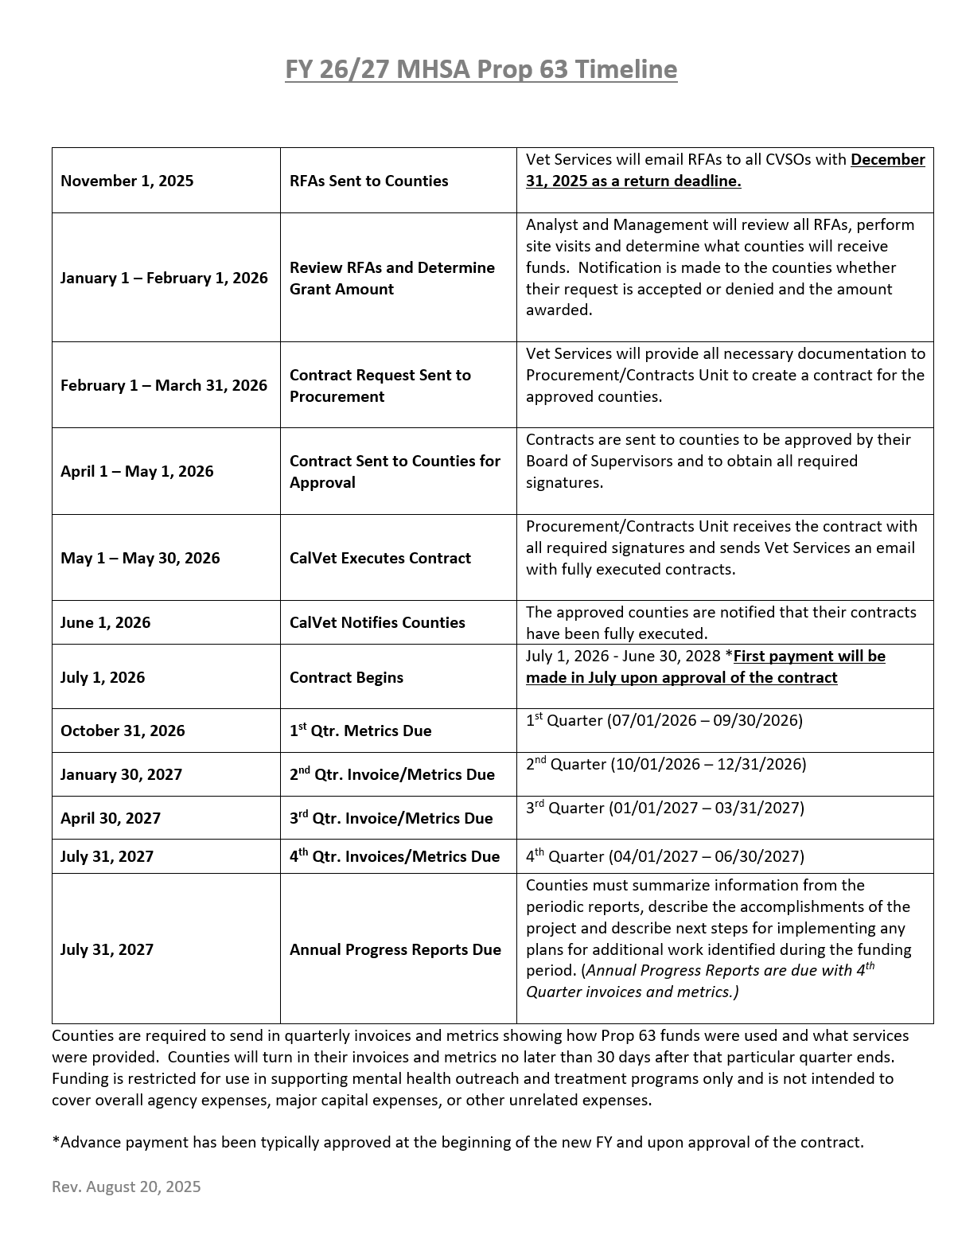
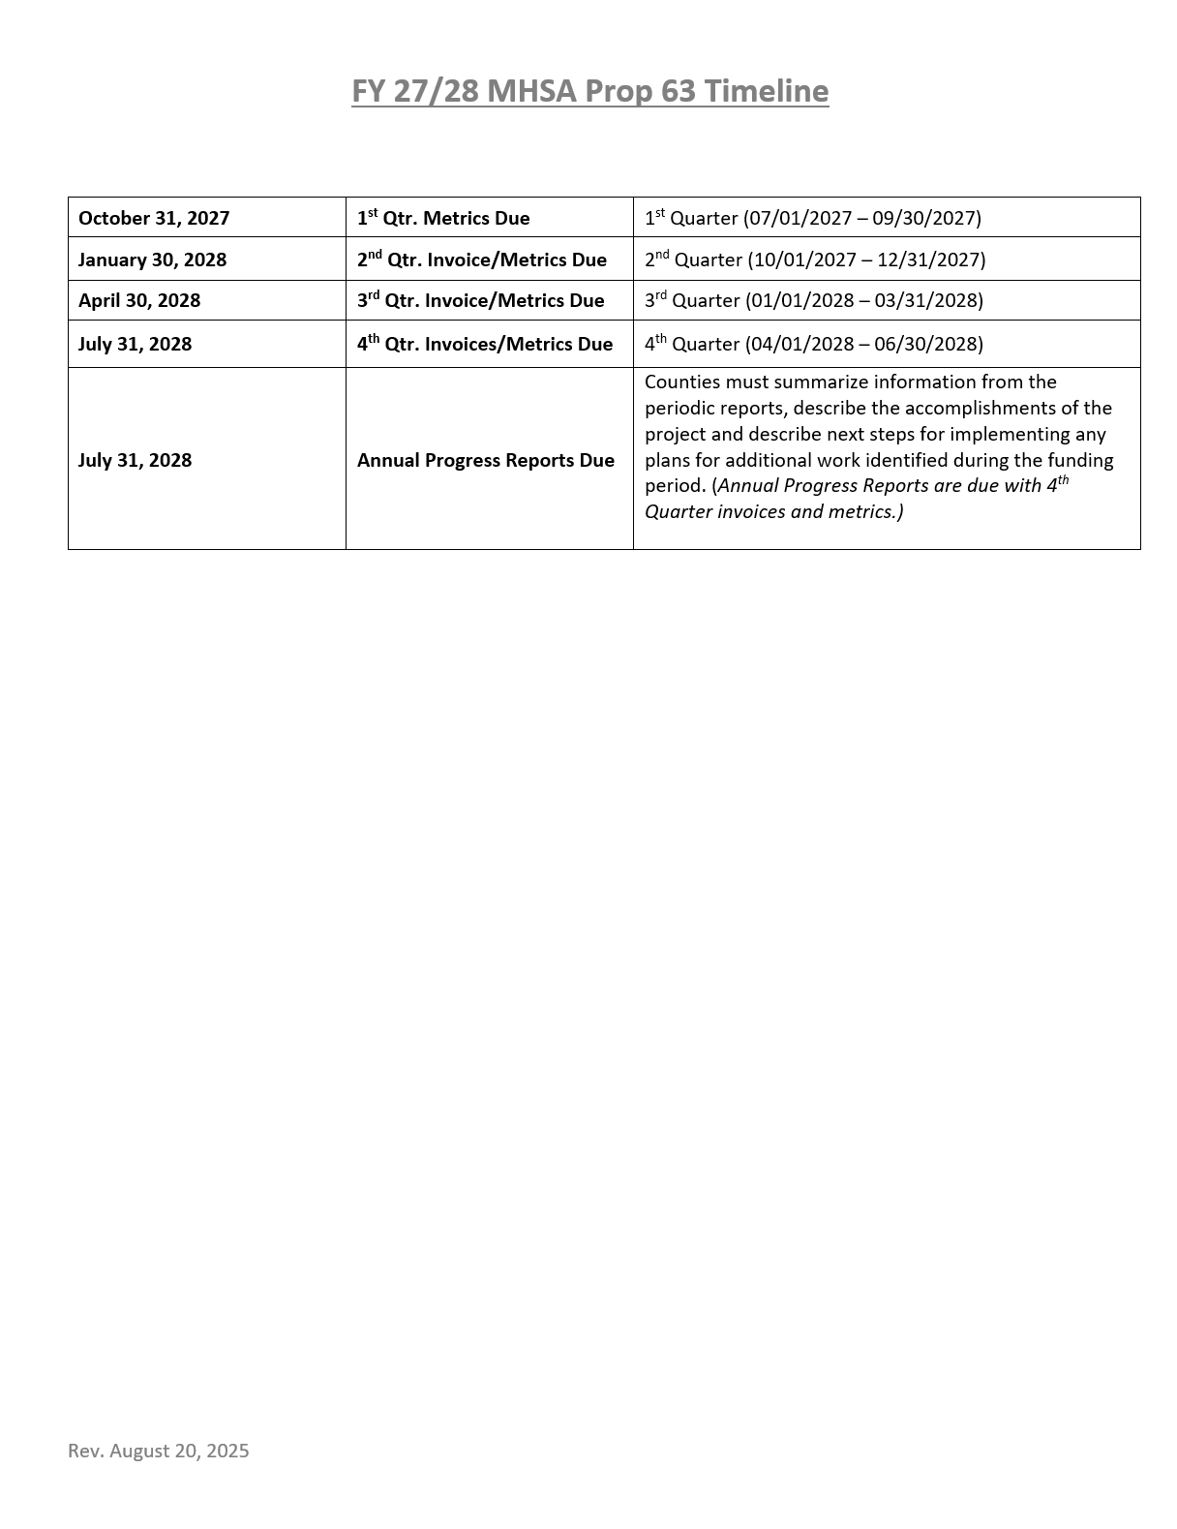

Slide 7
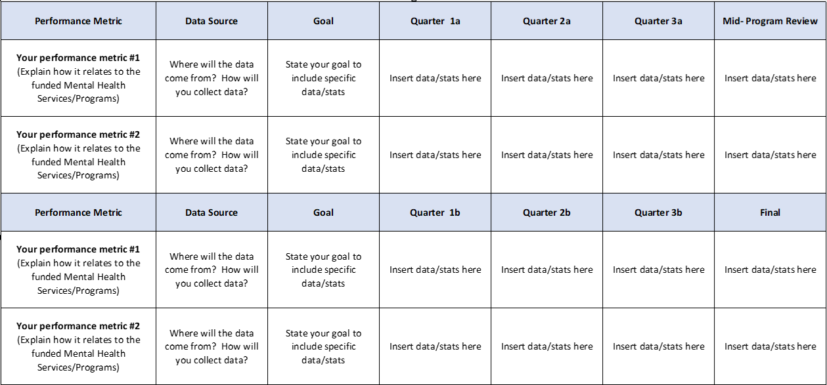
Metrics Due Oct 31

Slide 8
Contact Information
Samuel Griffin
Chief, Outreach & Operations
Veterans Services Division
California Department of Veterans Affairs
samuel.griffin@calvet.ca.gov
(916) 503-8073
Phillip Leggett
Mental Health Coordinator
Veterans Services Division
California Department of Veterans Affairs
phillip.leggett@calvet.ca.gov
(916) 503-8327

Slide 9
Questions

