Slide 1
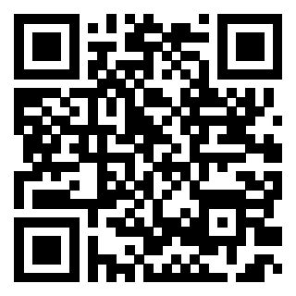
Overpayments
Waivers & Validity
CALVET/California Association of County Veteran Services Officers
2026 Fall Training Conference
October 11-16, 2026
https://bergmannmoore.participoll.com/
Notes:
Welcome everyone. This block is about VA overpayments: how a debt gets created, how to test whether it's valid, and how to get it waived when it is valid. After the break, we'll put all of it to work in a mock hearing based on a real fugitive-felon debt case.
Debt work can feel like a sideline to claims work, but it's often where a veteran is in the most immediate trouble. A rating decision changes future money. A debt letter can take money the veteran is counting on next month.
Make sure everyone can reach the polling link now. We'll use it several times.

Slide 2
Polling Question
How many VA debt cases have you handled in the last 6 months?
None
1-5 cases
6-10 cases
More than 10 cases
A
B
C
D
0
Notes:
If you selected more than ten, you may already qualify for a support group

Slide 3
Why This Matters
Scale: VA establishes hundreds of thousands of overpayments every year and everyone lands on a kitchen table.
Stakes: offset of monthly benefits, credit reporting, tax-refund offset, and real financial distress.
Your role: debts are where benefits practice meets collections law — and where skilled advocacy changes outcomes.
Advanced skill = knowing which lever to pull: validity, waiver, compromise, or appeal — and in what order.
Notes:
Scale: VA establishes hundreds of thousands of overpayments every year, and every one of them lands on some veteran's kitchen table.
Stakes: VA can offset monthly benefits, report to credit bureaus, and take tax refunds. For veterans on fixed incomes, this is real financial distress.
Your role: debts are where benefits practice meets collections law. It's an area where skilled advocacy clearly changes outcomes.
The advanced skill is knowing which lever to pull (validity, waiver, compromise, or appeal) and in what order. That's the thread through the whole session.

Slide 4
Learning Objectives
Trace any VA debt to its statutory, regulatory, and manual authority
Distinguish validity-of-debt disputes from waiver requests and know which clock applies
Apply the “equity and good conscience” standard the way an adjudicator does
Build a waiver file that wins: VA Form 5655, evidence, and legal theory
Advise veterans and eligible dependents on hearings, appeals, and alternatives to waiver
Notes:
I want you to leave with a way to think through a debt, even when the facts are messy.
By the end of this session you should be able to:
Trace any VA debt to its statutory, regulatory, and manual authority.
Tell the difference between a validity dispute and a waiver request, and know which deadline applies to each.
Apply the "equity and good conscience" standard the way an adjudicator does.
Build a waiver file that wins: VA Form 5655, evidence, and a legal theory.
Advise veterans and eligible dependents on hearings, appeals, and alternatives to waiver.
Check the debt. Protect the deadlines. Build the relief request

Slide 5
I. Statutory Authority
38 U.S.C.: what Congress said:
  § 5112 — effective dates: where overpayments are born
  § 5314 — offset: VA's collection engine
  § 5314A — the dispute process (added 2022)
  § 5302 — waiver: a relief statute
  § 5315 — interest & administrative costs
Compromise authority — 31 U.S.C. §§ 3711–3718; 38 CFR 1.930–1.936
Notes:
This slide is the map for the next several slides. Everything VA does on debts traces back to these statutes in Title 38, plus the general federal debt-collection statutes in Title 31
Congress supplies the authority. Before we accept the amount on a letter, we need to know what rule made the payment improper.
A divorce adjustment creates a debt (5112), withholding collects it (5314), and waiver addresses whether recovery would be fair. Each question needs its own legal analysis.
The statutes have different scopes which is why we are going to go over them individual.
. Section 5315 does not impose interest on every benefit debt. Explain the exclusions at slide 10.

Slide 6
38 U.S.C. § 5112 — Where Overpayments Are Born
§ 5112(a): increases and grants are generally effective the first day of the month following the event.
§ 5112(b): reductions and discontinuances are generally effective the last day of the month in which the change occurred.
The mechanics: VA pays monthly in arrears. When the § 5112 effective date precedes VA's adjustment, the delta becomes an overpayment.
VSO insight: every debt letter should map to a § 5112 effective date — if VA got the date wrong, the debt amount is wrong.
Sole VA administrative error: if VA alone caused it, the effective date is the date of last payment — no overpayment is created. Your best validity argument.
Notes:
Whether you know it or not, you are familiar with 38 USC 5112
Most overpayments aren't caused by VA paying too much by accident. They come from timing. Under § 5112, when something happens that reduces benefits, the reduction legally takes effect on a fixed date, usually the last day of the month the event happened. For divorce, for example, 38 C.F.R. § 3.501 makes the reduction effective at the end of the month of the divorce.
But VA doesn't learn of the event and adjust the award the same day. Everything paid between the legal effective date and the date VA actually adjusts the award becomes an overpayment. So the size of the debt depends entirely on two dates: when the reduction should have taken effect, and when VA acted.
That's why the effective date is the first thing to check. If VA used the wrong event date, or applied the wrong effective-date rule, the debt amount is wrong.
The last bullet is the most important. Under § 5112(b)(10) and 38 C.F.R. § 3.500(b)(2), when an overpayment results solely from VA administrative error, the reduction is effective on the date of the last payment. That means there is no overpayment at all. The catch is that the error must be VA's alone. If the veteran knew or should have known the payment was wrong, the courts have held it isn't "sole" VA error.

Slide 7
38 U.S.C. § 5112 — Where Overpayments Are Born
Divorce finalized
June 15
VA adjusts award
September — 3 months late
1
2
3
4
Reduction effective
June 30 — § 5112(b)
Overpayment created
July + August paid at old rate
The debt is the gap between the § 5112 effective date and the date VA actually acted. VSO move: verify the event date in the file, if VA used the wrong one, the “debt” shrinks or dies.
Notes:
[1] The divorce is finalized June 15.
[2] Under § 5112(b), the reduction is effective June 30.
[3] VA doesn't adjust the award until September, three months late.
[4] July and August were paid at the old rate. That's the overpayment.
The debt is the gap between the § 5112 effective date and the date VA actually acted.
If the facts change so does the result. If VA recorded the divorce as happening in April instead of June, the debt is two months too large. If the veteran reported the divorce in June and VA simply didn't process it, that delay is VA's fault. That supports a sole-administrative-error argument, or at least a strong waiver argument based on VA's fault.

Slide 8

38 U.S.C. § 5314 — Offset: VA's Collection Engine
The authority: VA may withhold (offset) current benefits to collect debts owed to the United States.
Scope: applies to compensation, pension, DIC, and other VA benefit payments.
Due process first: VA must give notice and an opportunity to dispute the debt or request waiver before offset begins.
VSO move: verify the pre-offset notice was actually sent and was adequate — defective notice can stall collection.
  Offsets are typically taken in monthly installments; the amount can be negotiated based on hardship.
Notes:
§ 5314 lets VA withhold, or offset, current benefits to collect debts owed to the United States.
Offset is how VA collects most benefit debts. Instead of sending a bill and waiting, VA keeps part or all of the veteran's monthly payment and applies it to the debt. It applies to compensation, pension, DIC, and other VA benefits.
Offset can't start without due process. VA has to send notice of the debt, tell the veteran their rights, and give them a chance to dispute it or request waiver before withholding begins. That's why the demand letter matters so much, and why we'll spend time on the 30-day window shortly.
Due Process: VA must give notice and an opportunity to dispute the debt or request waiver before offset begins.
Your move: check that the pre-offset notice was actually sent and was adequate. Defective notice can stall collection.
Offsets are usually taken in monthly installments, and the amount can be negotiated based on hardship.

Slide 9

38 U.S.C. § 5302 — Waiver: The Relief Statute
The core grant: the Secretary may waive recovery where collection would be “against equity and good conscience.”
Application required: the debtor must affirmatively request waiver.
Deadline (current): ONE YEAR from VA's notice (Pub. L. 117-328; 38 CFR 1.963 as amended Jan. 2026).
Collection bar: no collection where the cost of collection exceeds the debt (§ 5302(a)(2)).
Bars: fraud, misrepresentation, or bad faith precludes waiver.
Notes:
Waiver is forgiveness. It doesn't argue that the debt is wrong. It says that even though the money was overpaid, it would be unfair (in the statute's words, "against equity and good conscience") to make the veteran pay it back.
Waiver is never automatic (except in rare circumstances…Provide VBA pension matching example). The veteran must request it in writing, and VA won't consider it otherwise. And there's a deadline: one year from the date of VA's notice of the debt. That deadline used to be 180 days, so older materials and even some VA letters may still say 180. It changed through Pub. L. 117-328, and VA amended 38 C.F.R. § 1.963 to match in January 2026.
There's also a hard bar. If there is any indication of fraud, misrepresentation, or bad faith by the debtor, waiver isn't available, no matter how sympathetic the rest of the case is.

Slide 10
38 U.S.C. § 5315 — Interest & Administrative Costs
Interest: debts accrue interest at the Treasury “current value of funds” rate.
Administrative costs: VA may assess the costs of collection activity.
Accrual: interest generally runs from the date of the initial demand letter — the clock starts early.
VSO note: interest and costs can be part of waiver and compromise negotiations.
  A $5,000 debt ignored for two years is not a $5,000 debt anymore.
Notes:
For indebtedness arising on or after December 29, 2022, § 5315(a)(1) excludes disability compensation, pension, and educational assistance program debts from this statutory interest/cost provision. Loan programs and medical care debt require their own analysis.
§ 5315 allows VA to charge interest and administrative costs on debts. Interest runs at the Treasury rate, and as a general rule it starts from the date of the first demand letter.
The practical point for veterans: ignoring the letter doesn't make the debt go away. It can make it larger, and it moves the debt toward referral to the Treasury, where options narrow.
Interest and costs aren't untouchable. They can be included in a waiver request and in compromise negotiations.

Slide 11
38 U.S.C. § 5314A — The Dispute Statute (2022)
Added by the Cleland-Dole Act:
VA must provide: an efficient, effective, equitable process for disputing a debt's existence or amount
No offset while disputed: 38 U.S.C.§ 5314(a)(2) bars deductions from benefits while existence or amount is under dispute
No private collectors: a debt under active dispute may not be referred to a private collection agency
VSO impact: the dispute track now has teeth- file the dispute to freeze offset and keep the debt at VA
Notes:
Before 2022, veterans could dispute a debt, but there was no strong statutory requirement for how VA handled disputes, and collection often continued anyway. The Cleland-Dole Act changed that.
§ 5314A requires VA to have an efficient, effective, and equitable process for disputing whether a debt exists or how much it is. And § 5314(a)(2) now bars VA from deducting from benefits while the existence or amount of the debt is under dispute.
A debt under active dispute also can't be sent to a private collection agency. That keeps the debt with VA, where you can still work with DMC and the Committee on Waivers, instead of with an outside collector.
The result: a validity dispute is no longer just a letter of complaint. Filed properly, it stops offset and buys you time to get the file and do the math.
How VSOs use this
When there's any reasonable question about whether the debt is correct, file a written validity dispute right away, specifically challenging the existence or amount.
Keep proof of the dispute and when it was filed. If offset continues, you'll need that proof to show VA it's withholding in violation of the statute.

Slide 12
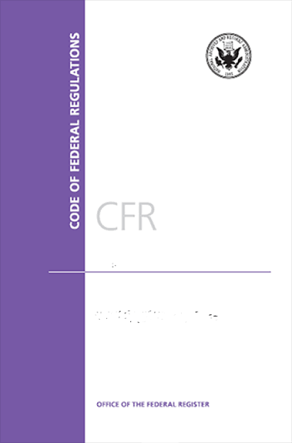
Regulatory Authority
Regulations implement the statute. They bind VA and their adjudicators.
38 C.F.R §§ 1.911-1.917 — collection standards, demand letters & due process
38 C.F.R § 1.912a(c) — the 30-day shield against offset
38 C.F.R §§ 1.962-1.970 — waiver: procedure, standard, hearings, appeals & compromise
Notes:
Now we move down one level, from statutes to regulations.
VA's debt regulations are in 38 C.F.R. Part 1. They have the force of law, so VA staff and adjudicators must follow them.
Three groups to know: §§ 1.911–1.917 cover collection standards, demand letters, and due process. § 1.912a is the 30-day protection against offset. §§ 1.962–1.970 are the waiver rules, including the standard, hearings, appeals, and compromise.
Regulations often give you more detail than the statute, which makes them very useful in a letter. The statute says VA can waive. The regulation says exactly what VA has to consider when deciding

Slide 13
38 CFR §§ 1.911-1.917 — Collection Due Process
38 C.F.R. § 1.911: implements the Federal Claims Collection Standards for VA — notice, demand, and the debtor's rights.
Demand letters must state: the amount, the reasons, payment terms, collection consequences, and the debtor's full menu of rights.
Simultaneous rights: the debtor may dispute validity, request waiver, request a waiver hearing, and appeal the underlying decision — all at once.
But: exercising these rights does not itself stay collection – the stay comes from § 1.912a(c) (next slide).
VSO tip: the demand letter is your roadmap – every right listed is a right you can exercise on day one.
Notes:
§ 1.911 is where VA adopts the federal debt-collection standards. In practice, it controls what the demand letter must say: the amount, the reason for the debt, payment options, what happens if the debt isn't paid, and the debtor's rights.
A key point: those rights can be used at the same time. The veteran can dispute validity, request waiver, ask for a waiver hearing, and appeal the underlying benefit decision, all at once. They don't have to pick one and wait.
But using these rights doesn't by itself stop collection. The protection against offset comes from § 1.912a and the dispute statute, so the timing of the filing matters.

Slide 14
38 CFR § 1.912a(c) — The 30-Day Shield
The single highest-leverage filing in a debt case.
The rule: a written dispute or waiver request filed within 30 days of notice generally defers offset until the initial review/decision
Hearings: a hearing request within 30 days blocks the waiver decision until the hearing is held
After an adverse initial decision, collection may resume even during further appeal — plan for it
VSO imperative: day-one triage — the 30-day filing freezes the money while you build the case
Notes:
This is the most important deadline in a debt case. Under § 1.912a, if the veteran files a written dispute or waiver request within 30 days of the notice, VA generally won't start offset until it makes an initial decision on that request.
A hearing request filed within 30 days also matters. It means VA can't decide the waiver until the hearing is held.
The protection has limits. After an initial decision against the veteran, collection can resume, even if you appeal. So the 30-day filing buys time, not a permanent stop.
Why this matters so much: if you miss the 30 days, VA may start taking the veteran's check while you're still gathering records. You can still win the case later and get a refund, but the veteran lives without that money in the meantime.
This is a great tool to postpone collection of debt. HOWEVER: According to VA.gov, the only options to submit at through VA.gov (veteran must take action) or by written statement to Debt
Debt Management center.
U.S. Department of Veterans Affairs
Debt Management Center
PO Box 11930
St. Paul, MN 55111

Slide 15
Poll
A debt is dated 8 months ago. Can the Veteran still request a waiver?
Yes – The Veteran is within one year from the notice date.
No – The 180-day window closed.
Only with showing of good cause.
Only if collection hasn’t started.
A
B
C
D
0

Slide 16
Poll Answer: 38 CFR § 1.963 — Requesting Waiver: The One-Year Clock
The deadline (current): ONE YEAR from the date of VA's notice of indebtedness (final rule effective Jan. 26, 2026).
The old 180-day rule was replaced by Pub. L. 117-328 — any source still citing 180 days is stale.
Where to file: the VA Debt Management Center (DMC).
Extension: the year may be extended if VA or postal error delayed your receipt of the notice.
Notes:
The answer is A. The veteran has one year from the date of VA's notice of the debt, so eight months is still timely.
The old 180-day deadline was replaced by Pub. L. 117-328, and VA's final rule updating § 1.963 took effect January 26, 2026. Any form, letter, website, or training material that still says 180 days is out of date.
Waiver requests go to the VA Debt Management Center, not the regional office.
The year can be extended if the veteran didn't receive the notice on time because of VA or postal error. That's why the date the veteran actually received the letter, and whether it went to the right address, matters.

Slide 17
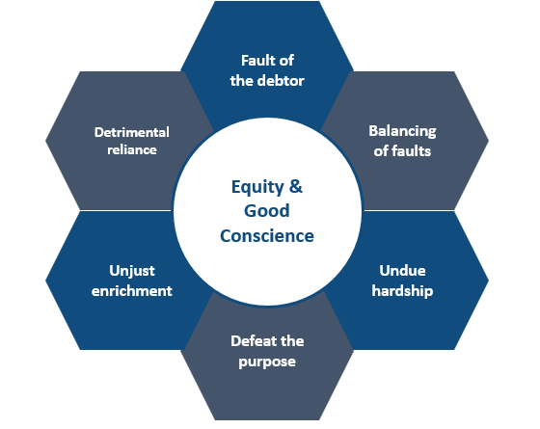
38 CFR § 1.965 — “Equity and Good Conscience”
1. Fault of the debtor — did the debtor's actions contribute?
2. Balancing of faults — weighed against VA's fault.
3. Undue hardship — would collection deny basic necessities?
4. Defeat the purpose — would recovery nullify the benefit's purpose?
5. Unjust enrichment — would the debtor keep an unfair gain?
6. Detrimental reliance — did the debtor change position relying on it?
The bars (§ 1.965(b)): any indication of fraud, misrepresentation, or bad faith precludes waiver.
The six factors are expressly nonexclusive: argue any other equity that fits your facts.
Notes:
This is the heart of a waiver case. VA decides whether collection would be against equity and good conscience by weighing these six elements.
1. Fault of the debtor: did the veteran do something, or fail to do something, that caused the overpayment?
2. Balancing of faults: the debtor's fault weighed against VA's.
3. Undue hardship: would repayment keep the veteran from meeting basic needs like food, shelter, and medical care?
4. Defeat the purpose: would collecting the money undermine the reason the benefit exists, for example taking need-based pension from someone who needs it to live?
5. Unjust enrichment: : would the veteran end up with money they had no right to if VA forgave the debt?
6. Detrimental reliance: did the veteran give up something or take on an obligation because they relied on getting the payments?
The bars in § 1.965(b): any indication of fraud, misrepresentation, or bad faith rules out waiver.
The six factors are expressly nonexclusive. Argue any other equitable consideration that fits your facts.
Undue hardship
A surviving spouse receives $2,100 a month. Her necessary expenses total $2,000, including rent, food, utilities, and medication. VA proposes withholding $300 a month.
She has $100 left before collection. Withholding $300 puts her $200 in the hole. Withholding would put impact her ability to pay for basic necessities.
Defeat the purpose
An older Veteran receives pension because his income is limited. He has a valid overpayment, but the proposed withholding would leave him unable to cover ordinary living expenses. Hardship asks whether collection would deprive him of necessities. Defeat the purpose asks whether recovery would undermine the objective of the benefit
Changing position to one’s detriment
After VA confirms a retroactive award and assures a surviving spouse that the amount is correct, she signs a binding contract for necessary accessibility modifications to her home. VA later identifies an overpayment. She remains legally obligated to pay the contractor.
Now we have something specific to investigate: a legal obligation she incurred in reliance on VA benefits. Obtain the contract, the dates, and the VA communications. Spending money alone does not establish detrimental reliance

Slide 18
38 CFR §§ 1.966—1.970 — Decisions, Hearings & Appeals
Decision-maker: the Committee on Waivers and Compromises.
Hearings: on the record; hearing available on request (38 C.F.R. § 1.966).
Refunds: a timely waiver can reach amounts already collected (38 C.F.R. § 1.967).
Committee appeal: denial appeals go to different members (38 C.F.R. § 1.963a).
Board appeal: denials appealable under Parts 19/20 (§ 1.958).
Compromise: under 38 C.F.R. §§ 1.930-1.936; accepted when advantageous to the Government (§ 1.970).
Notes:
The decision-maker is the Committee on Waivers and Compromises. . It's a separate body from the regional office raters you usually deal with.
Decisions are on the record, and a hearing is available on request (§ 1.966).
A timely waiver can reach amounts already collected, which means a refund (§ 1.967). I have not personally seen a waiver in the Veterans favor receive a refund of previously collected dollars. I think this is the regulatory authority to refund when a debt is deemed to be invalid and withholding have begun.
A committee-level appeal of a denial goes to different committee members (§ 1.963a).
Denials can also be appealed to the Board under Parts 19 and 20 (§ 1.958).
Compromise, which is settling for less than the full amount, is also handled under these rules. It's accepted when it's advantageous to the government, meaning VA gets more by settling than it likely would by continuing to collect.

Slide 19
III. Sub-Regulatory Guidance
Below regulations are VA's manuals: most importantly the M21-1 Adjudication Procedures Manual.
What it is: VA's internal operating instructions for claims and debt processing
What it isn't: law! It cannot override statute or regulation
Why it matters: it tells you exactly how VA staff are supposed to handle debts
Notes:
Below regulations is VA's internal guidance, mainly the M21-1 Adjudication Procedures Manual. This is the set of instructions VA employees follow when they process claims and debts.
The manual is not law. It can't override a statute or regulation, and a veteran's rights don't depend on it. But it tells you step by step what VA staff are supposed to do. That makes it a great checklist for finding where VA went wrong.

Slide 20
M21-1 Debt Guidance
The M21-1 was consolidated and reorganized (M21-1MR → M21-1). Old cites like “Part III, Subpart v, Ch. 4” are stale —current provisions (M21-1, Part VI, Subpart iii, Chapter 2, Sec. C).
What to pull today: overpayment creation & audits; validity-of-debt disputes; waiver development; waiver adjudication
Use it as persuasive authority: it binds VA staff procedure, not veterans' rights
Deviations matter: when staff skip required manual steps, cite the section — it shows arbitrary decision-making
Notes:
The M21-1 was reorganized, so older citations no longer work. Debt-related material is now in M21-1, Part VI, Subpart iii, Chapter 2, Section C.
What to look for: how VA is supposed to create overpayments and run audits, how it handles validity disputes, how it develops waiver requests, and how waivers are decided.
How to use it: the manual binds VA employees' procedures, even though it doesn't create rights for veterans. If a VA employee skipped a required step, cite the section and explain what should have happened. That shows the decision wasn't made according to VA's own process.

Slide 21
How Debts Get Created: The Audit Trail
Trigger: a benefit adjustment — dependency change, income change, incarceration — generates an overpayment audit.
M21-1 requires: staff to verify the 38 U.S.C. § 5112 effective date before establishing the debt.
Common failure: VA uses the notification or processing date instead of the event date, inflating the debt.
Always request: the audit worksheet, the effective-date determination, and the full payment history.
  If the audit worksheet doesn't exist (or is not in the record), or doesn't show its work, request it!
Notes:
The trigger is a benefit adjustment, such as a dependency change, income change, or incarceration. That generates an overpayment audit.
The M21-1 requires staff to verify the USC § 5112 effective date before establishing the debt.
Common failure: VA uses the date it was notified or processed the change instead of the date of the event, which inflates the debt.
Ask for a month-by-month paid-and-due audit. We need what VA paid, what VA says was payable, and the legal reason for the difference
If the audit worksheet isn't in the record, or doesn't show its work, request it.
You can't check math you haven't seen.

Slide 22
Validity-of-Debt Disputes in M21-1
The right: a debtor may dispute the existence or amount of the debt.
VA's duty: a dispute triggers review of the underlying determination.(M21-1 XIV.8.3.F.)
Outcome: if the debt is invalid (wrong payee, wrong amount, wrong effective date), it must be corrected or canceled.
The key distinction: validity disputes attack the debt itself; waivers may concede the debt but seek forgiveness.
  Never file a waiver on a debt you haven't validity-checked — you may be conceding money VA was never owed.Always consider validity first prior to submitting a waiver request.
Notes:
A validity challenge asks VA to prove the debt's legal basis and amount. A waiver request asks for relief from recovery if a debt remains.
VA’s M21 states: Follow the recommendations of the OIG Fugitive Felon Coordinator as to whether adjustment of a beneficiary’s award (or apportionee’s award, if applicable) is appropriate. It is the policy of OIG and VBA to resolve reasonable doubt in favor of the beneficiary (and/or apportionee, if applicable).
The OIG Fugitive Felon Coordinator will generally recommend against award adjustment if the evidence establishes that the beneficiary (or the beneficiary’s dependent, if applicable) was unaware of the warrant or made good faith attempts to clear the warrant as soon as they knew or should have known of the existence of the warrant.
A decision not to take action on a valid felony warrant may be made only if
a documented recommendation from OIG is of record, or
Compensation Service or P&F Service advises by e-mail that no action is required.
Notes:
A recommendation from OIG is not required if evidence from a court or a law enforcement agency establishes there was no valid felony warrant.
An OIG recommendation is required only if the warrant was valid but award action is not being taken because of extenuating circumstances

Slide 23
Waiver Development
M21-1 requires development of: financial status (VA Form 5655), the debtor's statement, and relevant records.
The numbers must be documented, not asserted: income, expenses, assets, and other debts — with proof.
Tie hardship to the math: show the monthly shortfall that collection would cause.
Submit everything at once: piecemeal development delays decisions for months.
Notes:
When a waiver request comes in, VA develops it by collecting the financial status report (VA Form 5655), the veteran's statement, and any relevant records.
The most common reason waivers fail is that the numbers are asserted rather than proven. Saying "I can't afford this" isn't evidence. A 5655 that shows income and expenses, backed up by documents, is.
Hardship needs to be connected to the math. The question is what happens to this veteran's monthly budget if VA withholds the amount it's asking for.
Submit everything together. When evidence arrives in pieces, the request sits while VA waits, and the delay can last months.
A hardship claim needs a financial picture someone else can follow.
EXAMPLE: ‘I cannot afford it’ becomes stronger when the record shows $2,200 net income, $2,100 in necessary expenses, and proposed withholding of $300. That leaves a $200 shortfall
Before filing, put together a single package: the 5655, proof for each major income and expense item, and the veteran's statement.
Help the veteran write their statement in their own words, focusing on what happened, why they didn't realize the payment was wrong, and what repayment would mean for them.

Slide 24
Waiver Adjudication
The decision-maker must address each 38 C.F.R. § 1.965 element with reasons: not conclusions.
Boilerplate denials: (“not against equity and good conscience”) are vulnerable on appeal.
The classic winning combination: favorable findings on fault plus documented hardship.
If denied, read the reasons: they tell you exactly what evidence to add on appeal.
Notes:
When the Committee decides a waiver, it's supposed to address each element of the equity-and-good-conscience test and explain its reasoning. A decision that says only that collection "is not against equity and good conscience" without discussing the elements is vulnerable on appeal.
What tends to win: findings that the veteran wasn't at fault, or that VA's fault was greater, combined with documented financial hardship.
A denial isn't the end. The reasons in the decision are a roadmap. If the Committee says hardship wasn't shown, that tells you what evidence to add.

Slide 25
The Hierarchy in Practice
When authorities conflict, the higher one wins. Your argument should cite all three levels:
Statute controls: if the M21-1 contradicts 38 U.S.C., the statute wins.
Regulation interprets: 38 CFR fills the statute's gaps with the force of law.
Manual guides: M21-1 shows how VA applies the rules.
  Powerful when VA staff deviate from it.
OGC precedent: a new overpayment from a separate transaction requires fresh notice of waiver rights (VAOPGCPREC 21-95) — serial debts, separate clocks.
Notes:
Pull the last few sections together. When sources conflict, the higher authority controls: statute over regulation, regulation over manual.
In practice, the strongest arguments cite all three levels. The statute provides the right, the regulation spells out the standard, and the manual shows the steps VA staff should have taken. Deviations from the manual are especially persuasive because they show that VA didn't follow its own process.
OGC precedent opinion on the slide, VAOPGCPREC 21-95. It says a new overpayment from a separate transaction requires fresh notice of waiver rights. In other words, each new debt starts its own clocks.

Slide 26
Recent Developments (2022—2026)
Cleland-Dole Act (2022): one-year waiver deadline; § 5314A dispute rights; no offset during dispute; cost-of-collection bar.
VA final rule (Nov. 2025, eff. Jan. 2026): 38 C.F.R. § 1.963 updated to the one-year deadline.
va.gov relief menu now lists: repayment plans, compromise, waiver, and hardship suspension (temporary pause).
Notes:
The Cleland-Dole Act in 2022 extended the waiver deadline to one year, created the § 5314A dispute right, barred offset while a debt is disputed, and added the cost-of-collection bar.
VA's final rule, published in November 2025 and effective January 2026, brought § 1.963 in line with the one-year deadline.
VA.gov now lists four forms of relief: repayment plans, compromise, waiver, and a temporary hardship suspension. The hardship suspension is useful when the veteran is in a crisis and needs collection paused while you work on a longer-term solution.

Slide 27
IV. The VSO Playbook
Serving Veterans & eligible dependents: from intake to resolution
This is where the authorities become advocacy. Process discipline wins debt cases.
Notes:
We've covered the law. Now we're moving to the practical steps: what you do when a veteran walks in with a debt letter.
The theme of this section is process discipline. Most lost debt cases aren't lost on bad facts. They're lost because a deadline was missed, a debt was conceded without checking the math, or the waiver package was incomplete.

Slide 28
Anatomy of a Debt Notice
Read for: debt amount, benefit type, period of overpayment, demand date, and the rights paragraph.
Red flags: no period specified; amount doesn't match payment history; wrong benefit type cited.
First three moves: (1) calendar every deadline, (2) request the file and the audit, (3) advise the veteran: do not ignore it — silence means offset.
Notes:
Start with the notice itself. It tells you the debt amount, the type of benefit involved, the period of the overpayment, the date of the demand, and the veteran's rights.
Red flags: a letter that doesn't specify the overpayment period, an amount that doesn't match the payment history, or a letter that cites the wrong type of benefit. Any of these suggests the debt may be wrong.
Your first three moves should be the same on every case. Calendar every deadline. Request the file and the audit. And tell the veteran clearly not to ignore the letter, because if nothing is filed, VA will start withholding benefits.

Slide 29

Two Clocks
Dispute clock: file within 30 days of notice to defer offset under § 1.912a — and § 5314(a)(2) bars offset while existence/amount is disputed.
Waiver clock: ONE YEAR from VA's notice (38 CFR 1.963, as amended Jan. 2026). The 180-day rule is gone.
Underlying benefits appeals: NOD/appeal deadlines run on their own track — don't conflate them with debt clocks.
Practice system: every debt intake gets a written deadline sheet on day one.
Notes:
There are two separate deadlines in every debt case, and confusing them is one of the most common mistakes.
The dispute clock: 30 days from the notice. Filing a dispute or waiver request in that window defers offset under § 1.912a, and § 5314(a)(2) bars offset while the debt's existence or amount is disputed.
The waiver clock: one year from the notice under the amended § 1.963.
There's a third track to keep separate. If the debt came from a benefit decision you want to challenge, like a reduction or a fugitive-felon finding, the appeal of that decision has its own AMA deadlines. The debt deadlines don't extend them, and they don't extend the debt deadlines.

Slide 30
Challenging Validity: Five Questions
1. Was there actually an overpayment? Payment history vs. legal entitlement, month by month.
2. Is the amount correct? Audit the audit — recompute it yourself.
3. Is the § 5112 effective date right? The single most common error.
4. Is this the right debtor? Payee vs. apportionee vs. fiduciary — debts follow the money.
5. Was due process followed? Notice, demand, opportunity to be heard.
Notes:
These five questions are your validity checklist.
Was there actually an overpayment? Compare what was paid with what the veteran was entitled to, month by month.
Is the amount right? Recalculate it yourself; don't rely on VA's figure.
Is the effective date right? This is the most common error.
Is this the right debtor? Debts follow the money, so if the payment went to an apportionee or fiduciary, the veteran may not be the one who owes it.
Was due process followed? Check that proper notice and demand were sent and that the veteran had a chance to respond.

Slide 31
Common Debt Scenarios
Dependency changes: divorce, marriage, death of a dependent — the #1 overpayment source.
Pension income: unreported or increased income creates pension overpayments fast.
Incarceration/fugitive-felon: felony incarceration beyond 60 days triggers reduction; fugitive-felon status can bar benefits — verify current section numbers before citing.
Concurrent receipt: drill pay, retired pay, and separation pay elections gone wrong.
Duplicate payments: system errors and dual awards — often pure VA fault.
Notes:
These are the situations you'll see most often.
Dependency changes, such as divorce, marriage, or a dependent's death, are the biggest source. The veteran often reports the change, and VA takes months to act.
Pension debts usually involve income. Pension is needs-based, so any increase in income, including Social Security, can reduce the benefit, and unreported changes produce debts quickly.
Incarceration and fugitive-felon debts: under 38 U.S.C. § 5313, benefits are reduced starting on the 61st day of incarceration for a felony. Under § 5313B, benefits can be cut off for periods when the veteran is a fugitive felon. These debts can be very large because they often go back years. We'll see one in the mock hearing.
Concurrent receipt issues include drill pay (the veteran can't receive VA compensation and drill pay for the same days), retired pay, and recoupment of separation pay. Duplicate payments from system errors are often purely VA's fault.

Slide 32
Debts Involving Dependents & Survivors
DIC and survivors pension debts: same waiver framework, different hardship calculus.
Apportionment: debts follow the payee; verify who actually received the funds before conceding liability.
Children aging out of dependency/Chapter 35: notice failures are common and well-documented.
Failure to notify VA of dropping out/stop going to class.
Advocacy note: survivors often learn of a debt while grieving; lead with options, not process.
Notes:
Survivors receiving DIC or survivors pension face the same waiver framework, but the hardship picture is often different. Many are older, live on a single fixed income, and may have fewer resources to absorb repayment.
Apportionment: when part of a benefit was paid to someone else, the debt follows the person who received the money. Before conceding that the veteran owes it, confirm who actually got paid.
Children aging out: payments for a child often continue past age 18 or past the end of school because nobody told VA, or because VA's notices about reporting weren't clear. The same is true when a student drops out or stops attending.
When you work with a survivor, remember they often learn of the debt while grieving. Start with what they can do and what you'll do for them, not with the procedural details

Slide 33
V. The Waiver Process
Step by step: from intake to decision
Follow the sequence. Skipping steps is how winnable waivers get denied.
Notes:
Now we'll go through the waiver process one step at a time, from deciding whether waiver is even available to the final decision.
The sequence matters. Each step builds on the one before it. Skipping ahead, for example writing the argument before you know whether there's a fraud issue, is how good waiver cases get lost.

Slide 34

Step 1: Is Waiver Available?
Threshold question: is there any indication of fraud, misrepresentation of a material fact, or bad faith?
Legal bars (38 U.S.C. § 5302; 38 CFR 1.965(b)): any such indication precludes waiver — full stop.
VSO screen: if the facts smell like fraud, pivot to validity or compromise.
Notes:
The first question is whether waiver is available at all. If there's any indication of fraud, misrepresentation of a material fact, or bad faith, the statute and § 1.965(b) bar waiver completely.
"Any indication" is a low threshold, so look at the file the way VA will. Did the veteran sign a form with incorrect information? Did they keep accepting payments after a clear VA letter told them to report a change?
If the facts look like they might support fraud or bad faith, don't build the case around waiver. Focus on validity, or on compromise and a repayment plan.
How VSOs use this
Ask the veteran directly about anything in the file that looks like a misstatement, and get their explanation in writing. Often it's confusion, not deception.
If you argue no bad faith, explain why the conduct was an honest mistake. Don't just deny it.

Slide 35

Step 2: Frame Your Theory
Pick two or three of the six 38 C.F.R. § 1.965 elements and build the case around them.
Classic theories: (a) no fault + hardship; (b) VA's fault outweighs the debtor's; (c) reliance/change of position.
Write the theory sentence first: “Collection should be waived because …”
Discipline: every piece of evidence you submit should tie to the theory.
Notes:
Next, choose a theory. Don't try to argue all six elements equally. Pick the two or three where the facts are strongest and build around them.
The classic combinations are on the slide. No fault plus hardship works when the veteran did everything right and repayment would hurt. VA's fault outweighing the veteran's works when the veteran made a small mistake but VA delayed for months. Reliance works when the veteran made decisions, like taking on a lease or medical expense, based on payments they believed were correct.
A good exercise is to write the theory in one sentence before gathering evidence: "Collection should be waived because...". If you can't finish that sentence, you're not ready to write the request.

Slide 36
Fault
Fault = the debtor knew or should have known the payment was erroneous.
Factors: the debtor's sophistication, the clarity of VA's notices, and the complexity of the rules involved.
Advanced practice: PTSD, TBI, and other conditions affecting financial comprehension — develop the medical nexus, don't just assert it.
VA error alone doesn't end the inquiry, but it anchors the balancing-of-faults test in your favor.
Notes:
Fault means the veteran knew, or should have known, that the payment was wrong. The question isn't just whether they made a mistake. It's whether a reasonable person in their position would have realized it.
That depends on the person. Relevant factors include the veteran's education and sophistication, how clear VA's notices were, and how complicated the rules are. Pension income rules, for example, are hard for anyone to apply.
Conditions like PTSD, TBI, or cognitive decline can affect a veteran's ability to understand financial notices. But these need evidence. A statement from a treating provider about how the condition affects the veteran's ability to manage paperwork carries far more weight than an assertion in your letter.
VA's error doesn't automatically end the analysis, but it shifts the balance of faults in the veteran's favor.

Slide 37
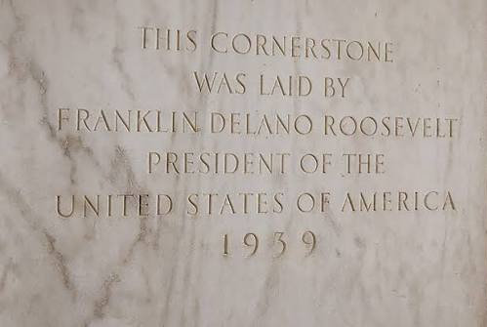
Financial Hardship
The 5655 is the foundation — complete it meticulously.
Document everything: income from all sources, necessary living expenses, assets, and other debts.
Show the math: collection of $X per month leaves a $Y monthly shortfall, make the adjudicator do no arithmetic.
Hardship is forward-looking: show what collection would do, not just current strain.
Notes:
Like any major infrastructure, the cornerstone is anchor of the foundation. The 5655 is the foundation of that argument, so it has to be complete and accurate.
Document all income, necessary living expenses, assets, and other debts. Then do the calculation for the decision-maker. If VA wants $400 a month and the veteran already has a $150 monthly shortfall, say so directly: collection would leave a $550 monthly gap.
This can be a difficult conversation with Veterans.
Hardship is about the future. The question is what repayment would do to the veteran going forward, not just whether things are hard right now. Upcoming medical costs, a fixed income, and age all matter.

Slide 38
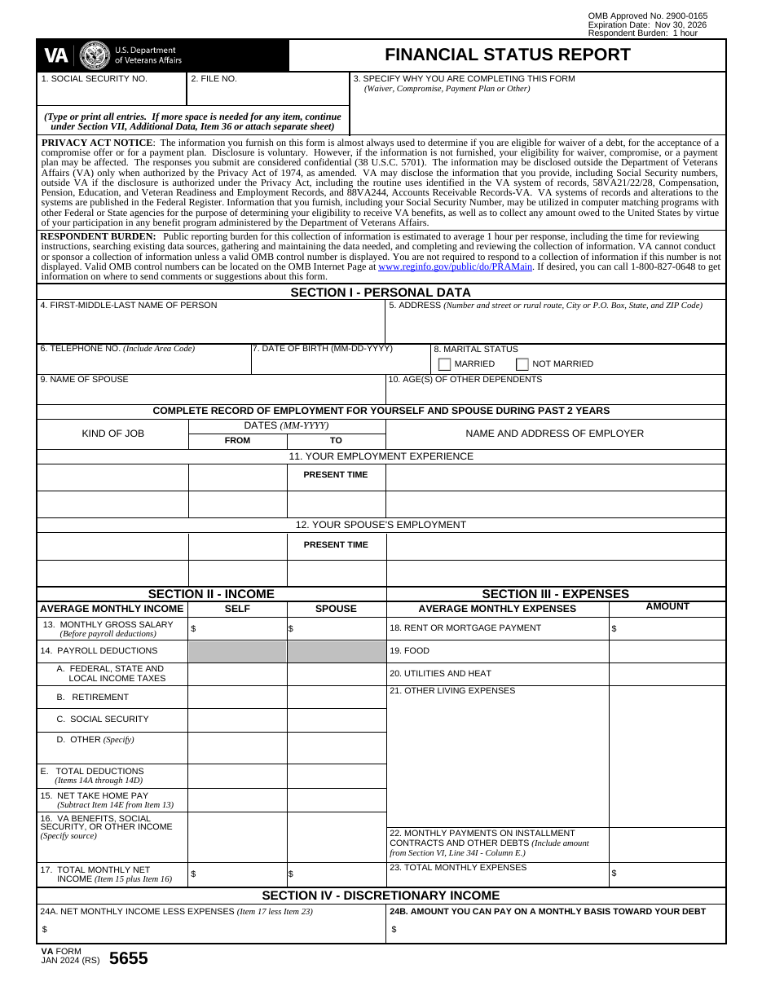
VA Form 5655 — Walkthrough
The whole case in one form:
Section I — who the debtor is
Sections II–III — income vs. expenses: the hardship math
Section IV — discretionary income: what VA thinks they can pay
Sections V–VII — assets, debts, and your narrative statement
VA Form 5655 (Jan. 2024), Financial Status Report — always pull the current version from va.gov before filing.
Notes:
The structure of the VA form5655 is not an outlier from other forms.
Section I identifies the debtor.
Sections II and III are income and expenses, which is where the hardship case is made.
Section IV calculates discretionary income, meaning what VA thinks the veteran has left over to pay.
Sections V through VII cover assets, other debts, and a statement.
Section IV. If the numbers show the veteran has money left over, VA will see that as ability to pay.
Accurate, complete expenses keep that figure realistic.
The current version is dated January 2024. Always download the latest version from VA.gov, because VA may reject outdated forms.

Slide 39
VA Form 5655 — Walkthrough
Sections: income, expenses, assets and liabilities, and remarks.
Common errors: omitting irregular income, understating medical expenses, understating debt, missing signatures.
Attach: pay stubs, bank statements, bills, and medical evidence.
The remarks section is your narrative — use it to connect the numbers to the 38 C.F.R. § 1.965 elements.
Notes:
These are the mistakes that weaken waiver requests: leaving out irregular income like occasional work or family help, understating medical expenses, understating debts, and missing signatures.
VA may see a missing income source as a credibility problem later, so include it.
Attach proof: pay stubs, benefit statements, bank statements, bills, and medical expenses.
The remarks section is valuable space. Use it to explain the numbers and tie them to the waiver elements, such as why the veteran's expenses are high or why their income won't increase.

Slide 40
Step 3: Filing
File with: VA Debt Management Center, PO Box 11930, St. Paul, MN 55111 — 1-800-827-0648. Not the regional office.
How: written request — VA Form 5655 for the financial picture, plus your argument.
Include: the debt notice, the audit, the 5655, supporting evidence, and a theory-mapped argument.
Protect yourself: keep proof of filing and calendar the one-year deadline from the notice date.
Notes:
Waiver requests and disputes for benefit debts go to the VA Debt Management Center, PO Box 11930, St. Paul, MN 55111. The phone number is 1-800-827-0648. Don't file at the regional office, where the request may sit or get lost.
Note that medical copay debts are handled separately by VHA, not DMC.
If the debt is for health care copays, check the letter for where to send the request.
The package should include the debt notice, the audit if you have it, the 5655, supporting evidence, and a written argument organized around your theory.

Slide 41
While You Wait
30-day shield: a dispute or waiver request filed within 30 days of notice generally defers offset until the initial decision (38 C.F.R. § 1.912(a)(c)).
After an adverse initial decision, collection may resume even during further appeal.
Refunds: amounts already collected can be waived and refunded if the waiver was timely (38 C.F.R. § 1.967).
Advise the veteran: keep paying other obligations; don't take on new debt while the case is pending.
Notes:
what happens while the request is pending. If it was filed within 30 days, offset generally stays deferred until the initial decision. After an adverse initial decision, collection can resume, even if you appeal.
If collection has already happened, a timely waiver can still reach that money. If the waiver is granted, the veteran can get a refund under § 1.967.
Advise the veteran to keep paying other bills and avoid taking on new debt. New obligations can complicate the financial picture, and the veteran's situation may be reviewed at a hearing.

Slide 42
Hearings
The right: a hearing before the waiver decision — in person or by video.
The purpose: credibility, explanation, and human context the paper file can't convey.
Prepare the veteran: a tight 10-minute narrative plus Q&A — bring the 5655 to life.
Your role as VSO: frame the legal theory; let the veteran tell the story.
Notes:
The veteran has a right to a hearing before the waiver decision, in person or by video. Hearings are underused in debt cases, and they can make a real difference.
A hearing gives the decision-maker what paper can't: the veteran's credibility, their explanation of how the overpayment happened, and the human impact of repayment. A sympathetic, believable veteran can change the outcome on fault and hardship.
Prepare the veteran. Aim for a short, clear account, about ten minutes, covering what happened, why they didn't realize payments were wrong, and what repayment would mean, followed by questions. Practice it with them.
Your role is to frame the legal theory at the beginning and close by connecting the testimony to the § 1.965 elements. Let the veteran tell the story.

Slide 43
Reconsideration & Board Appeal
Reconsideration: ask the Committee to reconsider with new evidence or a corrected legal theory.
Committee appeal: the Chairperson must assign a waiver-denial appeal to different Committee members than those who first decided it (38 C.F.R. § 1.963a).
Board appeal: adverse waiver decisions are also appealable to the Board of Veterans' Appeals, reviewed de novo (38 C.F.R. § 1.958).
Finality: waiver decisions are final except for new & material evidence, fraud, change in law, or CUE (38 C.F.R. § 1.969).
VSO judgment call: reconsider when the record is thin; appeal when the law was misapplied.
Notes:
After a denial, there are several paths. Reconsideration asks the Committee to look again, with new evidence or a corrected legal argument.
A Committee appeal goes to different members than those who made the original decision, under § 1.963a.
A Board appeal is also available, and the Board reviews the waiver question fresh rather than deferring to the Committee.
Waiver decisions become final unless there's new and material evidence, fraud, a change in law, or clear and unmistakable error.
Choosing the path: if the record is thin, for example a missing 5655 or no hardship evidence, reconsideration with the new evidence is usually faster. If the Committee misapplied the law, ignored a validity challenge, or skipped elements, a Board appeal may be better.

Slide 44
Repayment Plans & Compromise
Repayment plans: monthly installments based on ability to pay — under 5 years can be set up online/phone; longer needs the 5655.
Compromise (31 U.S.C. §§ 3711—3718; 38 CFR §§ 1.930—1.936, 1.970): a lump-sum offer for less than the full debt, accepted when advantageous to the Government. Trap: 38 U.S.C. § 5316 is VA's authority to sue — not compromise authority.
Hardship suspension: a temporary hardship suspension (pause short of waiver).
When to compromise: when waiver is barred but the veteran can pay something now.
Get it in writing: Do not rely on a phone agreement with DMC.
Notes:
When waiver isn't available or isn't granted in full, there are still options.
Repayment plans: VA will set up monthly installments based on ability to pay. Shorter plans, under five years, can be set up online or by phone. Longer plans require the 5655.
Compromise: VA can accept a lump sum for less than the full debt when that's advantageous to the government. The authority comes from Title 31 and 38 C.F.R. §§ 1.930–1.936 and 1.970. A common mistake is citing 38 U.S.C. § 5316. That section gives VA authority to sue to collect; it's not compromise authority.
Hardship suspension is a temporary pause in collection. It doesn't reduce the debt, but it can protect a veteran in crisis.
Compromise is most useful when waiver is barred, for example because of a bad-faith finding, but the veteran can pay something now, perhaps with family help.

Slide 45
Case Study 1: The Dependency Debt
Facts: veteran divorced in 2022; VA continued the spouse's additional compensation for 14 months. Debt: $8,400.
Validity check: was the § 5112 effective date right? Was the divorce notice actually in the file?
Waiver theory: no fault — veteran reported promptly; VA's 14-month delay dominates the balancing test. Hardship via the 5655.
Notes:
The facts: the veteran divorced in 2022, and VA kept paying the additional amount for the spouse for 14 months. The debt is $8,400.
First, validity. What's the divorce date, and did VA use the right effective date? When did VA receive notice of the divorce? If the veteran reported it promptly, the 14 months of extra payments came from VA's delay, not the veteran’s.
Then waiver. If the debt is valid, the theory is no fault: the veteran reported promptly. VA's 14-month delay weighs heavily in the balancing of faults. And the 5655 shows hardship.

Slide 46
Case Study 1: Poll
What is the outcome?
Waiver is denied – Veteran is responsible for debt.
Waiver partially granted – Veteran is responsible for 50% of the debt.
Waiver fully granted – Veteran is not responsible for any further collections.
Debt is deemed to be not valid – Veteran is not responsible for any further collection and must be refunded dollars collected.
A
B
C
D
0

Slide 47
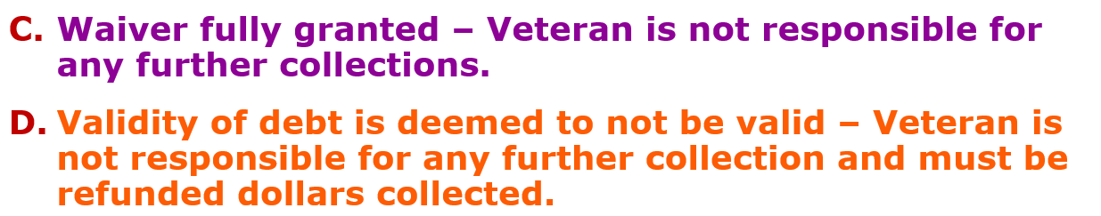
Poll Answer
Notes:
D, the debt is not valid, is the best outcome. If the veteran reported the divorce promptly and the overpayment came only from VA's failure to act, that's sole VA administrative error. Under § 5112(b)(10), the reduction is effective as of the last payment, so there's no overpayment, and anything already collected must be refunded.
C, full waiver, is the fallback. If VA finds the veteran shares some fault, or if VA's delay doesn't qualify as sole error, the debt stands, but no fault plus VA's long delay plus documented hardship is a strong waiver case.
The key takeaway: if you had gone straight to waiver, the best you could get is C. Raising validity first is what makes D possible.

Slide 48

Case Study 2: The Pension Income Debt
Facts: survivors pension recipient's Social Security increased; a data match generated a $12,000 debt.
Validity: was the income correctly counted? Were unreimbursed medical expenses deducted? Re-run the pension math.
Notes:
a surviving spouse receiving survivors pension had a Social Security increase. A data match between VA and SSA generated a $12,000 debt.
Start with validity, because pension math is complicated and data-match debts often have errors. Was the income counted correctly, and for the right period? Were unreimbursed medical expenses deducted? Under VA's pension rules, medical expenses above a set threshold reduce countable income, and data-match audits often don't include them because VA doesn't have that information unless the beneficiary submits it.
Re-running the calculation with the medical expenses included can reduce the debt substantially, or even eliminate it.

Slide 49
Case Study 2: Poll
Which overpayment theories are most appropriate?
Waiver: Fault of debtor & undue hardship
Validity of debt: VA error, incorrect payee
Waiver: Undue hardship & changing position to one’s detriment.
Waiver: Fault of Debtor, Undue hardship & Defeat of purpose
A
B
C
D
0
Notes:
Point out that some are waiver theories and one is a validity theory, so people need to decide what kind of argument fits these facts.

Slide 50
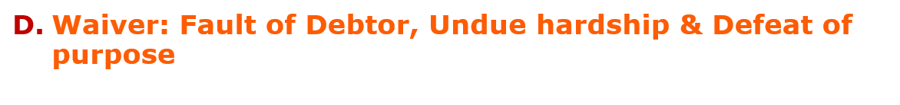
Poll Answer
Waiver theory: Survivor didn’t understand the reporting rules, no bad faith, undue hardship on a fixed income.
NOTE: always re-run VA's pension math before accepting the debt as credible. Data-match audits routinely miss deductible expenses.
Notes:
The answer is D: waiver based on fault of the debtor, undue hardship, and defeat of purpose.
Fault: the survivor didn't understand the income reporting rules and there's no indication of bad faith. Hardship: she's on a fixed income. Defeat of purpose: survivors pension is a needs-based benefit meant to keep low-income survivors out of poverty. Taking it back from someone who needs it to live works against that purpose
.
Why not B? There's no indication of VA error or a wrong payee here. That's why the validity work on the previous slide is still important: if re-running the math reveals an error, validity comes back into play.
Always re-run the pension math before accepting the debt, because data-match audits routinely miss deductible expenses.

Slide 51
Case Study 3: The Validity Win
Facts: veteran notified of a $9,200 pension overpayment after VA's income verification match.
Audit: the income was correctly reported: VA applied the wrong U.S.C. § 5112 effective date by two months.
Action: disputed validity with the audit worksheet; debt reduced to $3,100, then waived on hardship.
Lesson: dispute and request waiver simultaneously (§ 1.911) — but never concede a debt you haven't audited.
Notes:
This is a case where the process worked. The veteran received a $9,200 pension overpayment notice after VA's income verification match.
The audit showed the veteran had reported the income correctly. VA simply applied the wrong § 5112 effective date, two months off.
We filed a validity dispute with the audit worksheet, and the debt dropped to $3,100.
We then requested waiver of the remaining amount based on hardship, and it was granted.
The lesson: you can dispute validity and request waiver at the same time, and § 1.911 allows it. But don't concede any debt until you've audited it. Here, the audit removed two-thirds of the debt before the waiver was even considered.

Slide 52
VSO Checklist: Intake to Resolution
☐ Intake: get the debt notice, the audit worksheet, and the underlying award letter
☐ Calendar: the 30-day dispute shield and the one-year waiver deadline — day one.
☐ Validate: re-run the § 5112 effective dates and the math
☐ Screen: fraud/bad-faith bars before choosing your theory
☐ Build: VA Form 5655 + evidence mapped to the six § 1.965 factors
☐ File: DMC, with proof of filing
☐ Follow up: hearings, reconsideration, or appeal — and watch for new debts needing fresh notice
Notes:
This slide pulls the session together into a process you can use on every case. Walk through it as a sequence.
Intake: collect the debt notice, the audit worksheet, and the award letter behind the debt.
Calendar: the 30-day shield and the one-year waiver deadline, on day one.
Validate: re-run the effective dates and the math.
Screen: look for anything that suggests fraud or bad faith before choosing a theory.
Build: the 5655 and evidence, tied to the § 1.965 elements.
File with DMC and keep proof. Follow up: hearings, reconsideration, or appeal, and watch for new debts, which require fresh notice of waiver rights.
Print this checklist and attach it to the front of every debt file. It's the simplest way to avoid missed deadlines and conceded debts.

Slide 53
Resources & References
Statutes: 38 U.S.C. §§ 5112, 5302, 5314, 5314A, 5315
Regulations: 38 CFR §§ 1.911, 1.912a, 1.958, 1.962—1.970
Manual: M21-1 current debt-management provisions (old chapter cites are stale)
Forms & contacts: VA Form 5655; DMC 1-800-827-0648; PO Box 11930, St. Paul, MN 55111
OGC: VAOPGCPREC 21-95 — serial debts require fresh notice of waiver rights
Case law: Board decisions applying §§ 1.963/1.965 — search by fact pattern
Notes:
This is the reference page.
Keep this handy!
Statutes: 38 U.S.C. §§ 5112, 5302, 5314, 5314A, and 5315. Regulations: 38 C.F.R. §§ 1.911, 1.912a, 1.958, and 1.962–1.970. The current M21-1 debt sections, since old citations are out of date. VA Form 5655, and DMC's contact information. And VAOPGCPREC 21-95 on fresh notice for separate debts.
For case law, Board decisions applying §§ 1.963 and 1.965 are searchable by fact pattern. Looking up how the Board handled a similar situation is a good way to see what evidence persuaded it.
Transition: after the break, we'll apply all of this to a real case: a fugitive-felon debt of more than $200,000 that went through a validity dispute, a higher-level review, a supplemental claim, a waiver request, and a Board appeal.
How VSOs use this
When researching Board decisions, search for your fact pattern plus terms like "equity and good conscience" or "sole administrative error."

Slide 54
Break
BREAK

Slide 55

Mock Hearing Exercise
In this exercise, we will examine a case which exemplifies how debts can be easily established and walk you through the sometimes excruciatingly long process through the validity of the debt dispute and waiver requests.

Slide 56
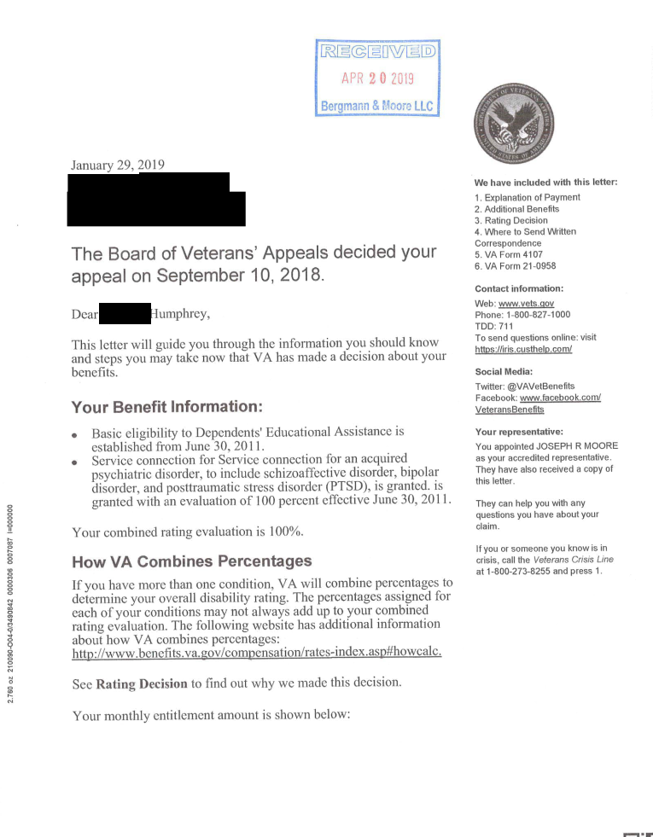
Grant of Benefits!
On January 29, 2019, VA effectuates a Board grant of service connection for PTSD and assigns a 100 percent schedular rating, effective June 30, 2011, resulting in past due benefits of $258,100.

Slide 57
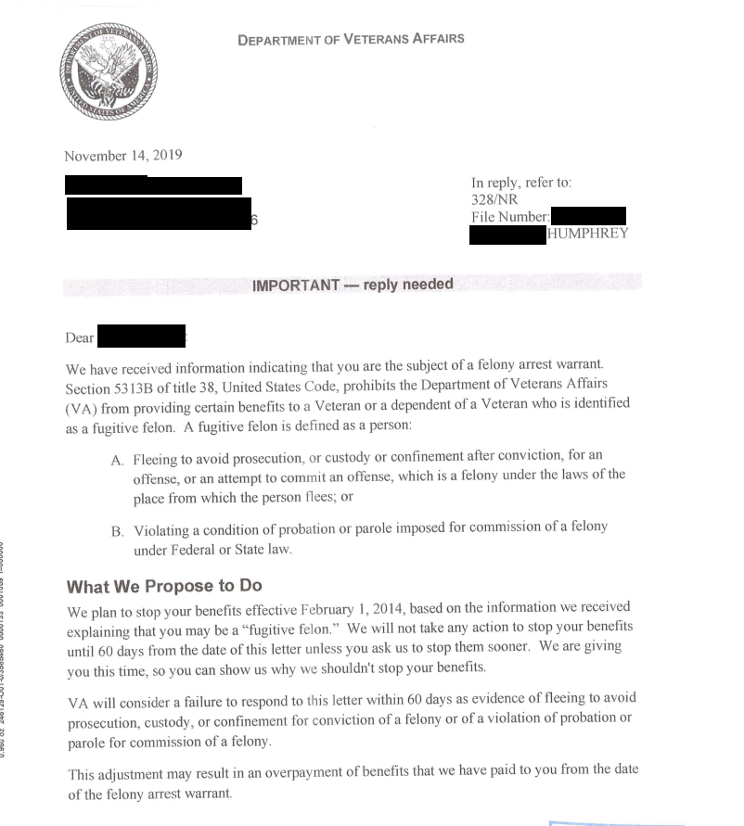
Yikes!
In November 2019, VA notifies the Veteran that they received information that he was the subject of a felony arrest warrant and that they plan to stop benefits effective February 1, 2014.
They provide 60 days to respond before stopping benefits.

Slide 58
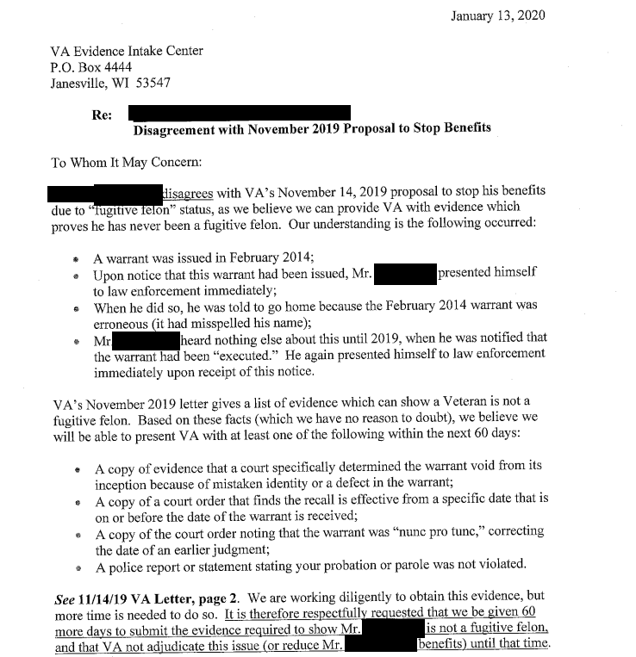
Our Initial Response
Within 60 days we expressed our disagreement with VA’s proposal to stop benefits, explaining why the Veteran was not a fugitive felon.
We request 60 more days to submit evidence, as we were waiting for evidence from the local authorities.

Slide 59
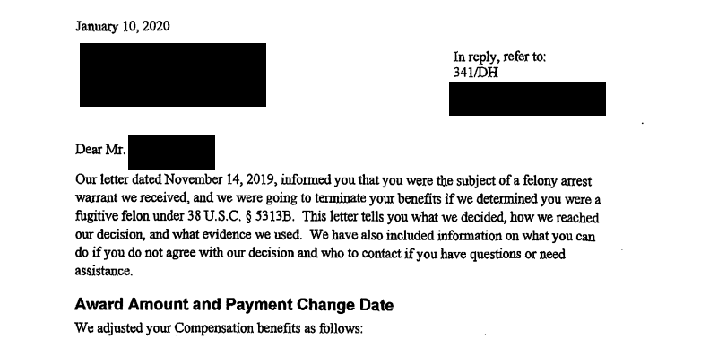
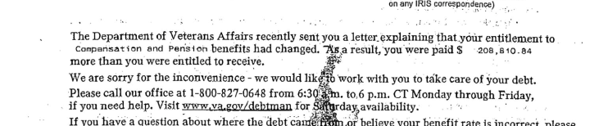
VA Determination
Before the expiration of the 60 days, VA determines that the Veteran was a fugitive felon and stops his benefits as of February 1, 2014.
This action creates an overpayment of $208,810.84.

Slide 60
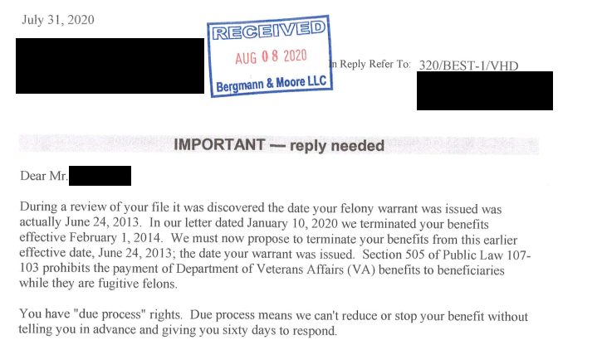
VA Proposes to Add to It
In July 2020 VA proposed to create a larger overpayment because the felony warrant was issued on June 24, 2013 instead of February 1, 2014, which would increase the debt to $229,264.00.

Slide 61
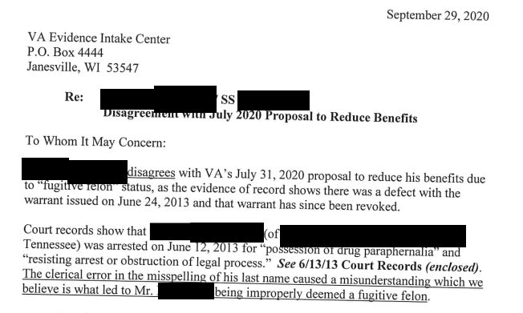
Our Reply
We replied in September 2020 with all of the evidence we had gathered to that point.

Slide 62
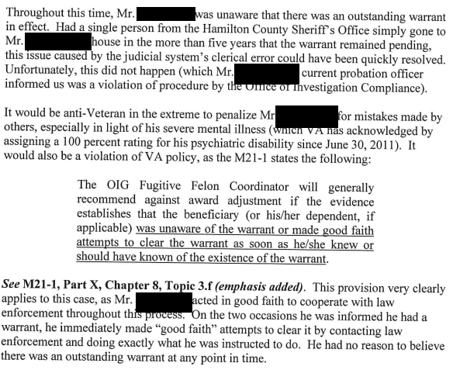
Legal Argument

Slide 63
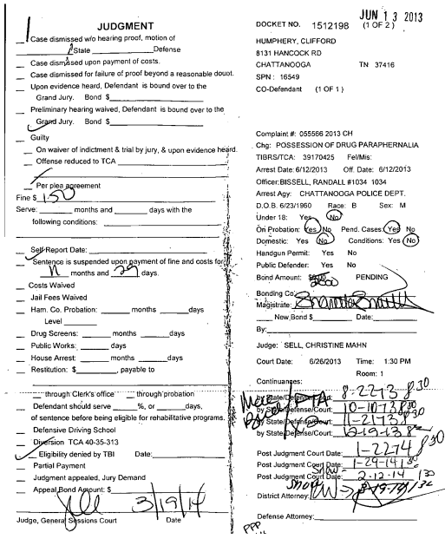
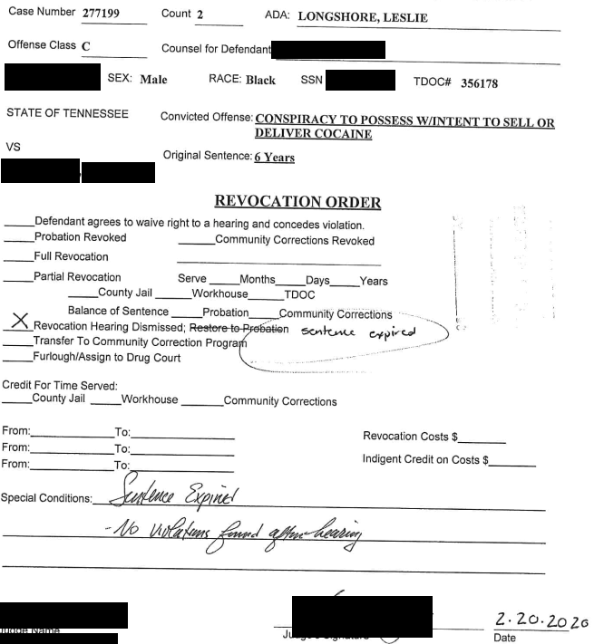
Our Reply Documents
The warrant and Court document with name misspelled.

Slide 64
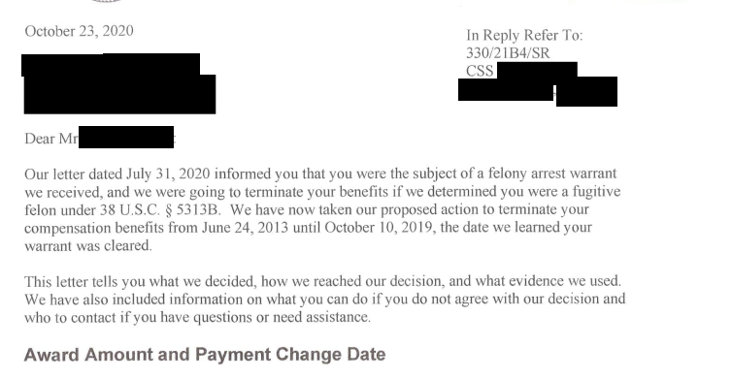
Subsequent Decision
In October 2020, the “fugitive felon” period was changed from June 24, 2013 (the date the warrant was issued) to October 10, 2019 (the date it was cleared), resulting in a total overpayment of $229,264.00.

Slide 65
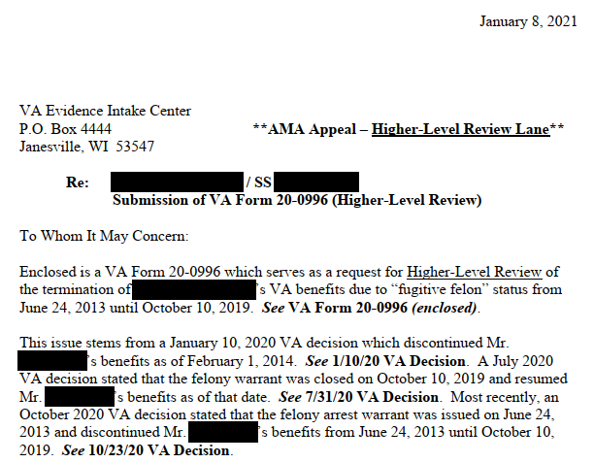
HLR Request
In January 2021, we filed a Higher-Level Review Request

Slide 66
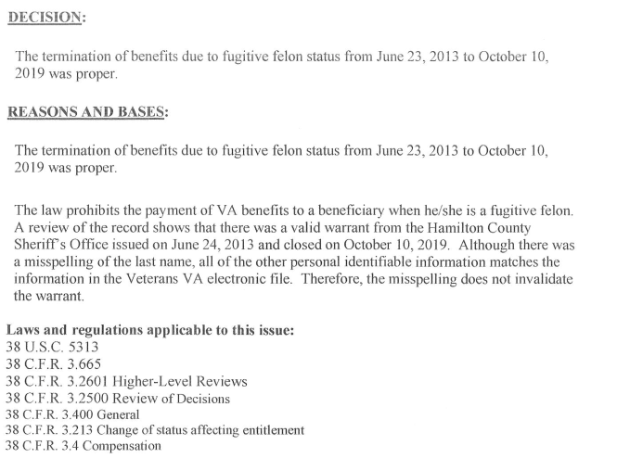
HLR Decision
On January 13, 2021, VA issued an HLR decision:

Slide 67
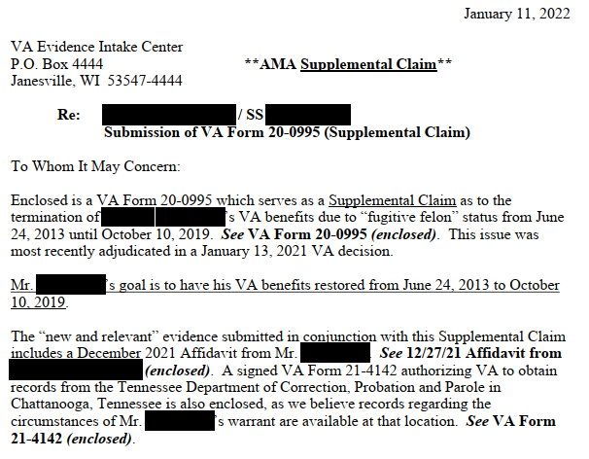
Supplemental Claim
In January 2022, we submitted a Supplemental Claim:

Slide 68
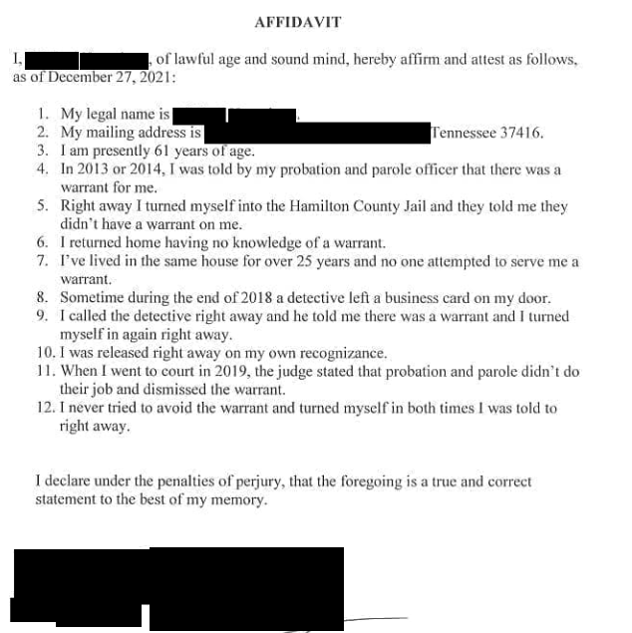
Evidence
Affidavit and VA Form 21-4142 for Sheriff’s records:

Slide 69
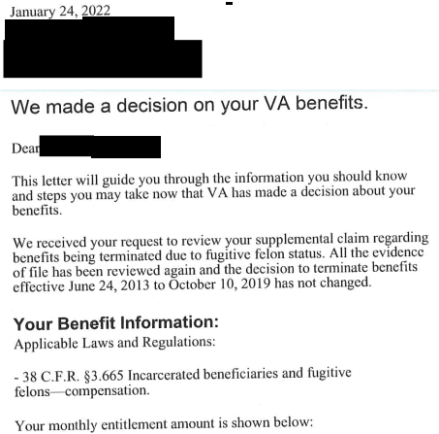
Supp. Claim Decision
On January 24, 2022, VA issued a supplemental claim decision letter (no actual rating decision):

Slide 70
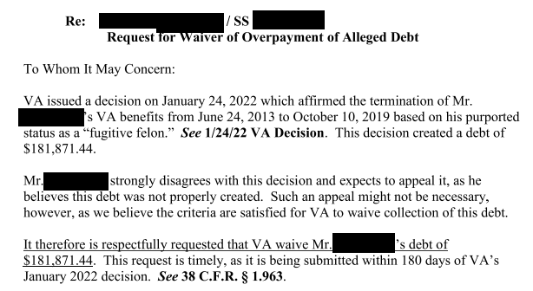
Waiver Request
In April 2022, we submitted a waiver request to the Committee on Waivers:

Slide 71
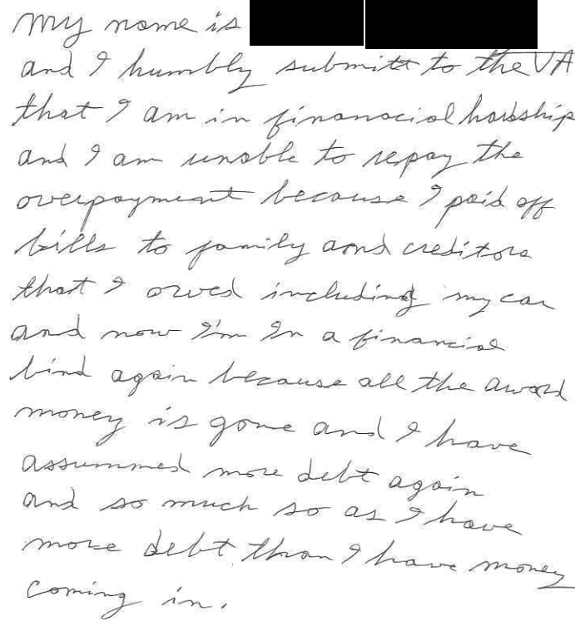
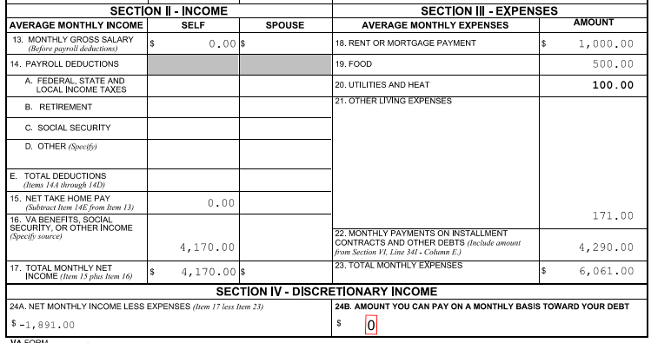
Evidence with Waiver Request
We included a VA Form 5655 and a statement from the Veteran:

Slide 72
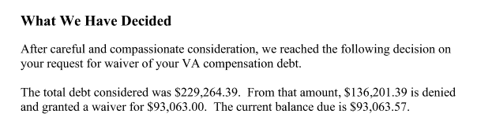
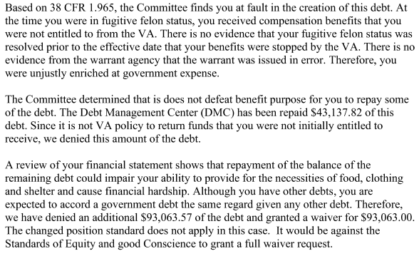
Waiver Decision
In June 2022, we received a decision which waived half of the remaining debt:

Slide 73
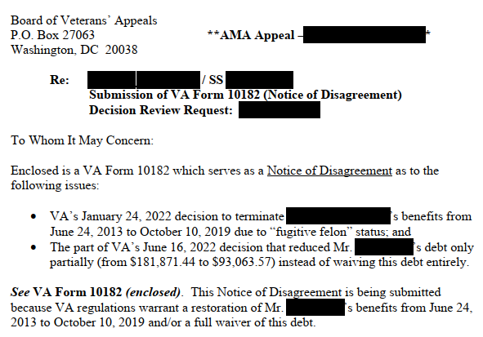
Appeal to the Board
Now that we have a decision on the validity and the waiver, we appealed to the Board:

Slide 74
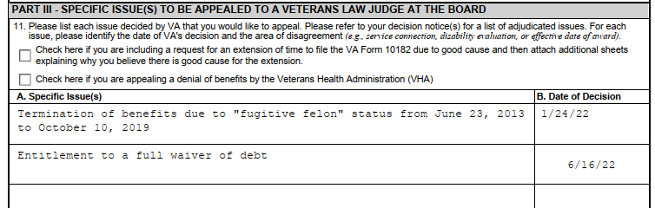
Notice of Disagreement

Slide 75
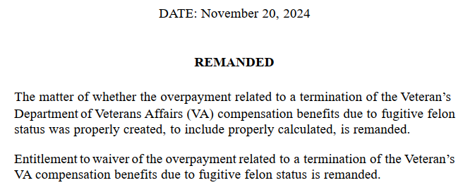
BVA Decision
In November 2024, the Board remands the appeal but includes very favorable language:

Slide 76
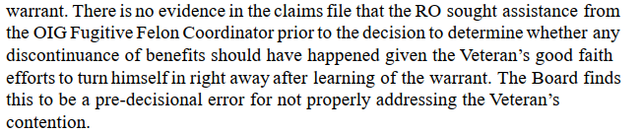
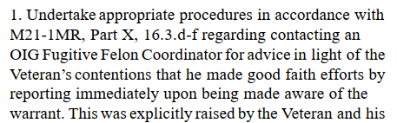
Board’s Language

Slide 77
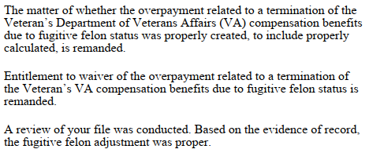
VA Decision
After reaching out to OIG asking for information about the warrant, OIG merely sent another copy of the warrant.
In a January 13, 2025 letter, VA found the debt valid:

Slide 78
Off to the Committee on Waivers
After several months of being assured that the waiver question had been forwarded to the Committee on Waivers and Compromises, we formally requested adjudication of the issue.
On August 5, 2025, the Committee requested a 5655, which we provided (monthly expenses were now $2,308 more than income).
Despite the 5655 being signed on August 6, 2025, the Committee responded that it was more than a year old and requested an updated 5655 – we called and pointed out their mistake.

Slide 79
Committee’s Next Decision
On September 11, 2025 the Committee sent a letter to our client (failed to cc us), advising that they waived half the debt on June 16, 2022 but he failed to appeal that decision:

Slide 80
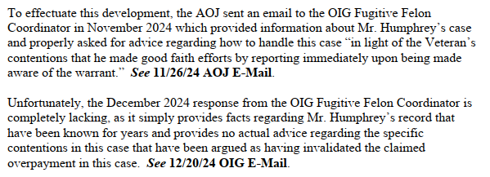
Meanwhile, back at the RO . . .
We filed a 10/8/25 HLR request on the validity issue (decided on 1/13/25), pointing the OIG’s failure to provide the information requested:

Slide 81
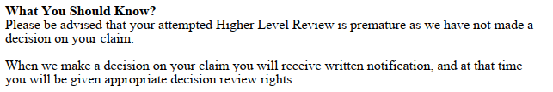
VA responds
We were equally puzzled:

Slide 82
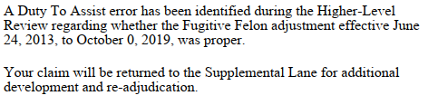
After a call to a DROC employee
On November 18, 2025, we were notified that a DTA error had been made and they were kicking the validity issue back to the Supplemental Claim Lane:

Slide 83
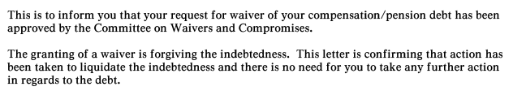
Back at the Committee . . .
In a 12/3/25 letter from the Committee on Waivers, the remaining debt was waived:

Slide 84
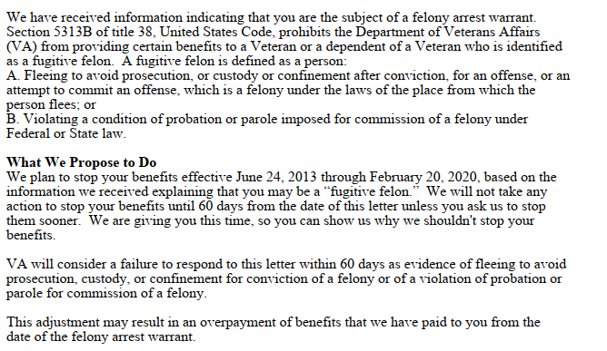
Supp. Claim Lane
Things have taken a turn (but now how we anticipated). In a December 30, 2025 letter:

Slide 85
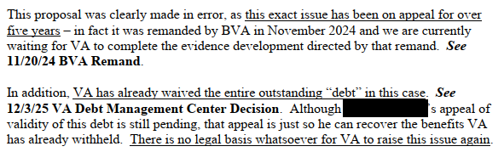
Our response

Slide 86
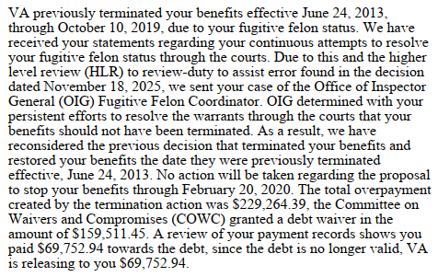
VA Decision
In a May 1, 2026 decision, VA finds the debt not valid!

Slide 87
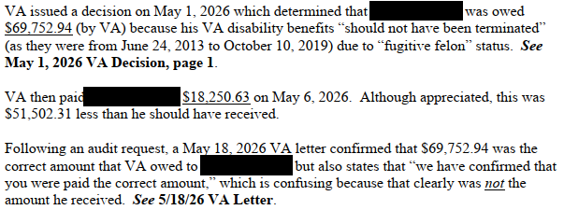
But it’s not over
On May 6, 2026, our client was paid $18,250.63 of the $69,752.94 that he’s owed.

Slide 88
Finally . . .
On July 6, 2026 our client was paid in full!

