Slide 1
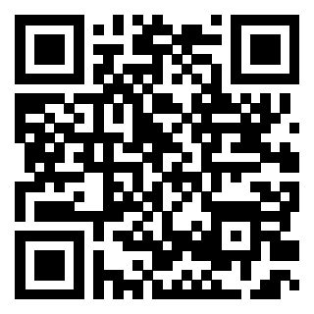
Recent Court Opinions
Mar. 2026 – Sept. 2026
CALVET/California Association of County Veteran Services Officers
2026 Fall Training Conference
October 11-16, 2026
https://bergmannmoore.participoll.com/

Slide 2
Polling Test Question
https://bergmannmoore.participoll.com/
How many decisions did the CAVC issue in FY2026 (Oct. 2025-Sept. 2026)?
Under 5,000
5,000-7,999
8,000-9,999
10,000-10,999
11,000-11,999
Over 12,000
A
B
C
D
E
F
0
Notes:
The answer is 10%
DC 6260 is one of only a few DCs that have a single rating for a disability. If a Veteran is service connected for tinnitus, then the only possible rating is 10%.
[click to appear]
It is important to be aware that some DCs include “Notes” that should be read to see if they apply to the Veteran’s situation.
These notes are binding.

Slide 3
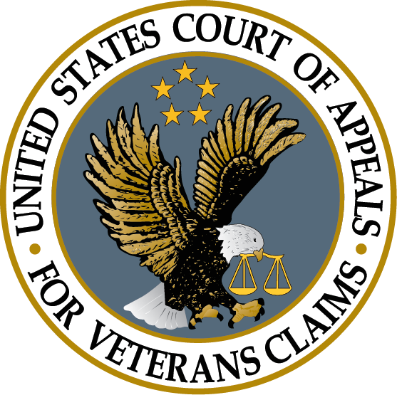
Polling Test Answer
11,000-11,999
The Chief Judge stated on Sept. 29th that the Court was on track for between 11,100 and 11,200 appeals.
This is another record number!
When the Chief was appointed in 2017, there were 4,040 appeals.
Notes:
The answer is 10%
DC 6260 is one of only a few DCs that have a single rating for a disability. If a Veteran is service connected for tinnitus, then the only possible rating is 10%.
[click to appear]
It is important to be aware that some DCs include “Notes” that should be read to see if they apply to the Veteran’s situation.
These notes are binding.

Slide 4
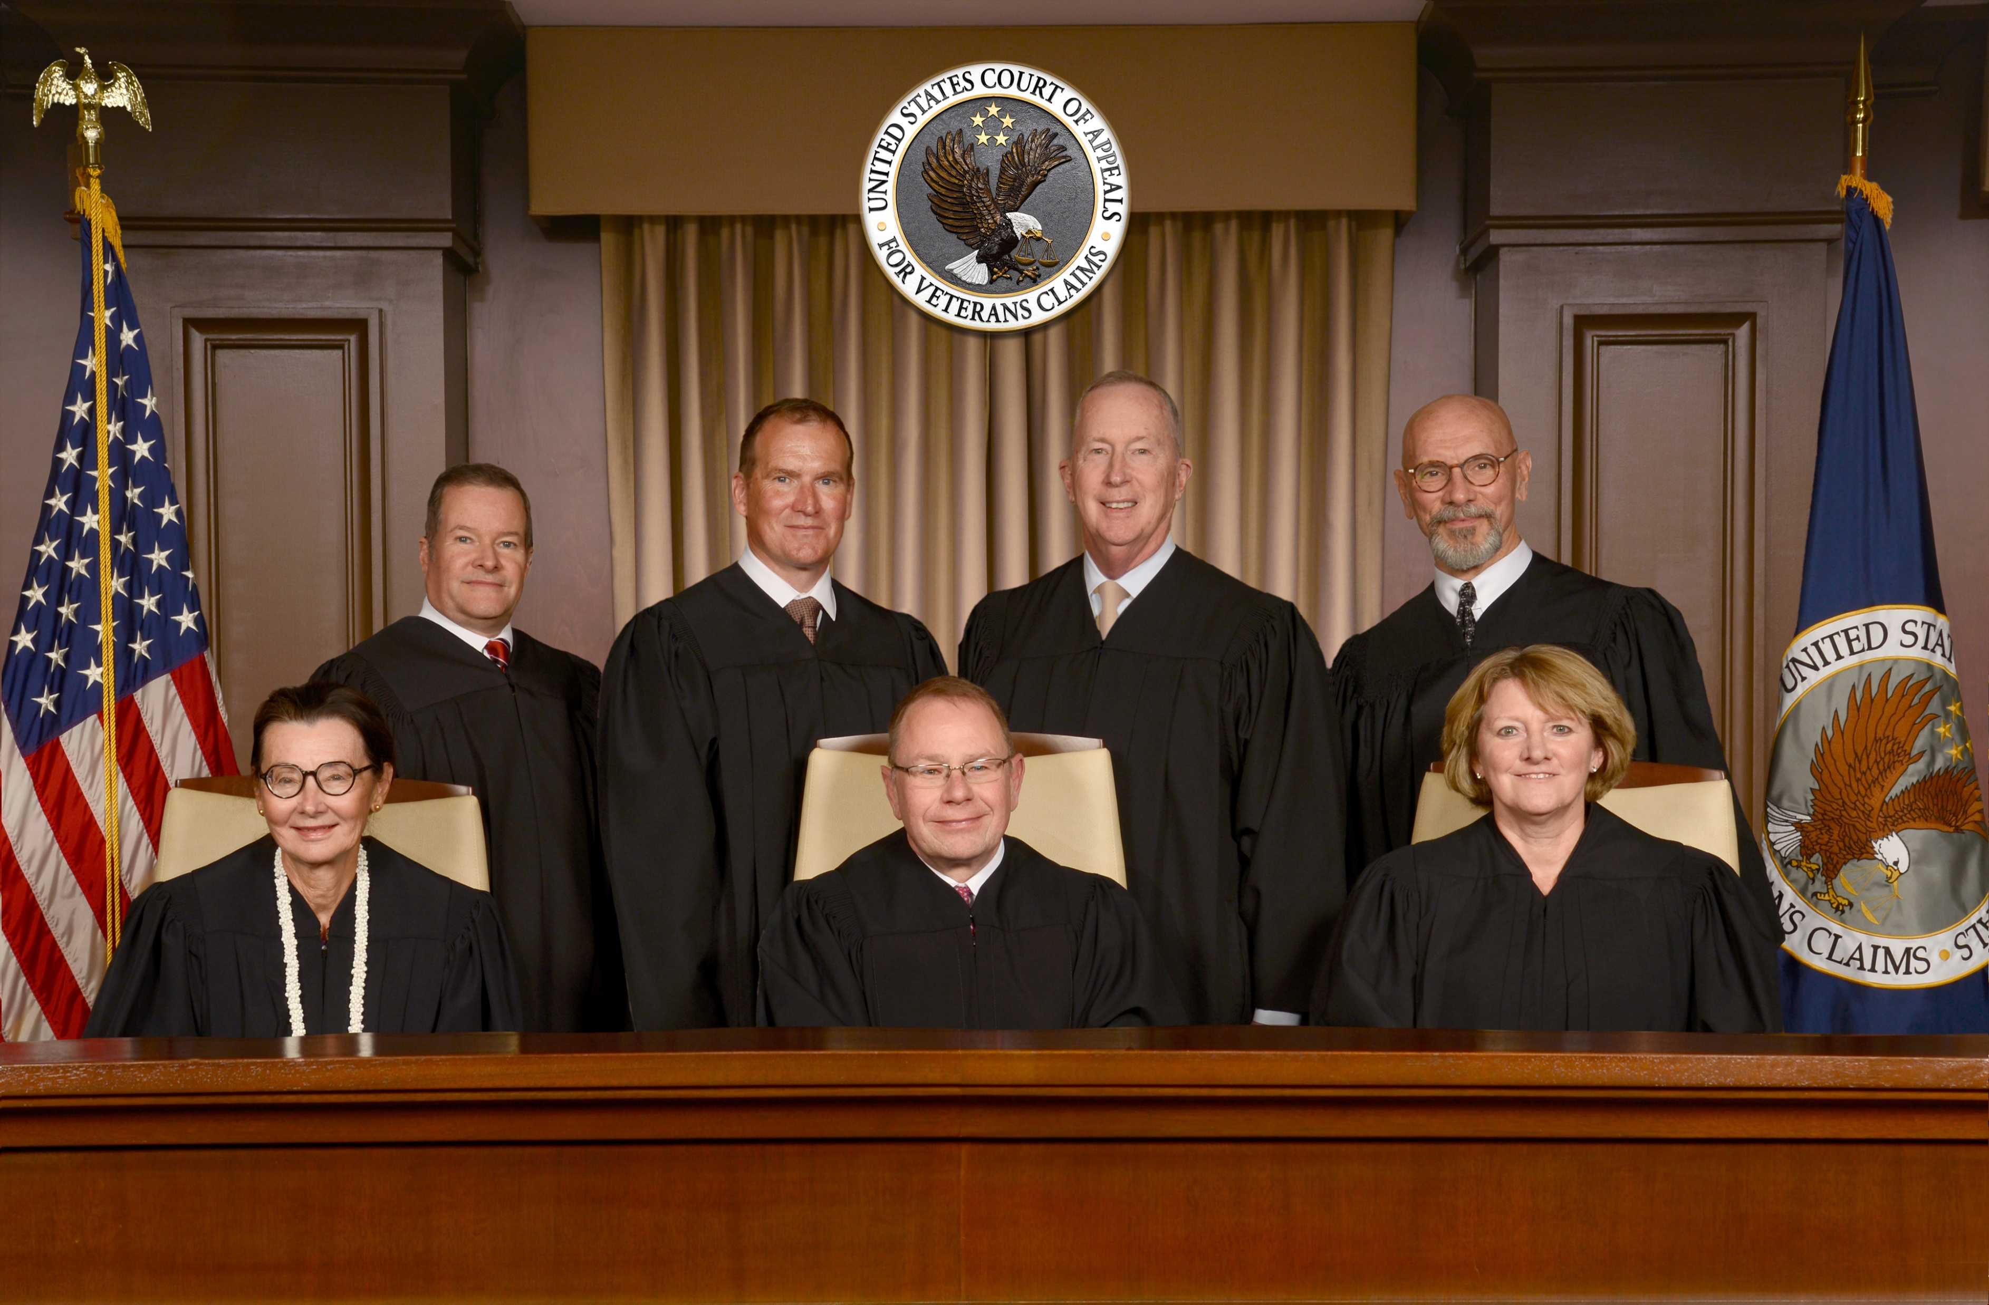
CAVC Vacancies
The CAVC is authorized to have ten judges.
The Court currently has seven judges.
There are three vacancies that need to be filled, and confirmation hearings were held in September for four (based upon a pending departure in March).
  It is unclear whether the Senate will act on these.
Wait times at the CAVC are very likely to rise sharply if these positions are not filled.
Notes:
It’s also important to recognize that the process doesn’t end when you complete the request.
Hopefully, the doctor will send the evidence back to you.
At this point, you need to read what the doctor provided and decide what to do next.
Review the documents before submitting them. Don’t submit records without looking at them.
[click] The first thing you want to do is to make sure that it is complete and accurate.
If there is a minor problem, contact the doctor to see if you can obtain a clarification.
[click] If there is a significant problem, you will likely need to contact the Veteran to sort out what happened.
Hopefully, the issue can be fixed.
But sometimes a Veteran misinterprets what their doctor is saying or the medical evidence turns out to problematic for some reason. Ultimately, [click] you are not required to submit evidence to VA that you think is bad for the Veteran.
Assuming that you get useful evidence, [click] now you have to decide how to use it.

Slide 5
Learning Objectives
Learn about important recent court decisions.
  Review the different courts above VA.
  Learn about some recent court decisions.
  Learn arguments to make based off these recent decisions.
Notes:
In this lesson, we will learn about the federal courts over VA.
[click] To this this, we will identify the different courts over VA;
[click] Learn about some recent decisions from the courts;
[click] And learn about the implications of these recent decisions.

Slide 6
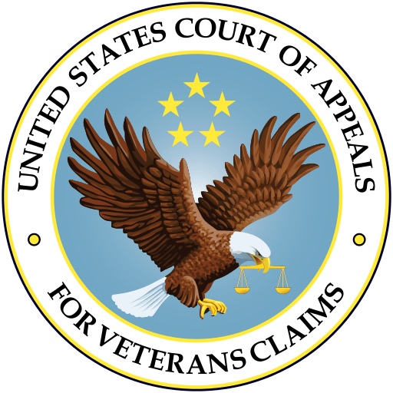
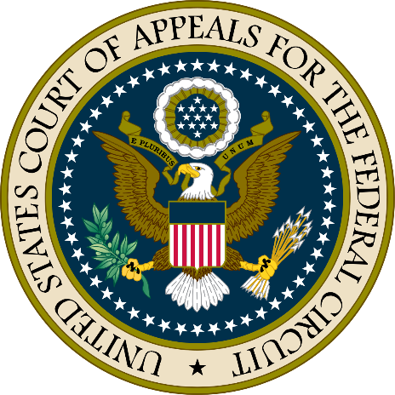
Brief Overview of VA’s Judicial Review
The Board of Veterans’ Appeals (Board) is the highest appellate body within VA.
Denials from Board can be appealed to the U.S. Court of Appeals for Veterans Claims (CAVC).
  CAVC handles only Board appeals from VA.
  Claimants cannot take VA appeals to any other court.
Denials from CAVC can be appealed to the U.S. Court of Appeals for the Federal Circuit (Fed. Cir.).
  Only decides questions of law.
  The next and highest court is the U.S. Supreme Court.
Notes:
Here is a brief overview of the federal courts that review decisions by VA.
[click] The Board of Veterans’ Appeals (Board) is the highest appellate body within VA.
Although its members are called judges, it is not a court. The employees work for VA.
[click] Denials from Board can be appealed to the Court of Appeals for Veterans Claims (CAVC).
[click] The CAVC handles only appeals from VA. Every type of VA benefit is handled by the CAVC, including education, healthcare, and other VA benefits.
[click] Claimants cannot appeal VA decisions to any other court.
[click] If the CAVC denies a claim, then that decision can be appealed to the U.S. Court of Appeals for the Federal Circuit
[click] However, that court only decides questions of law! So if the Veteran merely disagrees with the facts that were found or how the law was applied to those facts, then no further appeal is possible.
[click] If the Federal Circuit issues a ruling of law in a VA case, then it is possible to appeal to the U.S. Supreme Court, the highest court in our country.
However, the Supreme Court agrees to accept less than 1% of cases appealed to it. The Supreme Court decides a veteran law case only once every few years.

Slide 7

Freund v. Collins
39 Vet.App. 127 (2026)
Notes:
The first recent case we will talk about is Terry v. McDonough from the CAVC.

Slide 8
Freund Background
As far back as 1990, the Board’s legacy computer system (VACOLS) automatically closed appeals “on the first day of the month following” the expiration of the appeal period if a Form 9 was not entered into the system.
Thousands were closed erroneously, for example if the mail was received but just not logged in time.
No notice was sent to these Veterans.

Slide 9
Freund History
In 2021, Mr. Freund’s attorney petitioned to certify a class of Veterans whose appeals were improperly closed.
CAVC originally denied the class motion in 2022 as moot because Mr. Freund’s appeal was reopened.
In August 2024, the Federal Circuit found that the CAVC erred and remanded the case.
In December of 2025, the parties filed a Joint Motion to Approve the Proposed Settlement.

Slide 10
Expected Freund Notice
The class is based upon the period from December 12, 1990, to February 6, 2025.
Phase 1 – 28,000+ appeals with a timely Form 9 in VBMS
  VA will individually review and automatically reactivate.
  These Veterans will receive notice of the date of the SOC and appeal that has been reactivated.
Phase 2 – 64,000+ appeals with a VA Form 21-4138 in VBMS
  VA will attempt to screen out blank 21-4138s.
  Remaining Veterans will receive generic notice that they may have had an appeal improperly closed.
  If they respond within one year, VA will review for reactivation.

Slide 11
Timing and process
The CAVC held a hearing on August 13th and approved the plan on August 19th. Notice letters targeted for November 12th.
Once letters go out, representatives may need to examine what was filed within the relevant timeframe and submit argument that there was a valid appeal.
Once the legacy appeal is reopened, the claimant will need help with the merits.
VBA will likely send a Supplemental Statement of the Case and there will be an opportunity to opt into the AMA system at that point.

Slide 12
Look for Pending Appeals
Regardless of whether a veteran gets a Freund letter, be on the lookout for unprocessed substantive appeals.
If a substantive appeal was filed within 60 days of an SOC or within the remainder of one year of the rating decision.
  If no action was taken this may be a case where VACOLS improperly closed the appeal.
Help the client contact VA and ask for their appeal to be reactivated.
Freund is not the only pending class action where courts are ordering notice letters!

Slide 13

Jones v. Collins
39 Vet.App. 154
(2026)
Insert picture
Notes:
The next recent case we will talk about is Witkowski v. Collins from the CAVC.

Slide 14
Veteran Lawrence Jones filed an untimely appeal to the Board. In response, the Board sent him a standard form letter noting that his 10182 was untimely and explaining that he could request a good cause extension by submitting a written request to the Board within 60 days. Instead of a filing a written request, he filed an appeal to the CAVC within that time frame challenging the determination that his appeal was untimely.
Was the attempt to appeal the letter from the Board proper?
Yes. The letter effectively dismissed the appeal and, therefore, was a final, appealable decision.
No. The Veteran must respond to the letter and receive a good-cause determination by a VLJ before the CAVC can review the issue of timeliness.
A
B
0

Slide 15
Jones v. Collins
No. The Veteran must respond to the letter and receive a good-cause determination by a VLJ before the CAVC can review the issue of timeliness.
The CAVC held that the Board’s generic form letter was not a final decision and, therefore, was not appealable.
The Court distinguished its July 2024 decision in Cardoza v. McDonough, which held that an individualized letter signed by a Veterans Law Judge dismissing an appeal did constitute a final, appealable Board decision.
You must respond to a generic form letter even if the Veteran explained the good cause in the original submission!
Notes:
[click] The answer here is No. Referral to the Director of Comp Service is not a legal requirement.
[click] The CAVC held that the Board does have jurisdiction to decide extraschedular TDIU in the first instance.
[click] This decision overturned an earlier CAVC decision in Bowling v. Principi which had required Director review before the Board could act. Accordingly, if you knew how the system worked before, now it is different.
As an advocate, it is up to you to decide whether to waive referral.
[click] Waiving referral to the Director may lead to a quicker decision. However, you are also giving up a bite at the apple. There isn’t one right answer for all situations.

Slide 16
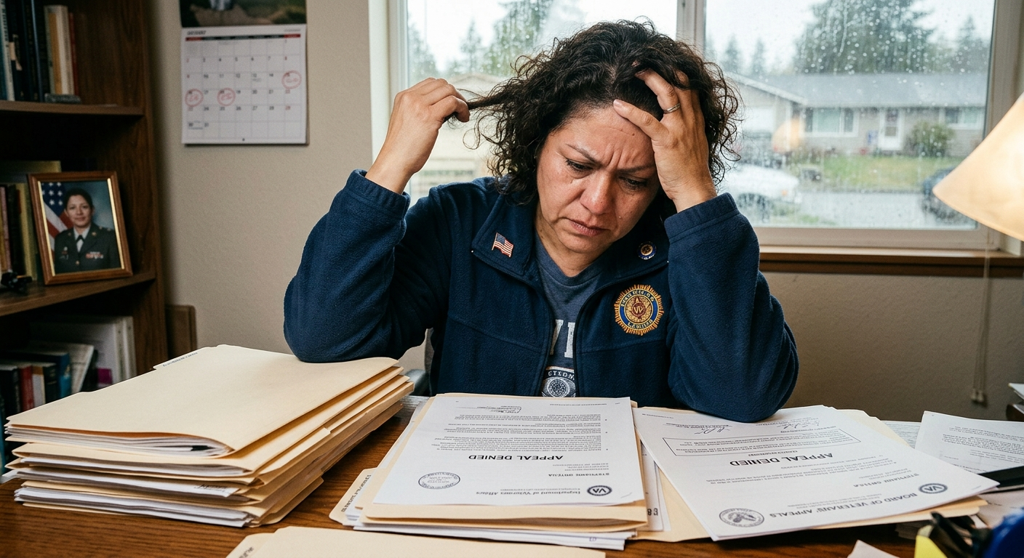
Ortega v. Collins
39 Vet.App. 182 (2026)
Insert picture
Notes:
The next recent case we will talk about is Witkowski v. Collins from the CAVC.

Slide 17
Veteran Stephanie Ortega appealed a VA decision and selected the evidence docket. The Board received her Notice of Disagreement (NOD) on November 5, 2020, starting a 90-day window, running through February 3, 2021, to submit additional evidence. The Board did not send its docketing letter confirming that window until February 4, 2021, one day after the window had already closed. In January 2023, Ms. Ortega submitted additional records, which the Board declined to consider as untimely.
Was the Board’s decision correct?
Yes. The records were not submitted during the evidence window.
No. The Veteran was not properly notified of when the evidence window began and ended.
A
B
0

Slide 18
Ortega v. Collins
Yes. The records were not submitted during the evidence window.
The CAVC held a Veteran’s due process rights are not violated when the Board of Veterans' Appeals (Board) issues a docketing letter after the 90-day deadline to submit evidence has already passed, so long as the Veteran was not prejudiced by the delay.
Docketing letters are frequently delayed so always submit additional evidence with the NOD or as promptly as possible thereafter.
Separately, the CAVC also held that an unfavorable finding of fact that the agency of original jurisdiction (AOJ) mistakenly labels as a favorable finding is not binding on VA.
Notes:
[click] The answer here is No. Referral to the Director of Comp Service is not a legal requirement.
[click] The CAVC held that the Board does have jurisdiction to decide extraschedular TDIU in the first instance.
[click] This decision overturned an earlier CAVC decision in Bowling v. Principi which had required Director review before the Board could act. Accordingly, if you knew how the system worked before, now it is different.
As an advocate, it is up to you to decide whether to waive referral.
[click] Waiving referral to the Director may lead to a quicker decision. However, you are also giving up a bite at the apple. There isn’t one right answer for all situations.

Slide 19

Ford v. Veterans Guardian VA Claim Consulting, LLC
No. 1:23-CV-756
(M.D.N.C. Jun. 15, 2026)
Notes:
The next recent case we will talk about is Witkowski v. Collins from the CAVC.

Slide 20
Ford May 20 ruling
The U.S. District Court for the Middle District of North Carolina has granted summary judgment in favor of the plaintiff Veterans on a key threshold question.
It held that Veterans Guardian VA Claim Consulting, LLC was acting as an unaccredited VA agent when it prepared and presented Veterans’ disability claims for a fee, in violation of federal law.
This is not a preliminary procedural ruling; it is an established finding of fact that will carry into the remaining proceedings.
Notes:
[click] The answer here is No. Referral to the Director of Comp Service is not a legal requirement.
[click] The CAVC held that the Board does have jurisdiction to decide extraschedular TDIU in the first instance.
[click] This decision overturned an earlier CAVC decision in Bowling v. Principi which had required Director review before the Board could act. Accordingly, if you knew how the system worked before, now it is different.
As an advocate, it is up to you to decide whether to waive referral.
[click] Waiving referral to the Director may lead to a quicker decision. However, you are also giving up a bite at the apple. There isn’t one right answer for all situations.

Slide 21
Ford June 15 ruling
The Court granted partial summary judgment in favor of the defendant, Veterans Guardian VA Claim Consulting, LLC.
The order holds that claims arising on or after October 1, 2025, do not constitute an unfair trade practice under the North Carolina Unfair and Deceptive Trade Practices Act (UDTPA) or the North Carolina Debt Collection Act (NCDCA) because the North Carolina legislature passed a law that explicitly defined unaccredited representation as not an unfair practice.
This narrows the class’s damages exposure, but does not affect claims arising before that date.
Notes:
[click] The answer here is No. Referral to the Director of Comp Service is not a legal requirement.
[click] The CAVC held that the Board does have jurisdiction to decide extraschedular TDIU in the first instance.
[click] This decision overturned an earlier CAVC decision in Bowling v. Principi which had required Director review before the Board could act. Accordingly, if you knew how the system worked before, now it is different.
As an advocate, it is up to you to decide whether to waive referral.
[click] Waiving referral to the Director may lead to a quicker decision. However, you are also giving up a bite at the apple. There isn’t one right answer for all situations.

Slide 22
Ford August 6 ruling
The Court granted summary judgment in favor of the plaintiff Veterans on the ultimate issue of liability.
The order holds that Veterans Guardian’s unlawful behavior renders them liable.
The court rejected the defense that Veterans were not harmed because they willingly paid the company.
This means that the issue is now what damages Veterans Guardian owes the plaintiffs.
Notes:
[click] The answer here is No. Referral to the Director of Comp Service is not a legal requirement.
[click] The CAVC held that the Board does have jurisdiction to decide extraschedular TDIU in the first instance.
[click] This decision overturned an earlier CAVC decision in Bowling v. Principi which had required Director review before the Board could act. Accordingly, if you knew how the system worked before, now it is different.
As an advocate, it is up to you to decide whether to waive referral.
[click] Waiving referral to the Director may lead to a quicker decision. However, you are also giving up a bite at the apple. There isn’t one right answer for all situations.

Slide 23

De Hart v. Collins
__ F.Appx. ___
2026 U.S. App. LEXIS 18635
(Jun. 26, 2026)
Notes:
The first recent case we will talk about is Terry v. McDonough from the CAVC.

Slide 24
In 2009, Mai De Hart appealed a rating decision that assigned a noncompensable (0 percent) rating for her spine and the issue has been on appeal ever since. In 2019, during the course of the appeal, the RO issued a rating decision granting service connection for bilateral lower extremity radiculopathy due to her back disability and assigned separate ratings and effective dates. When the back rating returned to the Board in 2021 the Board said it did not have jurisdiction over the radiculopathy ratings because Ms. De Hart had not filed a Notice of Disagreement with the 2019 rating decision. Does a Veteran have to separately appeal the neurological ratings associated with a back condition if the back rating was already on appeal when service connection is granted for the secondary conditions?
Yes. VA diagnostic codes do not make secondary symptoms automatically part of an appeal of a back rating.
No. A Veteran is not expected to understand that these back symptoms are considered legally separate.
A
B
0

Slide 25
De Hart v. Collins
Yes. The legal status of the primary rating does not transfer to the secondary rating.
The Federal Circuit affirmed the CAVC holding that “distinct and separately evaluated neurological complications do not remain part and parcel of the underlying spine condition claim for appellate purposes.”
This holding is hard to square with the decision in Chavis v. McDonough, 34 Vet.App. 1 (2021), which said that a Veteran does not have to file a separate claim for secondary neurological problems related to a back condition.
The Federal Circuit’s decision rejected the argument that VA regulations make secondary nerve symptoms automatically part of a back claim as a matter of law.
This leaves open the door to argue in a particular case that the scope of the claim includes secondary symptoms based upon the Veteran’s expressed intent.
When in doubt, if the RO issues a separate rating decision for secondary symptoms, then file a separate appeal.
Notes:
[click] The answer here is that The Veteran can appeal the original decision because he was still within a year of that decision.
[click] The CAVC held that that the relevant AMA statute, 38 U.S.C. § 5104C(a), unambiguously permits the claimant to file more than one administrative review request in response to, and within 1 year of, a VA decision.
[click] This is important because creates the opportunity to preserve a Veteran’s effective date by continuously pursuing a merits decision even if the Veteran filed a Supplemental Claim that was not supported by new and relevant evidence.
Look for this issue when a Veteran comes to you after an unsuccessful Supplemental Claim. If possible, do not get caught up fighting over whether evidence was new and relevant. If you lose that fight, the Veteran can lose continuous pursuit and the best effective date
To be clear: Advocates should choose whichever type of review is appropriate in their best judgment. However, frame it as a dispute with the most recent decision on the merits rather than a denial of reopening if you are filing within a year of the merits decision. Of course, if it has been more than a year, then you’ll have to attack the Supplemental Claim decision.
.

Slide 26
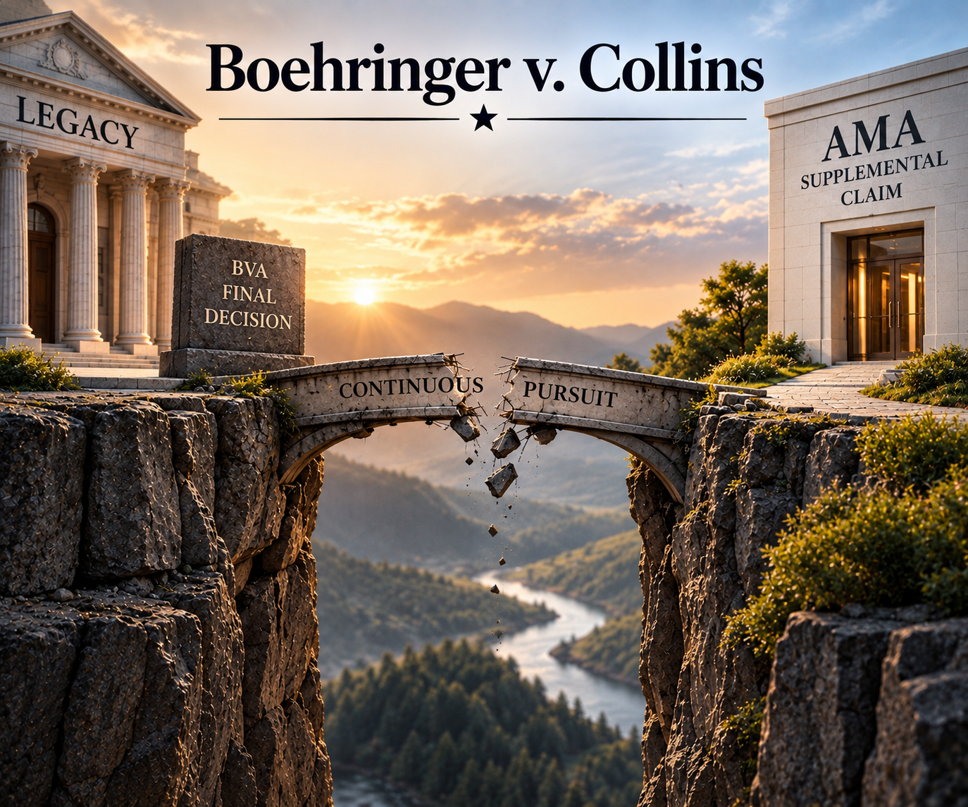
Boehringer v. Collins
__ Vet.App. __
(Jul. 15, 2026)
Notes:
The next recent case we will talk about is Witkowski v. Collins from the CAVC.

Slide 27
Veteran David Boehringer’s claim was denied in the legacy system in an October 2021 Board decision. Within a year, he filed a Supplemental Claim, which was eventually granted. For purposes of determining his effective date, can he be awarded benefits based upon the date of his legacy claim because he continuously pursued the matter by filing a Supplemental Claim within a year of the legacy Board decision?
Yes. The new claim was filed in the AMA system and continuous pursuit applies to all AMA claims.
No. The legacy and AMA systems are completely separate so it is not possible to continuously pursue a final legacy decision with a timely AMA claim.
A
B
0

Slide 28
Boehringer v. Collins
No. The legacy and AMA systems are completely separate so it is not possible to continuously pursue a final legacy decision with a timely AMA claim.
The CAVC held that Congress did not intend for Veterans to get the benefit of continuous pursuit outside the AMA system.
The Court recognized that the language of the AMA did not directly prohibit the application of continuous pursuit after a final legacy decision, but conclude that the overall context indicates that Congress did not want continuous pursuit to apply.
This holding is going to be important for legacy cases reactivated under Freund!
Notes:
[click] The answer here is No. Referral to the Director of Comp Service is not a legal requirement.
[click] The CAVC held that the Board does have jurisdiction to decide extraschedular TDIU in the first instance.
[click] This decision overturned an earlier CAVC decision in Bowling v. Principi which had required Director review before the Board could act. Accordingly, if you knew how the system worked before, now it is different.
As an advocate, it is up to you to decide whether to waive referral.
[click] Waiving referral to the Director may lead to a quicker decision. However, you are also giving up a bite at the apple. There isn’t one right answer for all situations.

Slide 29
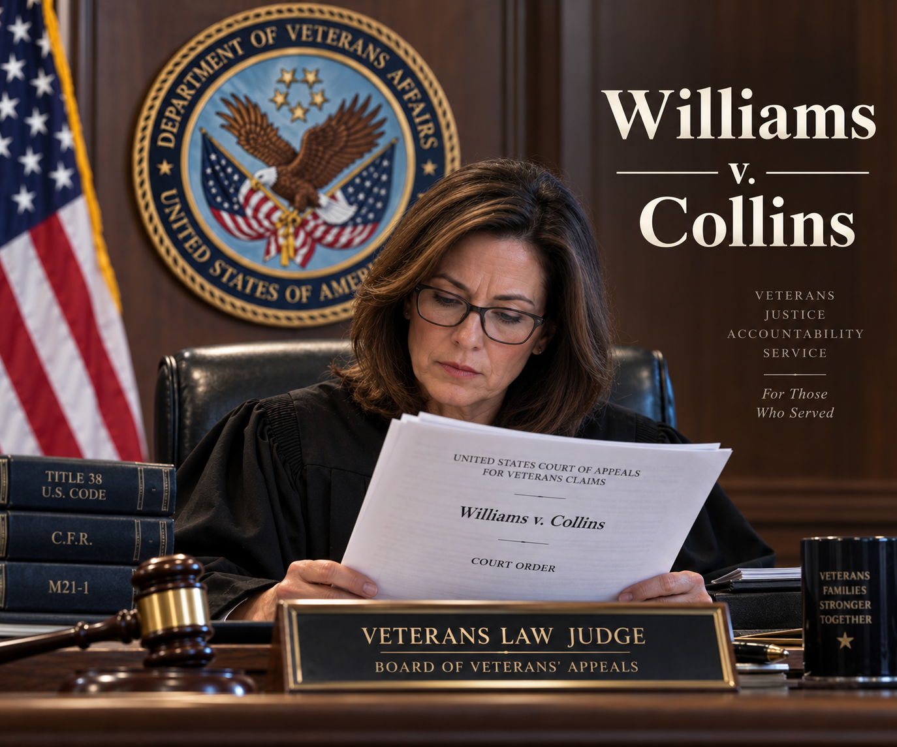
Williams v. Collins
__ Vet.App. __
(Jul. 27, 2026)
Needs image
Notes:
The next case we will talk about is Cash v. Collins from the CAVC.

Slide 30
Veteran John Williams was denied an increased rating for PTSD by the Board and appealed to the CAVC. At the Court, he argued that his claim reasonably raised TDIU, but the Board failed to address it.
Could the CAVC issue a “limited” remand of the issue directing the Board to address whether TDIU was raised and then returning the case to the Court without further action regardless of what the Board decided?
Yes. The Court has the power to seek clarification of Board decision before making a final ruling.
No. The failure to address a reasonably raised issue requires remand for the Board to take all appropriate actions.
A
B
0

Slide 31
Williams v. Collins
Yes. The Court has the power to seek clarification of Board decision before making a final ruling.
This is a really unusual outcome in a case that presents a very routine issue!
It is not clear that this will become a regular practice, but you should be aware this exists.
On remand, the Board originally found that TDIU was raised and remanded the case to the RO for development in violation of the Court’s order. That decision was vacated and a different VLJ then issued a new decision finding TDIU was raised.
Notes:
[click] The answer here No. Mr. Cash directed the Board’s attention to this evidence during a valid AMA evidence window.
[click] The Fed. Circ. reversed “Because we determine that Mr. Cash satisfied the statutory evidentiary submission requirement by clearly and timely referring to his prior submission to the Board in his Notice of Disagreement addendum.”
[click] In appealing to the Board specifically identify evidence already in the file you would like them to review during a valid AMA evidentiary window.
Of course, it is still safer to resubmit that evidence if possible, but this is a very helpful decision.

Slide 32
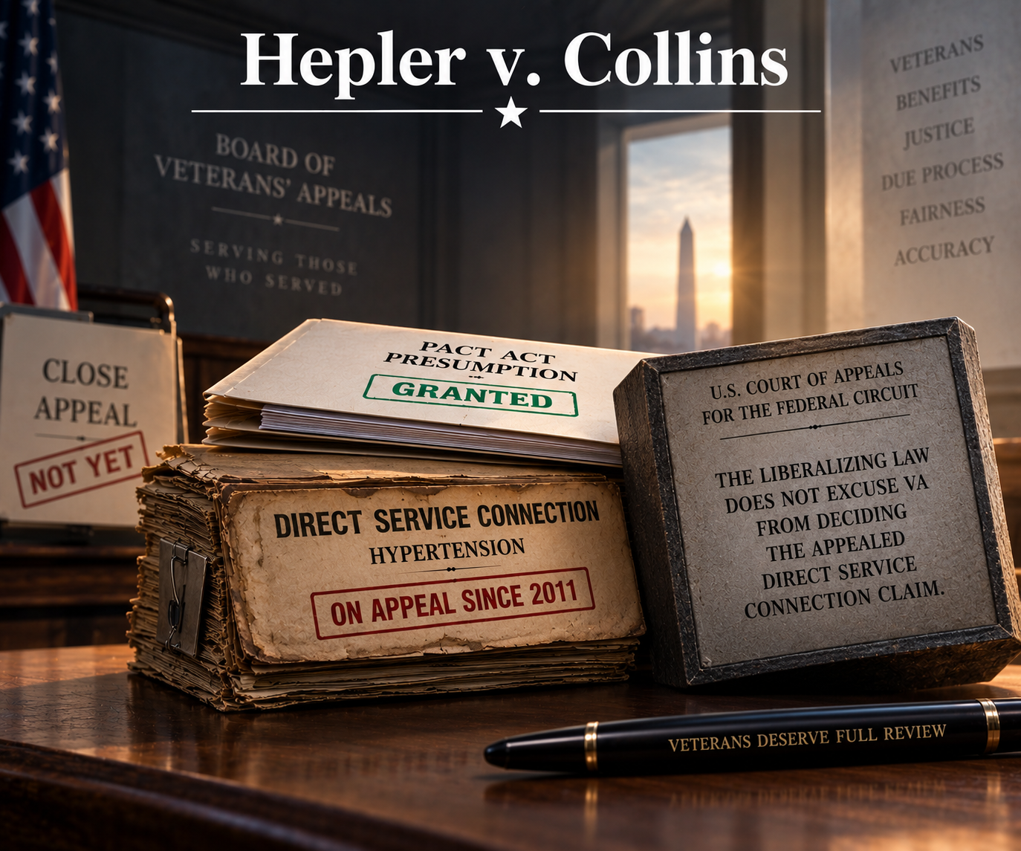
Hepler v. Collins
184 F.4th 1343
(Fed. Cir. 2026)
Notes:
The next case we will talk about is Cash v. Collins from the CAVC.

Slide 33
Vietnam Veteran Edward Hepler applied for direct service connection for hypertension and was denied. He appealed to the Board. His appeal was finally decided eleven years later and the claim was granted based upon the then-recent PACT Act. The Board noted that Mr. Hepler would be entitled to a more favorable effective date if his claim were granted on a direct basis but commented that he could raise this by disputing his effective date.
May the Board avoid deciding direct service connection by granting a claim based upon an intervening presumption?
Yes. The issue is service connection and the Board is granting service connection.
No. Direct service connection was properly appealed and it would provide more benefits.
A
B
0

Slide 34
Hepler v. Collins
No. Direct service connection was properly appealed, and it would provide more benefits.
This was a Bergmann & Moore case!
The Federal Circuit held that granting service connection based upon the PACT Act did not moot the issue of direct service connection.
The Court recognized that it would be unfair to make the Veteran appeal again to have the issue addressed when he had already done so once and waited eleven years.
Fortunately, the Board was mostly getting this right already.
Notes:
[click] The answer here No. Mr. Cash directed the Board’s attention to this evidence during a valid AMA evidence window.
[click] The Fed. Circ. reversed “Because we determine that Mr. Cash satisfied the statutory evidentiary submission requirement by clearly and timely referring to his prior submission to the Board in his Notice of Disagreement addendum.”
[click] In appealing to the Board specifically identify evidence already in the file you would like them to review during a valid AMA evidentiary window.
Of course, it is still safer to resubmit that evidence if possible, but this is a very helpful decision.

Slide 35
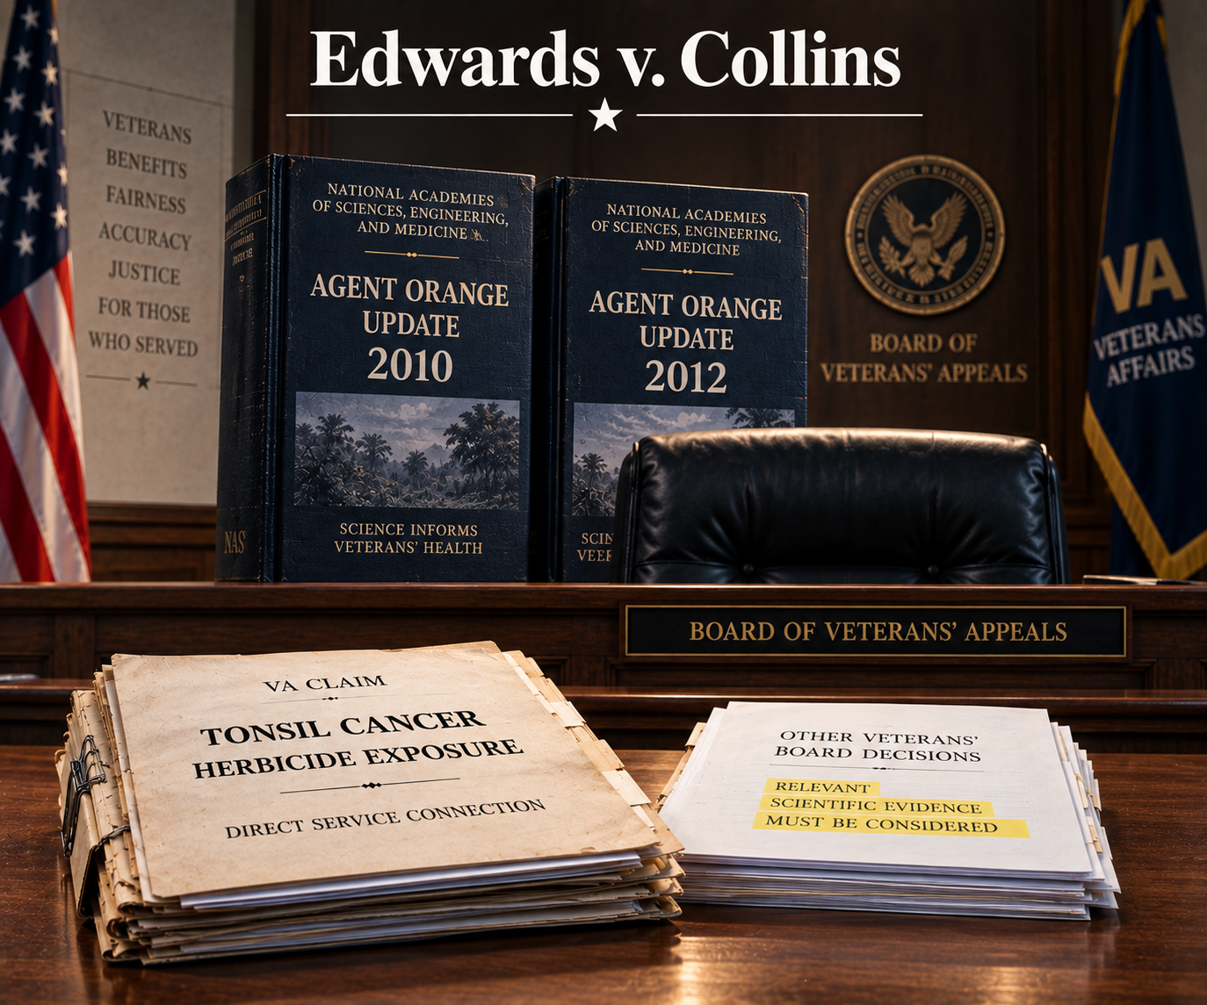
Edwards v. Collins
__ Vet.App. __
(Aug. 4, 2026)
Notes:
The next case we will talk about is Cash v. Collins from the CAVC.

Slide 36
Veteran Robert Edwards was exposed to herbicides in Vietnam and developed tonsil cancer, which is not a presumptive condition. He applied for service connection. The 2010 and 2012 NAS Agent Orange Updates discuss evidence tending to support his claim, but he did not submit these to VA.
Does VA have to consider these reports even though they were not submitted?
Yes. Euzebio v. McDonough held in 2021 that these are always constructively before VA.
No. Euzebio was a legacy case and constructive possession does not exist under the AMA.
A
B
0

Slide 37
Edwards v. Collins
Yes. Euzebio v. McDonough held in 2021 that these are always constructively before VA.
This was also a Bergmann & Moore case.
The Court held that nothing in the AMA indicates an intent to do away with the doctrine of constructive possession.
  But AMA evidence windows do apply! See Aviles-Rivera v. McDonough, 35 Vet.App. 268 (2022).
The Court also held that, when a Veteran submits Board decisions from other Veterans’ cases, VA must consider the information in those decisions even though they are not binding.
Notes:
[click] The answer here No. Mr. Cash directed the Board’s attention to this evidence during a valid AMA evidence window.
[click] The Fed. Circ. reversed “Because we determine that Mr. Cash satisfied the statutory evidentiary submission requirement by clearly and timely referring to his prior submission to the Board in his Notice of Disagreement addendum.”
[click] In appealing to the Board specifically identify evidence already in the file you would like them to review during a valid AMA evidentiary window.
Of course, it is still safer to resubmit that evidence if possible, but this is a very helpful decision.

Slide 38

Ley v. Collins
184 F.4th 1361
(Fed. Cir. 2026)
Notes:
The next case we will talk about is Cash v. Collins from the CAVC.

Slide 39
Mr. Ley is a Vietnam veteran. In 2012, he sought treatment for frequent and intensifying fatigue. Although his bloodwork indicated that he qualified for a diagnosis of leukemia, the VA doctor thought his condition was not bad and was not likely to develop into a more serious condition so he deliberately did not tell him that he had leukemia and “told him that maybe in 20 yrs he would need further investigation.” His condition progressed and in 2016 he was diagnosed with leukemia and awarded service connection on a presumptive basis after immediately applying for benefits. He appealed the effective date arguing that he would have applied four years earlier if the VA doctor had been honest about the nature of his condition. Can he be awarded an earlier effective date?
No. He did not apply until 2016 and the effective date cannot be earlier than the date of the application.
Yes. He was deceived into not applying for benefits by a VA employee who deliberately chose to hide the true nature of his condition.
A
B
0

Slide 40
Ley v. Collins
No. He did not apply until 2016 and the effective date cannot be earlier than the date of the application.
The Federal Circuit recognized that in Taylor v. McDonough, it held that the requirement to file a claim could be excused where a military secrecy oath prevented the Veteran from discussing his Edgewood Arsenal service for decades. 71 F.4th 909 (Fed. Cir. 2023) (en banc).
However, it held this exception did not apply because the Veteran knew he was sick and could have applied for benefits even without the critical information the VA doctor withheld.
Notes:
The answer here is No. He did not apply until 2016 and the effective date cannot be earlier than the date of the application.
[click] The CAVC held that there was no basis for excusing the requirements of 38 U.S.C. § 5110.
[click] The Court recognized that in the recent case of Taylor v. McDonough, the Federal Circuit held that the requirement to file a claim could be excused where a military secrecy oath prevented the Veteran from discussing his Edgewood Arsenal service for decades. 71 F.4th 909 (Fed. Cir. 2023) (en banc). In that case, the higher court recognized a constitutional exception where the government itself prevents the filing of a claim.
[click] The CAVC held that this exception did not apply because the Veteran knew he was sick and could have applied for benefits even without the critical information the VA doctor withheld.
We think this decision is wrong and the veteran has appealed it to the Federal Circuit. We will update you when that appeal has been decided, but that likely won’t be until early 2026.

Slide 41
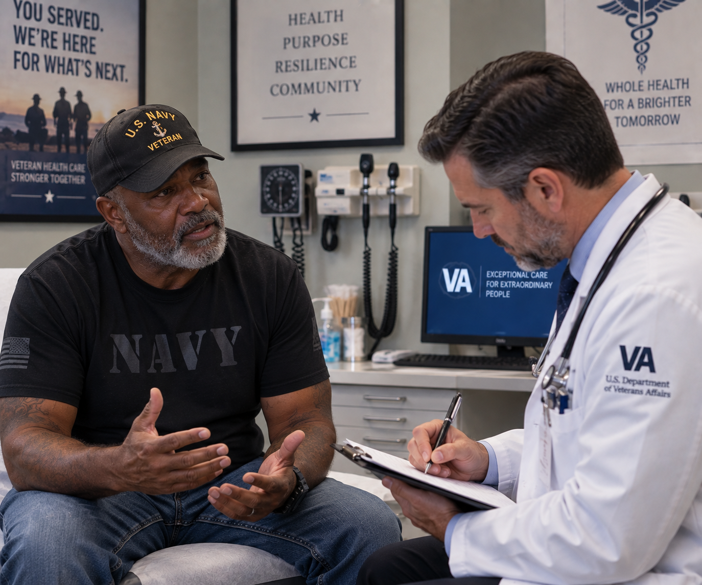
Hernandez v. Collins
___ F.4th ___
(Fed. Cir. Aug. 10, 2026)
Notes:
The next case we will talk about is Cash v. Collins from the CAVC.

Slide 42
Veteran Christopher Hernandez sought service connection for various conditions. The Board denied his claims finding that his private medical records reporting more recent onsets of his conditions were more persuasive than his statements in support of claim asserting that he has had symptoms since service. In doing so, the Board reasoned that the Veteran’s statements made to his doctors were more reliable because people seeking medical care have “inherent incentive to give the most accurate history to, in turn, receive the best or most appropriate medical care.”
May the Board find statements made to doctors are more reliable than statements made in support of a claim?
Yes. This is a traditional rule of how evidence is weighed.
No. Evidence rules do not apply to the VA system.
A
B
0

Slide 43
Hernandez v. Collins
Yes. This is a traditional rule of how evidence is weighed.
The Federal Circuit agreed that the Board had weighed the evidence appropriately.
It affirmed that the Federal Rules of Evidence provide useful guidance even though they are not binding.
The Board is not required to favor statements made to doctors, but it is permitted to do so.
Carefully check whether the medical record reflects a statement by the Veteran and whether it is being correctly interpreted!
Notes:
[click] The answer here No. Mr. Cash directed the Board’s attention to this evidence during a valid AMA evidence window.
[click] The Fed. Circ. reversed “Because we determine that Mr. Cash satisfied the statutory evidentiary submission requirement by clearly and timely referring to his prior submission to the Board in his Notice of Disagreement addendum.”
[click] In appealing to the Board specifically identify evidence already in the file you would like them to review during a valid AMA evidentiary window.
Of course, it is still safer to resubmit that evidence if possible, but this is a very helpful decision.

Slide 44

Hoffman v. Collins
__ Vet.App. __
(Aug. 24, 2026)
Needs image
Notes:
The next case we will talk about is Hoffman v. Collins from the CAVC.

Slide 45
Robert Hoffman filed an Intent to File (ITF) in February 2023. He followed it up with a formal application for benefits in July 2023. However, in the meantime, another claim of his was denied and he filed a supplemental claim to continuously pursue the denial. When his July claim was granted, VA said that the effective date could not be linked to the ITF because that was exhausted by the filing of the intervening supplemental claim.
Does the filing of a continuously pursued supplemental claim use up a pending ITF?
Yes. The ITF attaches to the next claim filed within a year.
No. It would serve no useful purpose for an ITF to be consumed by the filing of a supplemental claim.
A
B
0

Slide 46
Hoffman v. Collins
No. It would serve no useful purpose for an ITF to be consumed by the filing of a supplemental claim.
The CAVC held “VA may not apply § 3.155(d)(1)(ii) to associate a continuously pursued supplemental claim with an ITF when doing so would provide no effective-date benefit.”
VA caused this problem in part by never doing the rulemaking it promised to do to update its regulations after Military-Veterans Advocacy v. Secretary of Veterans Affairs, 7 F.4th 1110 (Fed. Cir. 2021).
Notes:
[click] The answer here No. Mr. Cash directed the Board’s attention to this evidence during a valid AMA evidence window.
[click] The Fed. Circ. reversed “Because we determine that Mr. Cash satisfied the statutory evidentiary submission requirement by clearly and timely referring to his prior submission to the Board in his Notice of Disagreement addendum.”
[click] In appealing to the Board specifically identify evidence already in the file you would like them to review during a valid AMA evidentiary window.
Of course, it is still safer to resubmit that evidence if possible, but this is a very helpful decision.

Slide 47

Brack v. Collins
__ F.4th __
(Sept. 8, 2026)
Notes:
The next case we will talk about is Hoffman v. Collins from the CAVC.

Slide 48
Priscilla Brack was denied DIC. Within a month, she had a representative who requested her claim file and also that the Board not take any action until 90 days after the file was provided. At that moment, she hadn’t actually filed an appeal. Two months later (with more than nine months left to file a timely NOD), the representative filed an NOD electing the direct docket even though the file had yet to be provided. The file was eventually provided over a year later and the Board decision came out 47 days afterward.
Does the Board have to honor a request not to decide a case for 90 days?
Yes. Ninety days is not an unreasonable amount of time.
No. It is not reasonable to expect that 90 additional days after the file is provided will be granted after electing the direct docket.
A
B
0

Slide 49
Brack v. Collins
No. It is not reasonable to expect that 90 additional days after the file is provided will be granted after electing the direct docket.
The reasonableness finding demonstrates that courts continue to misunderstand the AMA as absolutely prioritizing speed rather than recognizing true speed towards finality comes from letting veterans make informed choices.
Notes:
[click] The answer here No. Mr. Cash directed the Board’s attention to this evidence during a valid AMA evidence window.
[click] The Fed. Circ. reversed “Because we determine that Mr. Cash satisfied the statutory evidentiary submission requirement by clearly and timely referring to his prior submission to the Board in his Notice of Disagreement addendum.”
[click] In appealing to the Board specifically identify evidence already in the file you would like them to review during a valid AMA evidentiary window.
Of course, it is still safer to resubmit that evidence if possible, but this is a very helpful decision.

Slide 50
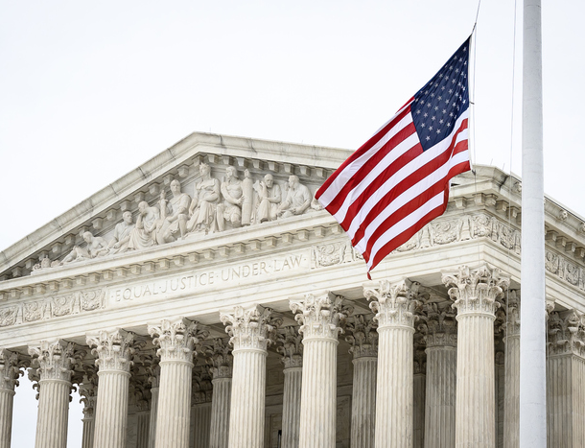
Supreme Court case we are closely watching
Notes:
Finally, here are two pending Supreme Court cases that we are keeping an eye on because they could be quite important.

Slide 51
Pending Decision
Johnson v. United States Congress
  Does the CAVC have exclusive jurisdiction over all VA benefits issues?
  Decision of the 11th Circuit Court of Appeals (Alabama, Florida, Georgia).
  Held that federal district court lacked jurisdiction over constitutional challenge to law reducing benefits to veterans while they are incarcerated.
  Review granted in April. Argued on October 5th and decided late this year or early next.
Notes:
[click] The first case is Rudisill v. McDonough
[click] You may have heard of this case before as it was the subject of three CAVC and Federal Circuit decisions.
[click] The question presented is whether veterans with multiple periods of service who qualify under both the Montgomery G.I. Bill and the Post-9/11 G.I. bill eligible for 36 or 48 months of benefits? Although this was decided in the Veteran’s favor the first two times, the current ruling is that veterans are limited to 36 months of benefits.
[click] THe other case is Loper Bright Enterprises v. Raimondo, which has a companion case that was argued with it.
[click] This case is also pending before the Supreme Court..
[click] THe question in Loper Bright is How much deference do courts owe agencies in interpreting statutory provisions?
This is not a veterans benefits case, but if the Court changes the balance of power between agencies and courts, it could significantly affect veterans law and the courts may revisit issues that were previously decided in favor of VA.
[click] Be sure you check the email that you used to register for this course for case updates from Bergmann & Moore!

Slide 52
Pending Decision
Johnson v. United States Congress
  Prior to VJRA, the Supreme Court held that U.S. courts of general jurisdiction could hear claims involving constitutional violations.
    This is how Nehmer was decided prior to the VJRA.
  Beginning with Veterans for Common Sense in 2012, some courts have held that the VJRA eliminated all jurisdiction over veterans benefits in courts other than the CAVC.
  However, the CAVC is not a trial court, so it has no ability to receive evidence and make factual findings.
  If the Supreme Court affirms, a veteran trying to make a constitutional challenge must go through VA for evidence development and initial fact finding.
Notes:
[click] The first case is Rudisill v. McDonough
[click] You may have heard of this case before as it was the subject of three CAVC and Federal Circuit decisions.
[click] The question presented is whether veterans with multiple periods of service who qualify under both the Montgomery G.I. Bill and the Post-9/11 G.I. bill eligible for 36 or 48 months of benefits? Although this was decided in the Veteran’s favor the first two times, the current ruling is that veterans are limited to 36 months of benefits.
[click] THe other case is Loper Bright Enterprises v. Raimondo, which has a companion case that was argued with it.
[click] This case is also pending before the Supreme Court..
[click] THe question in Loper Bright is How much deference do courts owe agencies in interpreting statutory provisions?
This is not a veterans benefits case, but if the Court changes the balance of power between agencies and courts, it could significantly affect veterans law and the courts may revisit issues that were previously decided in favor of VA.
[click] Be sure you check the email that you used to register for this course for case updates from Bergmann & Moore!

