Slide 1


Special Monthly Compensation Part 2:
Higher Levels of SMC
Spring 2023 Professional Training Conference
Winter 2023 Professional Training Conference
Winter 2023 Professional Training Conference
October 2026 Training Conference
Presenters:
Katrina J. Eagle, Esq.
Jim Radogna, VA Accredited Agent

Slide 2
2026 SMC Rates (no dependents)
SMC Level | SMC Rate | Additional Amount
K | $139.87 | +$139.87 added to 0% to 100%*
S | $4,408.53 | +$469.95 >100% rate
L | $4,900.83 | +$962.25 > 100% rate
L1/2 | $5,154.18 | +$1,215.31 > 100% rate
M | $5,408.55 | +$1,469.98 > 100% rate
M1/2 | $5,780.19 | +$1,841.61 > 100% rate
N | $6,152.64 | +$2,214.06 > 100% rate
N1/2 | $6,514.55 | +$2,575.97 > 100% rate
O | $6,876.52 | +$2,938.55 > 100% rate
R-1 | $9,826.88 | +$5,888.30 > 100% rate
R-2/T | $11,271.67 | +$7,333.10 > 100% rate
*SMC-K amount is paid in addition to regular monthly compensation (ex. 100% @ $3,938.58 + $139.87), all other levels are in place of regular monthly compensation. **All SMC levels other than SMC-K pay additional $ for a veteran’s dependents.

Slide 3

Higher Levels of
SMC

Slide 4
Higher Levels of SMC
The higher levels of SMC, L through O, and special aid and attendance benefits (R1 and R2), are payable for combinations of anatomical loss or loss of use of the extremities at different levels, blindness, and regular aid and attendance.
If a veteran is entitled to SMC-L, M, or N, and also has established entitlement to SMC-K on another basis, he or she will continue to receive SMC-K compensation for that disability.
There are seven levels of SMC between SMC-L and SMC-O: SMC-L, SMC-L1/2, SMC-M, SMC-M1/2, SMC-N, SMC-N1/2 and SMC-O.
SMC-P establishes the intermediate levels (L ½, M ½, etc.).

Slide 5
Levels of Loss For SMC Determinations
As we mentioned in part 1, when a veteran suffers a single loss, say loss of use of a foot, only one level of SMC is payable, which is SMC-K. It doesn't matter whether the loss is at the foot, knee or hip; only SMC-K may be paid for a single extremity loss.
Further, SMC-K necessitates No Light Perception in one eye as the minimum level, whereas achieving SMC-L requires a lesser level of visual impairment in both eyes (5/200).
In the higher levels of SMC, the location of anatomical loss/loss of use or degree of vision loss can make a substantial difference in the amount of special monthly compensation a veteran receives.
Let’s take a look at the different levels of loss…
, +

Slide 6
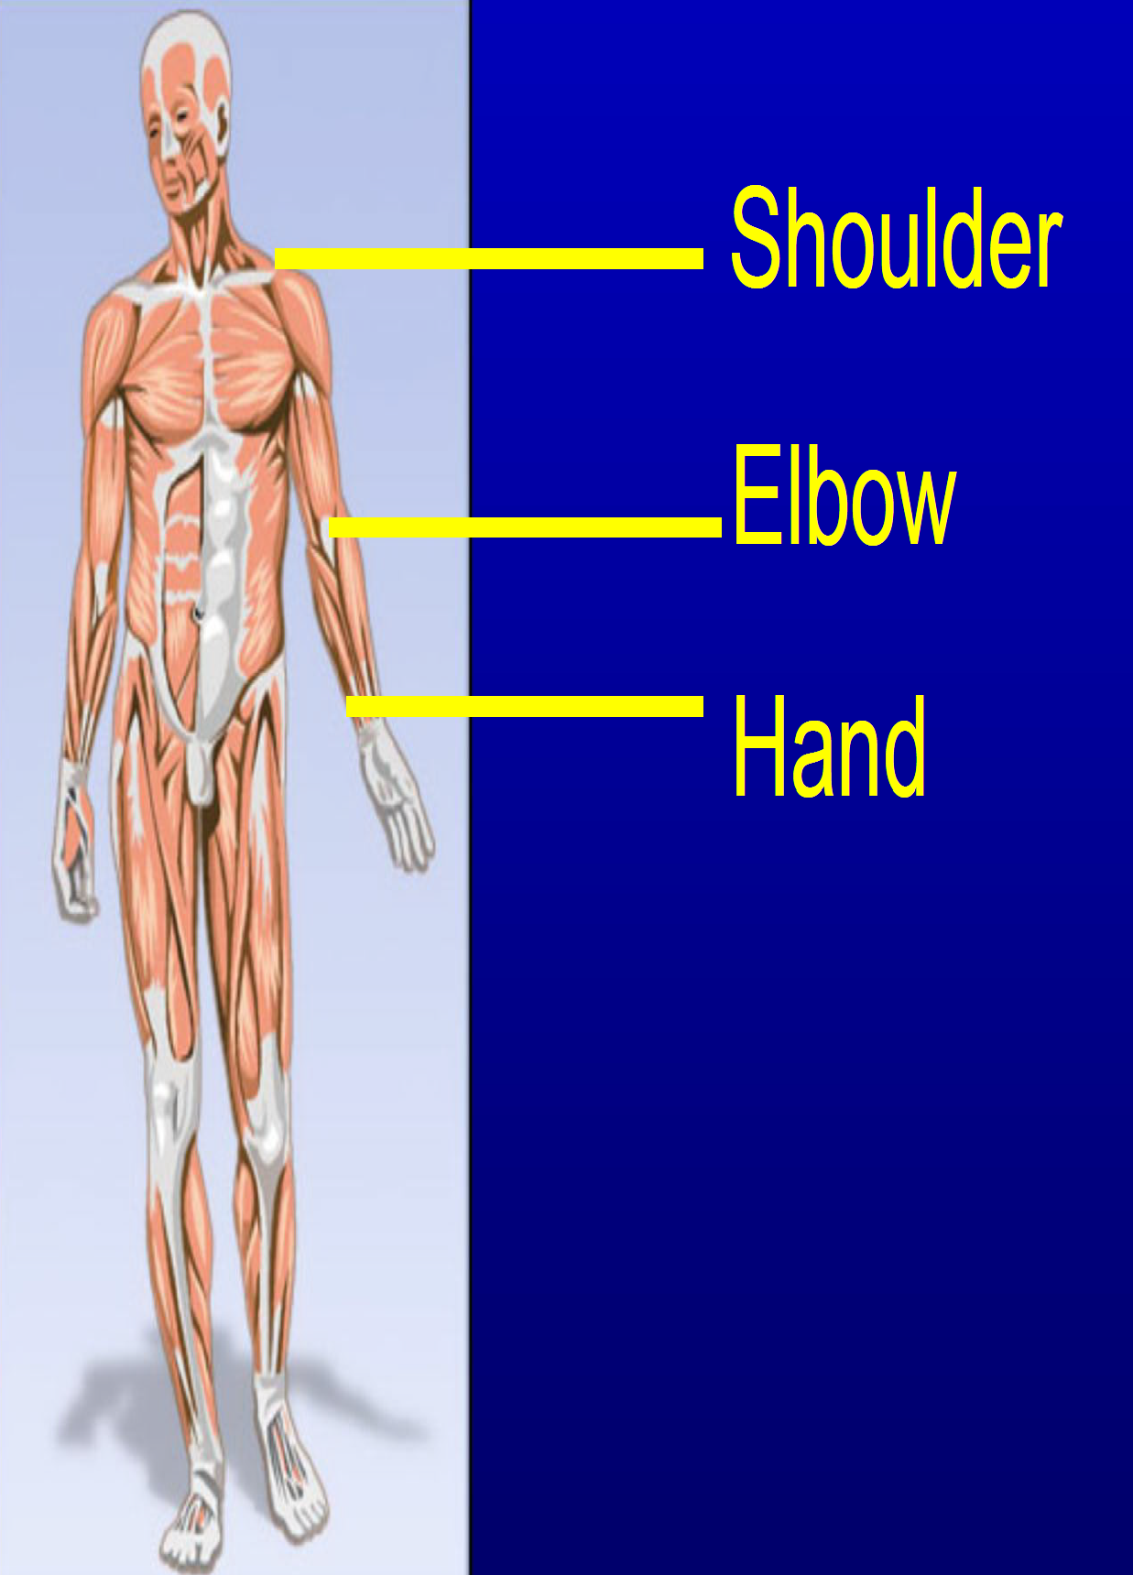
Levels of Loss/Loss of Use – Upper Extremities
There are three primary levels of loss for the upper extremities - hand, elbow, and shoulder.
Any anatomical loss or loss of use below the elbow is considered the hand level.
The elbow level requires an above elbow amputation or loss of natural elbow action.
To be considered at the shoulder level, there must be an anatomical loss. This means that there must be an amputation, and so high as to prevent the wearing of a prosthesis. There is no loss of use level at the shoulder, only anatomical loss.

Slide 7
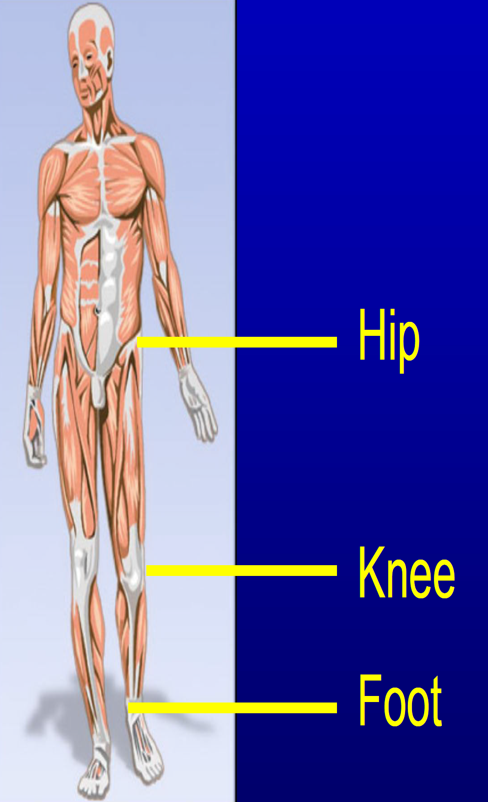
Levels of Loss/Loss of Use – Lower Extremities
There are three primary levels of loss for the lower extremities - the foot, knee, and hip.
An amputation below the knee or loss of use of the foot is considered a loss at the foot level.
To be considered at the knee level, there must be a loss of natural knee action or an above the knee amputation.
A loss at the hip level is established by amputation so high as to prevent the wearing of prosthesis. There is no loss of use level at the hip, only anatomical loss.

Slide 8
Natural Elbow or Knee Action
A veteran retains "natural use" of their knee or elbow only if the prosthetic requires them to actively bend their own joint. This keeps their muscles engaged.
Loss of Use Occurs If:
The prosthetic has a mechanical joint (a self-powered hinge) that moves for them, causing muscle atrophy.
The design blocks their natural joint from bending, even with a below-joint amputation.
The joint was already immobilized or paralyzed before receiving the prosthesis.
Bottom Line: If the prosthesis replaces the joint's natural movement, it's legally considered a loss of that joint's function.

Slide 9
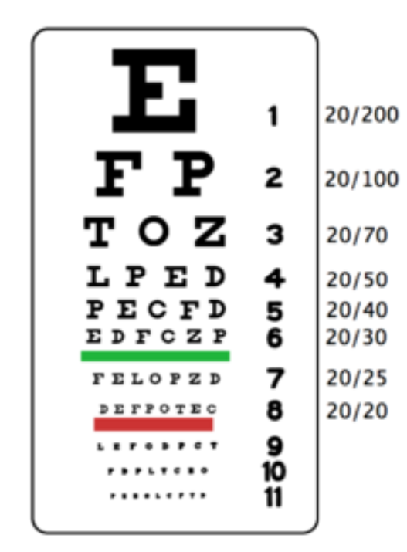
Levels of Loss/Loss of Use – Vision
There are four primary levels of loss of vision (blindness) for SMC purposes:
Visual Acuity of 20/200 or less or field of vision restricted to 20 degrees or less. Considered legally blind.
Visual Acuity of 5/200 or less or field of vision restricted to 5 degrees or less.
Light Perception Only (LPO) – Inability to recognize test letters at one foot or perception of objects, hand movements, or counting fingers cannot be accomplished at 3 feet.
No Light Perception (NLP) - Total blindness with the complete lack of form and visual light perception. The anatomical loss of an eye, or enucleation, is considered the same level of disability as no light perception.
VA only considers visual acuity and accuracy with use of corrective lenses

Slide 10
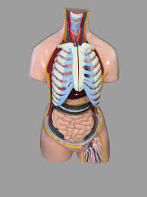
A Key Point About Higher Levels of SMC
For the higher levels of Special Monthly Compensation (i.e., SMC-L through SMC-O), the SMC rating increases as the anatomical loss or loss of use gets closer to the trunk of the body.

Slide 11
SMC-L, M, N,
and O
NOTE: The following examples do not cover all possible combinations of disabilities that lead to SMC-M, N, and O. We’ll discuss additional combinations in the upcoming SMC-P section.

Slide 12
SMC-L Review
The following combinations of loss/loss of use for lower and upper extremities and vision loss will entitle a veteran to SMC-L:
Anatomical loss or loss of use of both feet.
Anatomical loss or loss of use of one hand and one foot.
Blindness in both eyes with vision 5/200 or less or the visual field restricted to 5 degrees or less.
SMC-L is also available to a veteran who is:
Permanently bedridden, or
In need of aid and attendance (A&A)
38 U.S.C. § 1114(l); 38 C.F.R. § 3.350(b)

Slide 13
SMC-M

Slide 14
SMC-M
The following combinations of loss/loss of use of lower and upper extremities and vision loss will entitle a veteran to SMC-M:
Anatomical loss or loss of use of both hands (i.e., below the elbow loss).
Anatomical loss or loss of use of both legs at a level, or with complications preventing natural knee action with prostheses in place (i.e., above the knee loss).
Anatomical loss or loss of use of one upper and one lower extremity preventing natural elbow and knee action due to the level of involvement or with complications, with prosthesis in place (i.e., above knee and above elbow loss).
Blindness in both eyes having light perception only (LPO).
Blindness in both eyes (5/200 or less) leaving the veteran so helpless as to be in need of A&A.
38 U.S.C. § 1114(m); 38 C.F.R. § 3.350(c)

Slide 15
SMC-N

Slide 16
SMC-N
The following combinations of loss or loss of use for the lower and upper extremities and vision loss will entitle a veteran to SMC-N:
Anatomical loss or loss of use of both arms at a level or with complications, preventing natural elbow action with prosthesis in place (above elbows).
Anatomical loss of both legs so near the hip as to prevent use of a prosthetic appliance (amputations at hips).
Anatomical loss of one arm so near the shoulder as to prevent use of a prosthetic appliance (amputation at shoulder) with anatomical loss of one leg so near the hip as to prevent use of a prosthetic appliance (amputation at hip).
Anatomical loss of both eyes or blindness without light perception (NLP) in both eyes (or enucleation).
38 U.S.C. § 1114(n); 38 C.F.R. § 3.350(d)

Slide 17
Loss/Loss of Use Quick Guide
When both legs are involved:
Feet = SMC-L
Knees = SMC-M
Hips = SMC-N
Remember, hips must be anatomical loss, not just loss of use.

Slide 18
Loss/Loss of Use Quick Guide
When both arms are involved:
Hands = SMC-M
Elbows = SMC-N
Shoulders = SMC-O
Remember, shoulders must be anatomical loss, not just loss of use.

Slide 19
Loss/Loss of Use Quick Guide
When both eyes are involved:
5/200* = SMC-L
Light Perception Only = SMC-M
No Light Perception or Enucleation = SMC-N
* If vision is 5/200 bilateral and Aid & Attendance is needed solely due to blindness, SMC-M is warranted

Slide 20
SMC-O

Slide 21
SMC-O
The following combination of loss for the upper extremity will entitle a veteran to SMC-O:
Anatomical loss of both arms so near the shoulder as to prevent use of a prosthetic appliance (amputations at shoulders).
Bilateral deafness rated at 60 percent or more disabling (and the hearing impairment in either one or both ears is service connected) in combination with service-connected blindness with bilateral visual acuity 20/200 or less.
Service-connected total deafness in one ear or bilateral deafness rated at 40 percent or more disabling (and the hearing impairment in either one of both ears is service-connected) in combination with service-connected blindness of both eyes having only light perception (LPO) or less.
Conditions entitling the veteran to two or more of the SMC rates L through N, with no condition being considered twice (NOTE: this is generally the easiest path to entitlement to SMC-O).
Example: The veteran has bilateral LOU above knees and is entitled to SMC-M. The veteran is also entitled to SMC-L due to service-connected blindness in both eyes with vision 5/200 . Because the veteran meets the requirements for two SMC rates L through N and no condition was considered twice, he is entitled to SMC-O.
38 U.S.C. § 1114(o); 38 C.F.R. § 3.350(e)

Slide 22
SMC-O
SMC-O from a combination of two or more of the SMC rates L through N must be based upon separate and distinct disabilities. For example, where a veteran who had suffered the loss or loss of use of two extremities is being considered for SMC-O on account of helplessness requiring regular aid and attendance, the latter must be based on need resulting from pathology other than that of the extremities.
However, the fact that two separate and distinct entitling disabilities, such as anatomical loss, or loss of use of both hands and both feet, resulting from a common etiological agent, such as one injury or Parkinson’s Disease, will not preclude maximum entitlement under O.
For example, veteran has bilateral below the knee amputations due to diabetes. This entitles veteran to SMC-L. The veteran also suffered a stroke due to diabetes and because of the stroke, lost the use of both hands. This gives a second rate under M, thus establishing entitlement to SMC-O.

Slide 23
SMC-O
Entitlement to SMC-O can also be based on:
Paraplegia. Paralysis of both lower extremities together with loss of anal and bladder sphincter control will entitle to the maximum rate under 38 U.S.C. 1114(o), through the combination of loss of use of both legs and helplessness. The requirement of loss of anal and bladder sphincter control is met even though incontinence has been overcome under a strict regimen of rehabilitation of bowel and bladder training and other auxiliary measures.
Helplessness. The maximum rate, as a result of including helplessness as one of the entitling multiple disabilities, is intended to cover, in addition to obvious losses and blindness, conditions such as the loss of use of two extremities with absolute deafness and nearly total blindness or with severe multiple injuries producing total disability outside the useless extremities, these conditions being construed as loss of use of two extremities and helplessness.

Slide 24
SMC-O
If the loss or loss of use of two extremities or being permanently bedridden leaves the person helpless, increase is not in order on account of this helplessness. Under no circumstances will the combination of “being permanently bedridden” and “being so helpless as to require regular aid and attendance” without separate and distinct anatomical loss, or loss of use, of two extremities, or blindness, be taken as entitling to the maximum benefit.
38 C.F.R. § 3.350(e)(3)

Slide 25

QUESTIONS?

Slide 26
SMC-P

Slide 27
SMC-P
The fundamental aim of SMC-P is to offer extra compensation to veterans whose service-connected disabilities surpass the criteria for any of the rates specified in SMC-L through SMC-N.
SMC-L, M, N and O are considered statutory rates; SMC-L½, M½, and N½ are considered intermediate rates.
SMC-P provides for half-step and full-step increases (or “bumps”). Examples: SMC-L to SMC-L1/2 is a half-step bump and SMC-M to SMC-N is a full-step bump.
Half-step bumps are determined by arithmetic means, rounded to the nearest dollar, between the two “full step” rates concerned (e.g., SMC-L and SMC-M)
In some instances, SMC-P may pay the same amount of compensation as SMC-O. But SMC-P compensation can never exceed that of SMC-O.
SMC-P has many moving parts, so we’ll break it down systematically.
38 U.S.C. § 1114(p); 38 C.F.R. § 3.350(f)

Slide 28
SMC-P – The Statute
38 U.S.C. § 1114(p): In the event the veteran’s service-connected disabilities exceed the requirements for any of the rates prescribed in this section, the Secretary may allow the next higher rate or an intermediate rate, but in no event in excess of $4,667. In the event the veteran has suffered service-connected blindness with 5/200 visual acuity or less and (1) has also suffered bilateral deafness (and the hearing impairment in either one or both ears is service connected) rated at no less than 30 percent disabling, the Secretary shall allow the next higher rate, or (2) has also suffered service-connected total deafness in one ear or service-connected anatomical loss or loss of use of one hand or one foot, the Secretary shall allow the next intermediate rate, but in no event in excess of $4,667. In the event the veteran has suffered service-connected blindness, having only light perception or less, and has also suffered bilateral deafness (and the hearing impairment in either one or both ears is service connected) rated at 10 or 20 percent disabling, the Secretary shall allow the next intermediate rate, but in no event in excess of $4,667. In the event the veteran has suffered the anatomical loss or loss of use, or a combination of anatomical loss and loss of use, of three extremities, the Secretary shall allow the next higher rate or intermediate rate, but in no event in excess of $4,667. Any intermediate rate under this subsection shall be established at the arithmetic mean, rounded down to the nearest dollar, between the two rates concerned.

Slide 29
SMC-P – The Corresponding Regulations
38 C.F.R. § 3.350(f)(1) – covers combinations of loss/LOU of extremities (12 examples including intermediate and statutory rates).
38 C.F.R. § 3.350(f)(2) – covers combinations of blindness in connection with deafness and/or loss or loss of use of a hand or foot. (9 examples including intermediate and statutory rates).
38 C.F.R. § 3.350(f)(3) – covers half-step bumps for additional independent 50% disabilities.
38 C.F.R. § 3.350(f)(4) – covers full-step bump for additional independent 100% ratings.
38 C.F.R. § 3.350(f)(5) – covers half-step bumps for loss/LOU of three extremities.

Slide 30
SMC-L1/2 (As Listed in 38 CFR § 3.350(f)(1) and f(2))
Anatomical loss or loss of use of one foot (below knee) with anatomical loss or loss of use of one leg at a level, or with complications preventing natural knee action with prosthesis in place (above knee).
Anatomical loss or loss of use of one foot (below knee) with anatomical loss or loss of use of one arm at a level, or with complications, preventing natural elbow action with prosthesis in place (above elbow).
Anatomical loss or loss of use of one leg at a level, or with complications, preventing natural knee action with prosthesis in place (above knee) with anatomical loss or loss of use of one hand (below elbow).
Blindness of one eye with 5/200 visual acuity or less and blindness of the other eye having only light perception (LPO).

Slide 31
SMC-M1/2 (As Listed in 38 CFR § 3.350(f)(1) and f(2))
Anatomical loss or loss of use of one leg at a level, or with complications, preventing natural knee action with prosthesis in place (above knee) with anatomical loss of one leg so near the hip as to prevent use of a prosthetic appliance (amputation at hip).
Anatomical loss or loss of use of one leg at a level, or with complications, preventing natural knee action with prosthesis in place (above knee) with anatomical loss of one arm so near the shoulder as to prevent use of a prosthetic appliance (amputation at shoulder).
Anatomical loss of one leg so near the hip as to prevent use of a prosthetic appliance (amputation at hip) with anatomical loss or loss of use of one arm at a level, or with complications, preventing natural elbow action with prosthesis in place (above elbow).
Anatomical loss or loss of use of one hand (below elbow) with anatomical loss or loss of use of one arm at a level, or with complications, preventing natural elbow action with prosthesis in place (above elbow).
Blindness of one eye having only light perception (LPO) and anatomical loss of, or blindness having no light perception (NLP) in the other eye.

Slide 32
SMC-N1/2 (As Listed in 38 CFR § 3.350(f)(1) and f(2))
The following combination of loss or loss of use of the upper extremity will entitle a veteran to SMC-N1/2:
Anatomical loss or loss of use of one arm at a level, or with complications, preventing natural elbow action (above elbow) with prosthesis in place with anatomical loss of one arm so near the shoulder as to prevent use of a prosthetic appliance (amputation at shoulder).

Slide 33
SMC-P Statutory Rates As Listed in 38 CFR § 3.350(f)(1)
Anatomical loss or loss of use of one foot with anatomical loss of one leg so near the hip as to prevent use of prosthetic appliance = SMC-M
Anatomical loss or loss of use of one foot with anatomical loss or loss of use of one arm so near the shoulder as to prevent use of a prosthetic appliance = SMC-M
Anatomical loss of one leg so near the hip as to prevent use of a prosthetic appliance with anatomical loss or loss of use of one hand = SMC-M
Anatomical loss or loss of use of one hand with anatomical loss of one arm so near the shoulder as to prevent use of a prosthetic appliance = SMC-N

Slide 34
Other 38 CFR. § 3.350(f)(2) Combinations
Blindness of one eye with 5/200 visual acuity or less and anatomical loss or NLP in other eye = SMC-M.
Blindness in both eyes with visual acuity of 5/200 or less, or one eye 5/200 and other eye LPO or NLP, when accompanied by service-connected total deafness in one ear = half-step bump.
Blindness in both eyes having only light perception or less, or one eye LPO and other eye NLP, when accompanied by bilateral deafness (and the hearing impairment in either one or both ears is service-connected) rated at 10 or 20 percent disabling = half-step bump.
Blindness in both eyes rated under 38 U.S.C. 1114 (l), (m) or (n), or intermediate rates, or one eye 5/200 and other eye LPO or NLP OR one eye LPO and other eye NLP, when accompanied by bilaterial deafness rated at no less than 30 percent, and the hearing impairment in one or both ears is service-connected = full-step bump.
Blindness in both eyes rated under 38 U.S.C. 1114 (l), (m), or (n), or intermediate rates, when accompanied by service-connected loss or loss of use of one hand = full step bump.
Blindness in both eyes rated under 38 U.S.C. 1114 (l), (m), or (n), or intermediate rates, when accompanied by service-connected loss or loss of use of one foot which by itself or in combination with another compensable disability would be ratable at 50 percent or more = full step bump.
Blindness in both eyes rated under 38 U.S.C. 1114 (l), (m), or (n), or intermediate rates, when accompanied by service-connected loss or loss of use of one foot which is ratable at less than 50 percent and which is the only compensable disability other than bilateral blindness = half step bump.

Slide 35
But There’s An Easier Way of Figuring Out Most SMC-P Ratings…

Slide 36
Calculating Extremity Half & Full Steps On the Fly
Starting with SMC-L for loss/LOU of both feet or hand and a foot; or SMC-M for loss/LOU of both hands, there is an additional half-step elevation for every additional joint level. For instance:
Veteran had one leg amputated below the knee and the other leg amputated above the knee.
What is the SMC level?
SMC-L1/2 (start with SMC-L for loss of 2 feet, then add half-step for above the knee).
Veteran loss of use of one foot and amputation of an arm at the shoulder.
What is the SMC level?
SMC-M (start with SMC-L for loss of one hand and one foot, then add 2 half-steps for shoulder).
Veteran loss of use of one hand and amputation of the other arm above the elbow.
What is the SMC level?
SMC-M1/2 (start with SMC-M for loss of 2 hands, then add half-step for above the elbow).

Slide 37
Calculating Blindness Half & Full Steps On the Fly
Starting with SMC-L for bilateral visual acuity of 5/200, there is an additional half-step elevation for every additional blindness level. For instance:
Veteran has visual acuity of 5/200 in one eye and LPO in the other.
What is the SMC level?
SMC-L1/2 (start with bilateral 5/200 = SMC=L, then add half-step for LPO).
Veteran has visual acuity of 5/200 in one eye and NLP in the other.
What is the SMC level?
SMC-M (start with bilateral 5/200 = SMC=L, then add 2 half-steps for LPO).
Veteran has visual acuity of NLP in one eye and LPO in the other.
What is the SMC level?
SMC-M1/2 (start with bilateral 5/200 = SMC-L, then add 2 half-steps for NLP and another half-step for LPO).

Slide 38
38 C.F.R. § 3.350(f)(3)
38 CFR 3.350(f)(3) states that if a veteran has additional permanent disabilities, rated at combined 50% or more, then he or she is entitled to the next higher intermediate rate (half-step). The disability or disabilities independently ratable at 50 percent or more must be separate and distinct and involve different anatomical segments or bodily systems from the conditions establishing entitlement under SMC-L through N.

Slide 39
38 CFR § 3.350(f)(4)
38 CFR 3.350(f)(4) states that if a veteran has an additional single permanent disability individually rated at 100% (NOT IU), he or she is entitled to the next higher statutory rate (full-step). The single permanent disability independently ratable at 100 percent must be separate and distinct and involve different anatomical segments or bodily systems from the conditions establishing entitlement under SMC-L through N.
The 50% under 3.350(f)(3) may be a combination of unrelated disabilities but the 100% under 3.350(f)(4) must be a single disability.
For purposes of 3.350(f)(4), the definition of “one disability” in 38 CFR § 4.16 (i.e., TDIU) doesn’t apply. Per Bradley v. Peake, § 4.16 only applies to total disability based on TDIU.
According to VA guidance, concurrent entitlement to SMC under both 38 CFR 3.350(f)(3) and 38 CFR 3.350(f)(4) is prohibited. In other words, the veteran can’t get both half step bumps for 50% and a full step bump for 100%.
Disability evaluations used to support entitlement to (f)(3) and (f)(4) must be permanent with no future examinations scheduled.

Slide 40
38 CFR § 3.350(f)(5) - More Half Step Bumps
38 CFR 3.350(f)(5) states that elevated rates may also be authorized for the loss or loss of use of three extremities.
If a veteran has suffered the service-connected loss or loss of use, or a combination of anatomical loss or loss of use, of three extremities, he/she is entitled to the next higher rate regardless of whether that rate is a statutory rate or an intermediate rate.
The rate of SMC payable to a veteran who has the service-connected loss or loss of use of three extremities will be determined by ascertaining the rate payable without regard to the three extremities rule and then increasing that rate by a half step (this can lead to some interesting pyramiding which we’ll discuss later).

Slide 41
Half and Full-Step Bump Examples
Example involving 38 CFR 3.350(f)(3):
Veteran has anatomical loss of both lower extremities that meets the requirements for SMC-M (above knee) and a 70% permanent SC evaluation for PTSD that is completely independent of the anatomical loss of both lower extremities.
Result: the Veteran is entitled to the intermediate rate of SMC-M1/2, because of additional and different independent disabilities rated 50% or more.
Example involving 38 CFR 3.350(f)(4):
Veteran has anatomical loss of both lower extremities that meets the requirements for SMC-M (above knee) and a 100% permanent SC evaluation for PTSD that is completely independent of the anatomical loss of both lower extremities.
Result: the Veteran is entitled to the next higher rate of SMC-N, because of the additional, single, permanent disability that is independently ratable as 100-percent disabling.

Slide 42
Half and Full-Step Bump Examples
Example involving 38 CFR 3.350(f)(3) plus SMC-K:
Veteran has anatomical loss of both hands, a 30% SC evaluation for loss of one eye, and 30% for removal of both testes.
Result: the Veteran is entitled to the intermediate rate of SMC-M1/2, because of additional and different independent disabilities rated 50% or more.
Also entitled to SMC-K for blindness of one eye AND an additional SMC-K for anatomical loss of a creative organ.
Advocacy Tip: We’ve encountered several scenarios where a veteran receives SMC-S, then is granted (A&A). However, the rater assigns SMC-L without including a half-step bump under (f)(3) or a full-step bump under (f)(4). Based on our experience, a veteran transitioning from SMC-S to SMC-L is quite likely entitled to SMC-L1/2 or a higher level.

Slide 43
38 CFR § 3.350(f)(3) and (f)(4) Exception
The same etiological disease or injury supporting the statutory or intermediate rates between (l) and (o) may not be used to support the independent 50% or 100% rating unless rated without regard to loss or loss of use.
Example involving a multisystem disorder:
A Veteran has lost the use of both feet due to SC multiple sclerosis (entitlement to SMC-L)
She also has the following other disabilities due to multiple sclerosis:
  Dysarthria @ 30%
  Impairment of anal sphincter control @ 10%
  Loss of bladder control at 10%
  Nystagmus @ 10%
Result: the Veteran is entitled to the intermediate rate of SMC-L1/2, even though the additional 50% disabilities are all from multiple sclerosis. This is because the additional disabilities are rated without regard to the loss of use of both feet.
NOTE: If this veteran had loss of use of both anal and bladder sphincter control, she would be entitled to SMC-O.

Slide 44
Anatomical Segments
The musculoskeletal system within the VA Schedule for Rating Disabilities is divided into anatomical segments which include:
  shoulder and arm
  wrist
  hand
  lumbosacral and sacroiliac joints
  thoracolumbar spine
  cervical spine
  hip and thigh
  knee and leg
  ankle
  foot
  skull
  ribs
  Coccyx
Each extremity includes separate anatomical segments. For example, the right hand and the left hand are separate anatomical segments.

Slide 45
Anatomical Segment Example
Example: A Veteran is SC for amputation of bilateral feet, evaluated as 100-percent disabling.
The Veteran underwent a total knee replacement.
Following the temporary evaluation assigned after knee replacement, the knee is evaluated as 60-percent disabling.
SMC-L is warranted for the bilateral foot amputation, and SMC-P is warranted under 38 CFR 3.350(f)(3) for the knee disability since it is an additional permanent disability independently evaluated as 50 percent or more.
The knee and the foot are separate anatomical segments as is required in 38 CFR 3.350(f)(3) and (4). Since the knee disability involves a separate anatomical segment, the SMC-P may be assigned in spite of the fact that the disabilities are of a common bodily system.

Slide 46
Maximizing Benefits With SMC-P
The M21-1 manual directs adjudicators to maximize SMC benefits:
“Do not rate multiple disabilities as a single disability if there is a possibility of entitlement to SMC under 38 U.S.C. 1114(s), or an intermediate or next higher rate of SMC under 38 CFR 3.350(f)(3), or 38 CFR 3.350(f)(4).” M21-1 VIII.iv.4.A.2.a.
“The assignment of a single evaluation of 100 percent for a multisystem disorder, based on LOU of two extremities, may overlook the disorder’s involvement in other body systems. This involvement might meet requirements for an intermediate rate under 38 CFR 3.350(f)(3), or the next higher rate under 38 CFR 3.350(f)(4).” M21-1 VIII.iv.4.A.2.b.
Adjudicators often fail to follow this guidance!

Slide 47
SMC-P Caveats
3.350(f)(3) and (f)(4) bumps can be added to SMC-L, L1/2, M, M1/2, N, or N1/2.
SMC-K(s) can be added to SMC-L, L1/2, M, M1/2, N, or N1/2.
Concurrent entitlement to SMC under both 38 CFR 3.350(f)(3) and 38 CFR 3.350(f)(4) is prohibited.
Entitlement to more than one half-step bump under 38 CFR 3.350(f)(3) is allowed as of May 16, 2024, pursuant to the Barry v. McDonough Fed Circuit decision (example: half-step for PTSD @ 50% plus half-step for CAD @ 60%, etc. – total bumps can’t exceed SMC-O).
Concurrent entitlement to SMC under either (f)(3) or (f)(4) AND (f)(5) is NOT prohibited. In other words, a veteran can be paid half-step(s) or full-step bump under (f)(3) or (f)(4) AND another half step bump for loss of use of 3 extremities.
The graduated ratings for arrested tuberculosis will not be utilized in (f)(3) or (f)(4), but the permanent residuals of tuberculosis may be utilized.
Remember, the total compensation under SMC-P can’t exceed that of SMC-O (and the Ks go away).

Slide 48
"Barry Bump" Example
Veteran receiving SMC-L for Aid and Attendance due to COPD. Also has the following ratings
100% coronary artery disease
50% migraines
60% peripheral arterial disease
50% depression
20% right knee
20% left knee
10% tinnitus

Slide 49
"Barry Bump" Example
What is the proper level of SMC?
SMC-L for COPD plus…
100% coronary artery disease (full-step bump per 3.350(f)(4))
50% migraines (half-step bump per 3.350(f)(3))
50% depression (half-step bump per 3.350(f)(3))
60% peripheral arterial disease (NO bump because same body system as Coronary Artery Disease )
20% right knee + 20% left knee + 10% tinnitus = 50% (half-step bump per 3.350(f)(3))
So, either SMC-L for COPD + 100% coronary artery disease = SMC-M (remember, no concurrent (f)(3) and (f)(4) per M21)
Or, SMC-L for COPD + 50% migraines + 50% depression + 20% right knee /20% left knee/10% tinnitus = SMC M1/2
Thus, the answer is SMC-M1/2 (the higher benefit)

Slide 50
"Barry Bump" Caveat
Veteran receiving SMC-L for Aid and Attendance based on the following conditions:
100% COPD
100% coronary artery disease
50% migraines
60% peripheral arterial disease
50% depression
Also has the following conditions that are not part of the A&A grant:
20% right knee
20% left knee
10% tinnitus
Based on this scenario, veteran is only entitled to SMC-L1/2
(20% right knee + 20% left knee + 10% tinnitus = 50% (half-step bump per 3.350(f)(3))
Lesson: VA often grants A&A based on all or most SC conditions unless you claim otherwise. This can limit the level of SMC granted.

Slide 51
Advocacy Tip
While the M21-1 Adjudication Manual states that concurrent entitlement to SMC under both 38 C.F.R. § 3.350(f)(3) and § 3.350(f)(4) is prohibited, the Board of Veterans’ Appeals (BVA) may rule differently. In one Board decision, it was noted:
" The Board observes that VA’s Adjudication Manual bars concurrent entitlement to SMC under both 38 C.F.R. § 3.350(f)(3) and § 3.350(f)(4). However, the Board is not bound by the Manual. There is no provision in the applicable laws or regulations, including 38 C.F.R. § 3.350, that explicitly prohibits concurrent entitlement under these subsections. Furthermore, in Barry, the Federal Circuit determined that § 3.350(f)(3) allows for multiple intermediate-rate SMC increases."
This means that if a veteran has a 100% rating for one disability and additional separate disabilities rated at 50% or more, it may be worth appealing to the BVA to have all of them factored into SMC calculations.
BUT THE QUESTION OF WHETHER 3.350(f)(3) AND § 3.350(f)(4) MAY BE APPLIED CONCURRENTLY WILL LIKELY BE RESOLVED BY A FUTURE COURT DECISION.

Slide 52
“Pyramiding P” Example
Veteran has anatomical loss of both hands.
Also has amputation of the left foot (rated at 40%).
Also has hypertension rated at 20%.
Result:
SMC-M on account of anatomical loss of both hands.
SMC-P under 38 CFR § 3.350(f)(3) on account of additional disabilities of loss of left foot and hypertension independently ratable as 50 % or more = SMC-M1/2.
SMC-P under 38 CFR § 3.350(f)(5) due to loss of three extremities = SMC-N.
SMC-K on account of anatomical loss of one foot = SMC-N +K.
So, veteran gets two half-step bumps AND gets to keep SMC-K.

Slide 53
“Pyramiding P” Example
Veteran has below knee amputation and above knee amputation.
Also has loss of use of one hand rated at 60%
Result:
SMC-L1/2 on account of above knee and below knee amputations
SMC-P under 38 CFR 3.350(f)(3) on account of loss of use of one hand independently ratable as 50 % or more = SMC-M.
SMC-P under 38 CFR 3.350(f)(5) due to loss of three extremities = SMC-M1/2.
SMC-K on account of loss of use of one hand = SMC-M1/2 +K.
So, veteran gets two half-step bumps AND gets to keep SMC-K. The loss of use of hand counts for entitlement to BOTH (f)(3) and (f)(5) because it’s rated at 50% or more.

Slide 54
SMC-Q

Slide 55
SMC-Q
SMC-Q is a protected rate that hasn’t been awarded since August 19, 1968.
SMC-Q is payable for those veterans who had a non-compensable evaluation for inactive tuberculosis prior to August 19, 1968, when there is no other compensation payable. It is currently $67.00.

Slide 56
SMC-R1

Slide 57
SMC-R1
SMC-R1 and R2 are considered special aid and attendance benefits and an extension of SMC-O.
A Veteran is entitled to SMC-R1 when he or she is receiving SMC-O, SMC-P at a rate equal to SMC-O, or SMC-N1/2 plus SMC-K AND is in need of regular aid and attendance. (NOTE: Entitlement to SMC-R is an inferred issue once these levels of entitlement are reached).
Example: The veteran experiences loss of use in both feet. Additionally, due to PTSD, he poses a danger to himself and requires regular Aid & Attendance (A&A). As a result, the veteran qualifies for SMC-L based on the loss of use of both feet. Furthermore, considering the need for regular A&A, he is eligible for an additional SMC-L. Since he meets the requirements for two SMC rates (L through N) without any condition being counted twice, he is entitled to SMC-O. Moreover, because he already qualifies for regular A&A under SMC-L, he is also entitled to SMC-R1.
38 U.S.C. § 1114(r)(1); 38 C.F.R. § 3.350(h)

Slide 58
SMC-R1
SMC-R1 is payable whether or not the need for aid and attendance was a partial basis for entitlement to the maximum rate or was on an independent factual determination. In other words, the veteran isn’t required to have been granted SMC-L for A&A to qualify for SMC-R1. Once SMC-O, maximum P, or N1/2 + K is established, VA must determine if there is a need for A&A, and if so, entitlement to SMC-R1 will be established.
Example: Veteran has loss of an arm at the elbow level, the other arm at the shoulder level and has loss of use of a creative organ. She is entitled to SMC-N1/2 + SMC-K.
In this case there is not a separate SMC-L for the A&A since that would require another 100% disability in addition to the arms.
But if there is a factual need for A&A due to her service-connected disabilities, then she is entitled to SMC-R1.*
*Per M21-1 VIII.iv.4.B.12.e., adjudicators are directed to apply a liberal interpretation of the law in determining the need for A&A for veterans receiving SMC-O, maximum P, or N1/2).

Slide 59
SMC-R1
SMC-R1 can also be achieved by establishing entitlement to Aid & Attendance for two separate and distinct disabilities.
Example: The veteran requires regular Aid & Attendance (A&A) due to his service-connected Parkinson’s Disease, which hinders his ability to perform essential daily tasks like dressing and feeding himself. Additionally, his service-connected PTSD poses a risk to his own safety, necessitating regular A&A. Given that he qualifies for two SMC rates (L through N) without any condition being counted twice, he is entitled to SMC-O. Furthermore, since he already meets the requirements for regular A&A under SMC-L, he is also entitled to SMC-R1.
NOTE: There’s some pushback on this entitlement at the BVA. Whether two separate A&A awards can establish entitlement to SMC‑R1 will likely end up being decided by the courts.

Slide 60
SMC-R1
Question? If the veteran is granted SMC-L for being “bedridden” rather than in need of aid and attendance, does he or she qualify for R1?
Probably. But 38 CFR § 3.352(a) states: “Bedridden” will be a proper basis for the determination… Determinations that the veteran is so helpless, as to be in need of regular aid and attendance will not be based solely upon an opinion that the claimant's condition is such as would require him or her to be in bed. They must be based on the actual requirement of personal assistance from others.

Slide 61
SMC-R1 Case Study
Veteran granted service-connection for Parkinson’s Disease.
Excellent 2680 filled out by his treating physician:
  “Poor grip, inability to twist with hand, weakness, stiffness, and tremors – cannot open or close containers, maintain control of razor to shave. Cannot button, grasp or manipulate small objects. Shoulder and arm stiffness such that unable to dress without assist. Requires full assistance to use bathroom and shower. Unable to carry items of any size or weight when walking (contributes to falls). Limited range of motion of upper extremities, and loss of strength.”
  “Festinating gait (rapid, mall steps and one foot moves faster than other, with extremely stooped trunk resulting in inability to maintain center of gravity). Ankle rigidity and edema makes putting on socks and shoes very difficult. Stiffness in hips and cannot lift legs. Overall loss of balance and range of motion. Very difficult to get into car. Chronic backpain due to stooped posture, loss of muscle tone, and previous spinal fractures from falls.”

Slide 62
SMC-R1 Case Study
Veteran files for A&A with 2680.
VA grants A&A from date of 2680.
We argued that he is also entitled to SMC-M for loss of use of hands (can’t dress himself due to Parkinson’s).
Further argued that he is entitled to SMC-L for loss of use of feet (frequent falls due to inability to balance from Parkinson’s).
Result = SMC-R1 with earlier effective date.

Slide 63
Advocacy Tip
While some VA adjudicators do an adequate job assigning straightforward SMC ratings—such as SMC-L for the loss of both feet, SMC-M for the loss of both hands, or SMC-L for bilateral blindness - they often overlook the broader criteria. The ultimate goal for veterans is to reach SMC-N1/2 or SMC-O, which are gateways to the highest compensation levels. Fortunately, SMC-P offers numerous pathways to achieve these goals.
Remember that SMC-P allows for a number ways to increase SMC levels:
Higher levels of loss in extremities and vision.
MULTIPLE half-step bumps through 3.350(f)(3).
Full step bump through 3.350(f)(4).
Half-step bump for loss/LOU of 3 extremities.
Combinations of blindness with deafness or blindness with extremity loss.

Slide 64
The Proper Level of Loss Can Make a Big Difference (Make Sure VA Gets it Right!)
It’s not unusual for VA adjudicators to assign an incorrect level of loss when calculating SMC.
For instance, loss of use of foot is granted when it should be loss of use at the knee level, loss of use of hand when it should be elbow level, or 5/200 visual acuity when it should be LPO or NLP.
Check out this example…

Slide 65
The Proper Level of Loss Can Make a Big Difference (Make Sure VA Gets it Right!)
Veteran granted Aid & Attendance based on anatomical loss of both hands.
Also has amputation of the left foot (rated at 40%).
Also has hypertension rated at 20%.
Result:
SMC-M on account of anatomical loss of both hands.
SMC-P under 38 CFR 3.350(f)(3) on account of additional disabilities of loss of left foot and hypertension independently ratable as 50 % or more = SMC-M1/2.
SMC-P under 38 CFR 3.350(f)(5) due to loss of three extremities = SMC-N.
SMC-K on account of anatomical loss of one foot = SMC-N + K.
Question:
What if the veteran has loss of use of one arm at the elbow level? Then N1/2 + K.
Since A&A is already granted the result moves up to SMC-R1 (an additional $3,534.37 per month!).

Slide 66
More R1 Strategy
Scenario:
Veteran is granted SMC-L for loss of use of 2 feet due to bilateral footdrop.
He’s also 100% service-connected for PTSD.
Rater assigns SMC-M based upon 38 CFR § 3.350(f)(4).
Sounds right, doesn’t it?
Maybe. But perhaps the veteran is entitled to A&A for his PTSD in order to protect himself from hazards or dangers incident to his daily environment?
For instance, does the veteran’s PTSD affect his judgement and/or memory?
If so, the 100% PTSD rating would be better utilized for a grant of A&A than as a full-step bump under 3.350(f)(4).
Instead of SMC-M, the veteran would be entitled to SMC-R1.

Slide 67
SMC-R2

Slide 68
SMC-R2
For a “higher level” of special aid and attendance, which is SMC-R2, all of the following conditions must be met:
The veteran is entitled to compensation authorized under SMC-O, SMC-P at a rate equal to SMC-O, or SMC-N1/2 plus SMC-K.
The veteran meets the requirements for entitlement to the special aid and attendance requirements under R1.
The veteran needs a "higher level of care" than is required to establish entitlement to R1 and, in the absence of the provision of such higher level of care, the veteran would require hospitalization, nursing home care, or other residential institutional care.
38 U.S.C. § 1114(r)(2); 38 C.F.R. § 3.350(h)

Slide 69
SMC-R2
Need for a higher level of care shall be considered to be need for personal health-care services provided on a daily basis in the veteran's home by a person who is licensed to provide such services or who provides such services under the regular supervision of a licensed health-care professional.
Personal health-care services include (but are not limited to) such services as physical therapy, administration of injections, placement of indwelling catheters, and the changing of sterile dressings, or like functions which require professional health-care training or the regular supervision of a trained health-care professional to perform.
A licensed health-care professional includes (but is not limited to) a doctor of medicine or osteopathy, a registered nurse, a licensed practical nurse, or a physical therapist licensed to practice by a State or political subdivision thereof.

Slide 70
SMC-R2
The term “under the regular supervision of a licensed health-care professional” means that an unlicensed person performing personal health-care services is following a regimen of personal health-care services prescribed by a health-care professional, and that the health-care professional consults with the unlicensed person providing the services at least once each month to monitor the prescribed regimen. The consultation need not be in person; a telephone call will suffice.
The higher-level aid and attendance allowance is to be granted only when the veteran's need is clearly established and the amount of services required by the veteran on a daily basis is substantial.
Entitlement to the higher A&A allowance may be awarded when an otherwise eligible Veteran is receiving residential or nursing-home care in an institution at the Veteran’s own expense.
38 CFR § 3.352(b)(3)

Slide 71
SMC-R2
Formerly, VA required that a veteran's need for a "higher level of care" must be determined by a VA physician or, in areas where no VA physician is available, by a physician carrying out such function under VA contract or fee arrangement based on an examination by such physician.
However, this has changed. Evidence of need for a higher level of care from a private medical professional can now be submitted.
The evidence of record must indicate:
An ongoing need for skilled personal care and,
In the absence of such care, the Veteran would require hospitalization, nursing home care, or other residential institutional care.
Entitlement may be established by evidence which shows:
The conditions justifying the need for this level of care
Nature, extent, and frequency of the services provided, and
Nature and extent of the supervision being provided, if the services are actually provided by a nonprofessional.

Slide 72
SMC-T

Slide 73
SMC-T
In 2011, Congress recognized that the disabilities caused by TBI can be as profound as those caused by the loss of limbs, blindness, etc. As such, SMC-T pays the same amount of compensation as SMC-R2 even though the veteran wouldn’t qualify otherwise.
So, what does it take to qualify for SMC-T?
38 U.S.C. § 1114(t); 38 C.F.R. § 3.350(j)

Slide 74
SMC-T
The statute 38 U.S.C. § 1114(t) states: “if any veteran, as the result of service-connected disability, is in need of regular aid and attendance for the residuals of traumatic brain injury, is not eligible for compensation under subsection (r)(2), and in the absence of such regular aid and attendance would require hospitalization, nursing home care, or other residential institutional care, the veteran shall be paid, in addition to any other compensation under this section, a monthly aid and attendance allowance equal to the rate described in subsection (r)(2)…”
So, according to the statute, it appears that a veteran would not need a higher level of care like that required by SMC-R2 right?
That’s correct, but the VA regulation, 38 CFR § 3.352(b)(2)(ii), stated that “as a result of service-connected residuals of traumatic brain injury, the veteran needs a “higher level of care”.
A CAVC case decided on September 6, 2024, Laska v. McDonough, invalidated that part of the regulation, so a need for higher level of care is no longer required for SMC-T.

Slide 75
Potential SMC-T Challenge
If a Veteran has TBI along with a comorbid mental disorder, and the examiner can’t clearly distinguish the symptoms and the occupational and social impairment, the VA assigns a single evaluation either under DC 8045 (Residuals of TBI) or for mental disorders as specified in 38 CFR § 4.130.
VA adjudicators will generally only consider SMC-T if the veteran has a 100% rating for residuals of TBI that are not rolled into a mental health disorder.
So, distinguishing the ratings for TBI and mental health becomes essential. An independent medical opinion may be necessary to achieve this separation.
M21-1 VIII.iv.4.A.8.b. states "To establish entitlement to SMC (t), the need for A&A must be due to traumatic brain injury (TBI) or multiple disabilities due to TBI that combine to a 100-percent evaluation."

Slide 76
Other SMC Details

Slide 77
Hospitalization
When a veteran is hospitalized at the expense of the U.S. government, the additional aid and attendance allowance authorized under R1, R2 or T will be discontinued effective the last day of the month following the month in which the veteran is admitted for hospitalization.
Exception: If the need for A&A is due to paraplegia involving paralysis of both lower extremities, together with loss of anal and bladder sphincter control, or Hansen’s disease, the above A&A allowance will not be discontinued.
If the veteran is receiving regular aid and attendance (SMC-L) alone (without other higher levels of SMC), A&A will be discontinued during hospitalization and the rate reduced to that of SMC-S.
When hospitalized, the veteran may be paid SMC-Ks that were previously not paid due to reaching the maximum rate.

Slide 78
Hospitalization
The SMC rate payable during hospitalization is based on the veteran's actual disabilities without regard to any amount for Aid & Attendance.
Example: The veteran is entitled to A&A because of service-connected PTSD evaluated 100% (SMC-L), and the veteran has loss of use of the left hand and loss of use of the right leg at the knee level (SMC-L1/2).
When not hospitalized, the veteran has entitlement to SMC-R1.
When hospitalized, the veteran has entitlement to SMC-L1/2 for the hand and leg, plus a full step elevation for the additional 100% PTSD rating, so the hospitalized rate is SMC-M1/2.
See 38 CFR § 3.552 for complete information about hospitalization & SMC.

Slide 79
Paired Organs
38 CFR § 3.383 Special consideration for paired organs and extremities.
(a) Entitlement criteria. Compensation is payable for the combinations of service-connected and nonservice-connected disabilities specified in paragraphs (a)(1) through (a)(5) of this section as if both disabilities were service-connected, provided the nonservice-connected disability is not the result of the veteran's own willful misconduct.
(1) Impairment of vision in one eye as a result of service-connected disability and impairment of vision in the other eye as a result of non-service-connected disability and
  (i) The impairment of vision in each eye is rated at a visual acuity of 20/200 or less; or
  (ii) The peripheral field of vision for each eye is 20 degrees or less.
(2) Loss or loss of use of one kidney as a result of service-connected disability and involvement of the other kidney as a result of nonservice-connected disability.
(3) Hearing impairment in one ear compensable to a degree of 10 percent or more as a result of service-connected disability and hearing impairment as a result of nonservice-connected disability that meets the provisions of § 3.385 in the other ear.
(4) Loss or loss of use of one hand or one foot as a result of service-connected disability and loss or loss of use of the other hand or foot as a result of nonservice-connected disability.
(5) Permanent service-connected disability of one lung, rated 50 percent or more disabling, in combination with a nonservice-connected disability of the other lung.

Slide 80
Automobile Allowance and Adaptive Equipment
Loss, or permanent loss of use, of one or both feet, or
Loss, or permanent loss of use, of one or both hands, or
Permanent decreased vision in both eyes: 20/200 vision or less in better eye with glasses, or greater than 20/200 vision but with a visual field defect that has reduced peripheral vision to 20 degrees or less in better eye, or
A severe burn injury, or
Amyotrophic lateral sclerosis (ALS), or
Ankylosis in one or both knees or hips (this qualifies only for an adaptive-equipment grant)
  38 U.S.C. § 3901

Slide 81
Specially Adaptive Housing
Loss or loss of use of more than one limb.
Loss or loss of use of a lower leg along with the residuals of an organic disease or injury.
Blindness in both eyes (with 20/200 visual acuity or less).
Certain severe burns.
The loss, or loss of use, of one lower extremity (foot or leg) after September 11, 2001, which makes it so you can’t balance or walk without the help of braces, crutches, canes, or a wheelchair (limited to 120 Veterans and service members each fiscal year).
38 CFR § 3.809

Slide 82
Spousal Aid & Attendance
Increased compensation is payable to a Veteran who rated at 30% or above by reason of the Veteran’s spouse being in need of A&A. The spouse will be considered in need of A&A if:
The individual is blind with corrected visual acuity of 5/200 or less, in both eyes, or concentric contraction of the visual field to 5 degrees or less.
Is a patient in a nursing home because of mental or physical incapacity.
Has disabilities causing a factual need for A&A as defined in 38 CFR 3.352(a).
For spousal A&A benefits to be payable, the Veteran must be entitled to compensation for disabilities evaluated as 30 percent or more disabling
Spousal A&A rate is currently $61.00 to $201.41, depending on the Veteran's rating.

Slide 83
SMC
Calculators

Slide 84
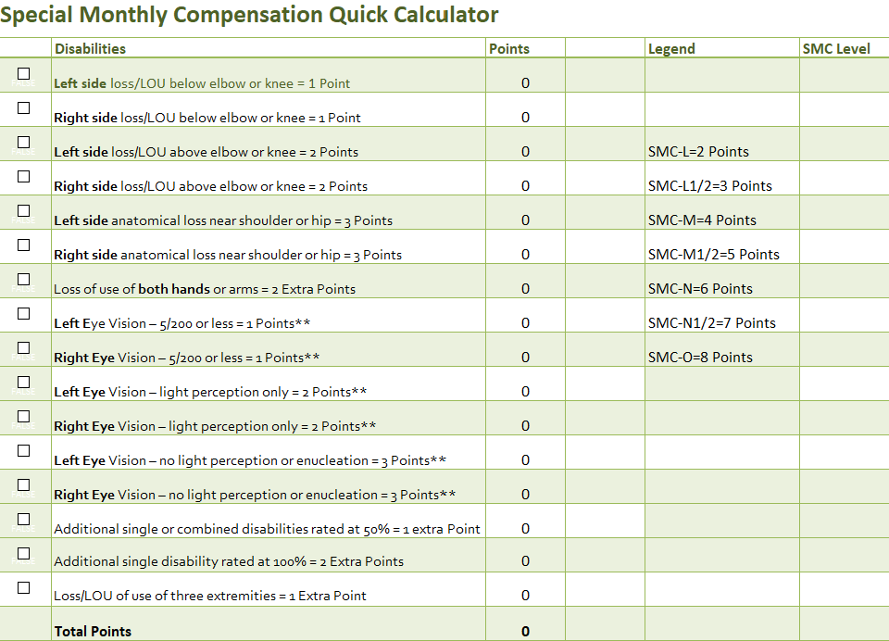
SMC Quick Calculator
NOTE: This calculator will be available on the NACVSO website.

Slide 85
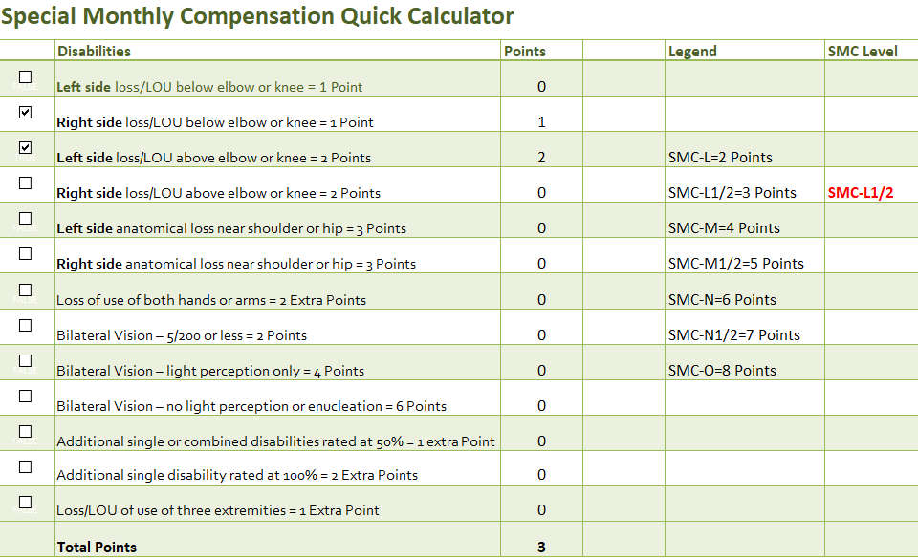
SMC Quick Calculator
Example #1: Loss of left leg above knee, plus loss of use of right hand.

Slide 86
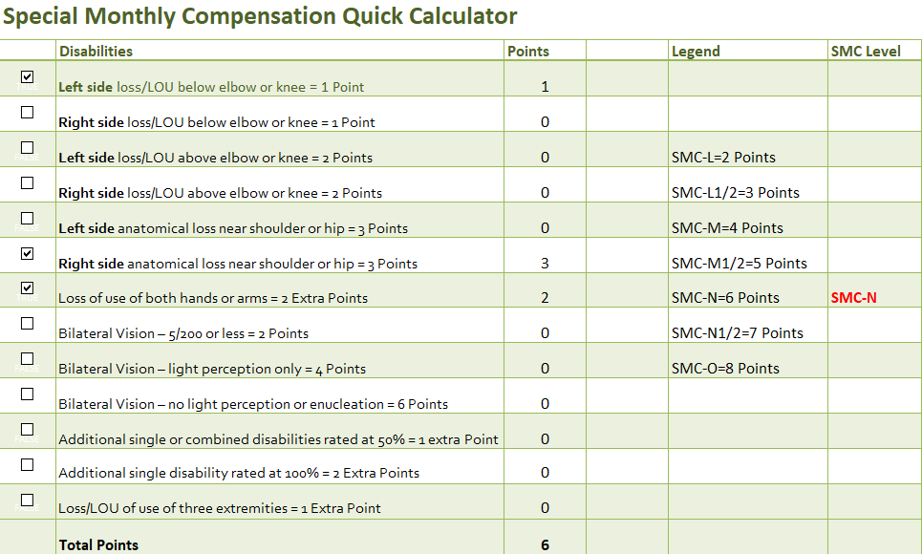
SMC Quick Calculator
Example #2: Anatomical loss of right arm near shoulder, plus loss of use of left hand.

Slide 87
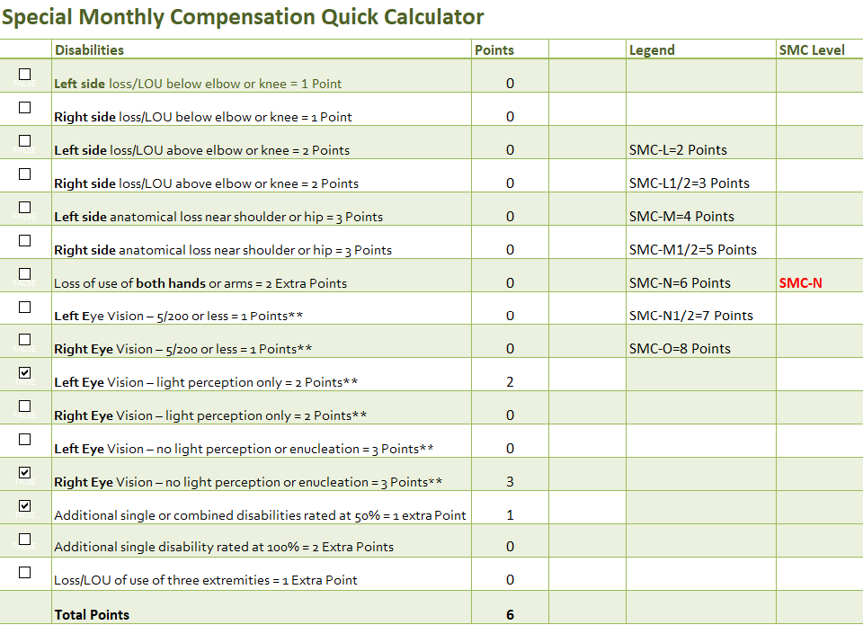
SMC Quick Calculator
Example #3: Left eye LPO plus right eye NLP, plus additional 50% combined disability.

Slide 88
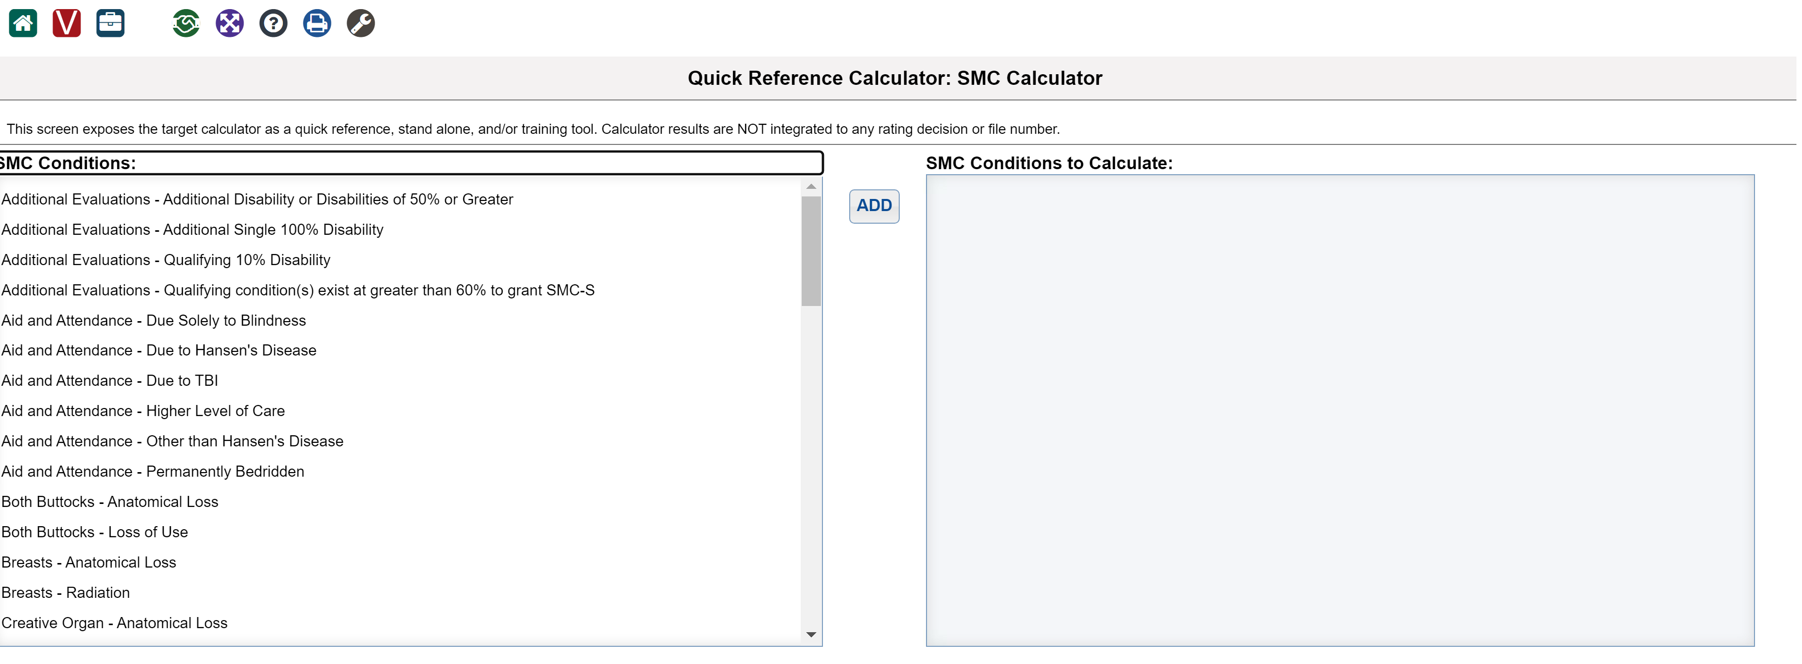
VA’s SMC Calculator
Access VBMS-R
Click on tool icon
Choose SMC Calculator on right side
VA decision makers are required to use the SMC Calculator to determine appropriate SMC level.

Slide 89
SMC Filing Examples

Slide 90
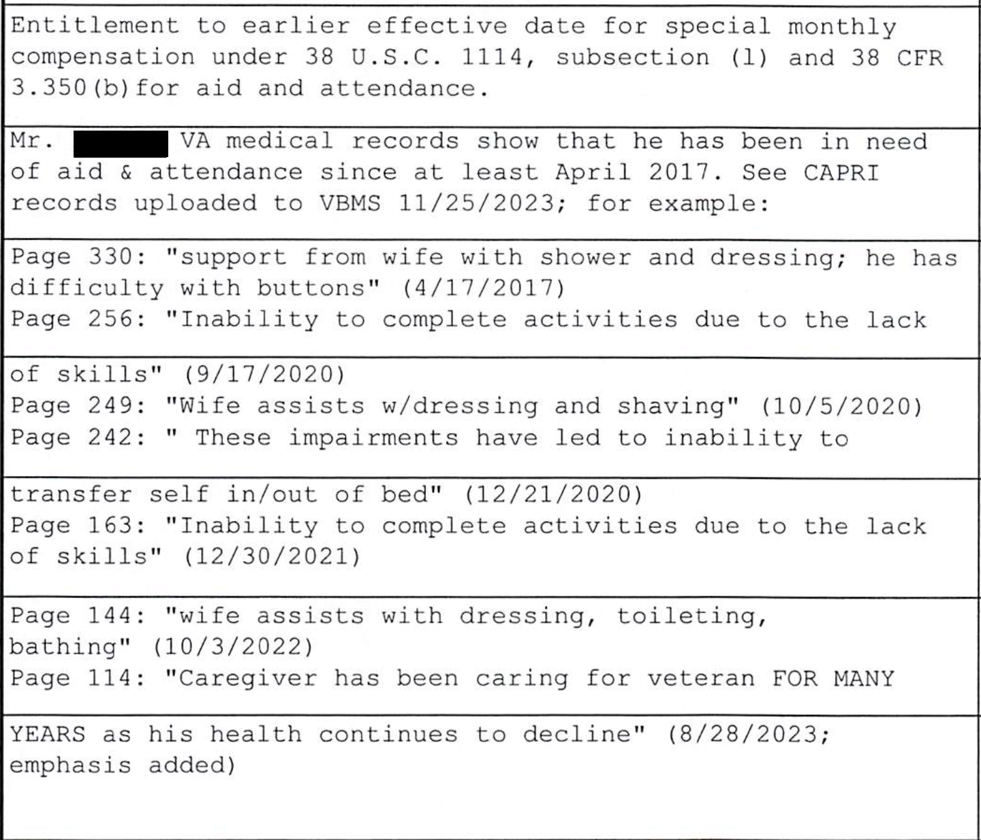
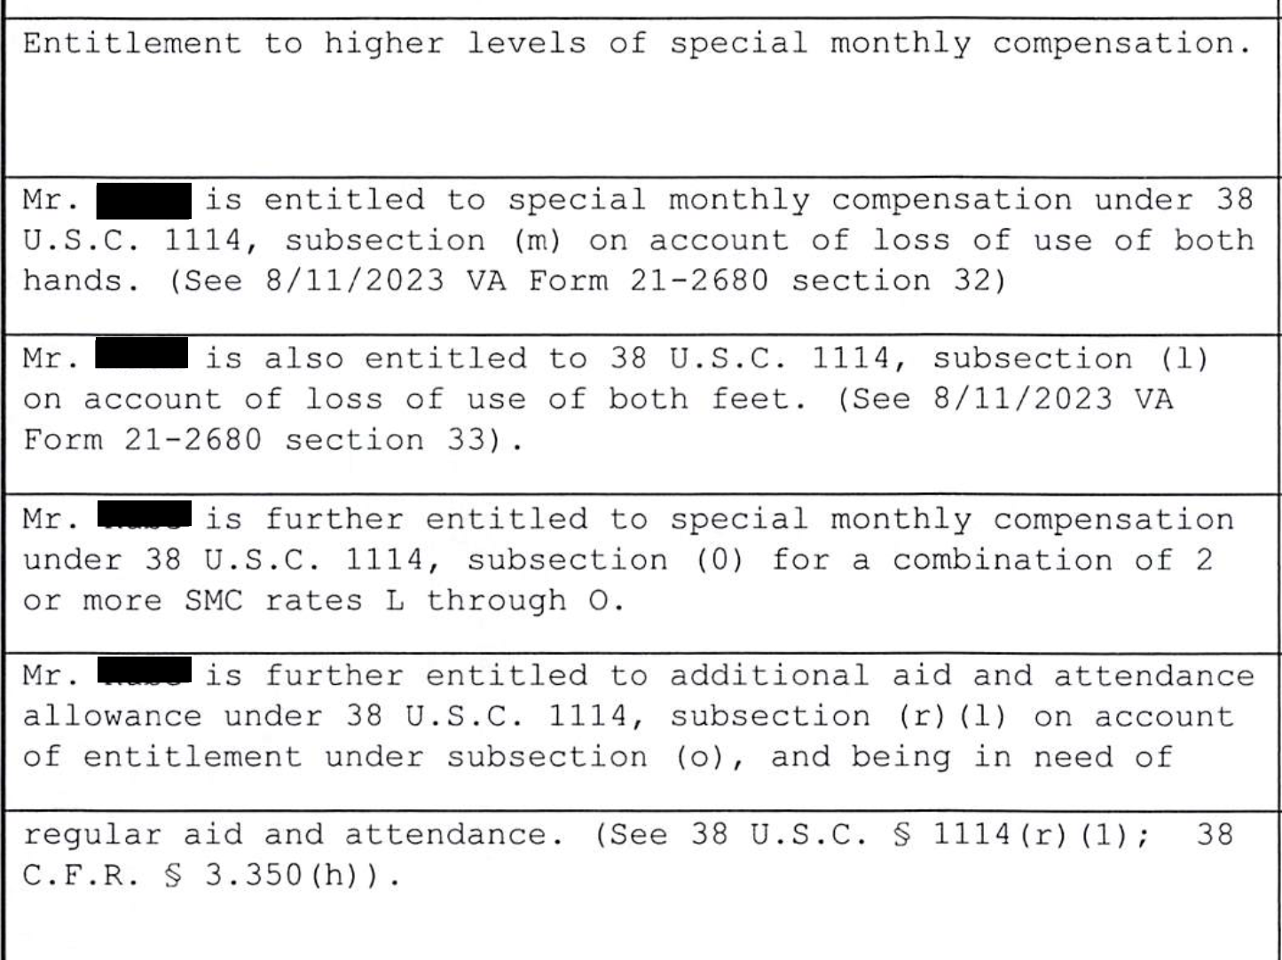
SMC Higher Level Review Example*
* This was the case where VA initially granted A&A but with an incorrect effective date, and failed to grant higher levels of SMC.

Slide 91
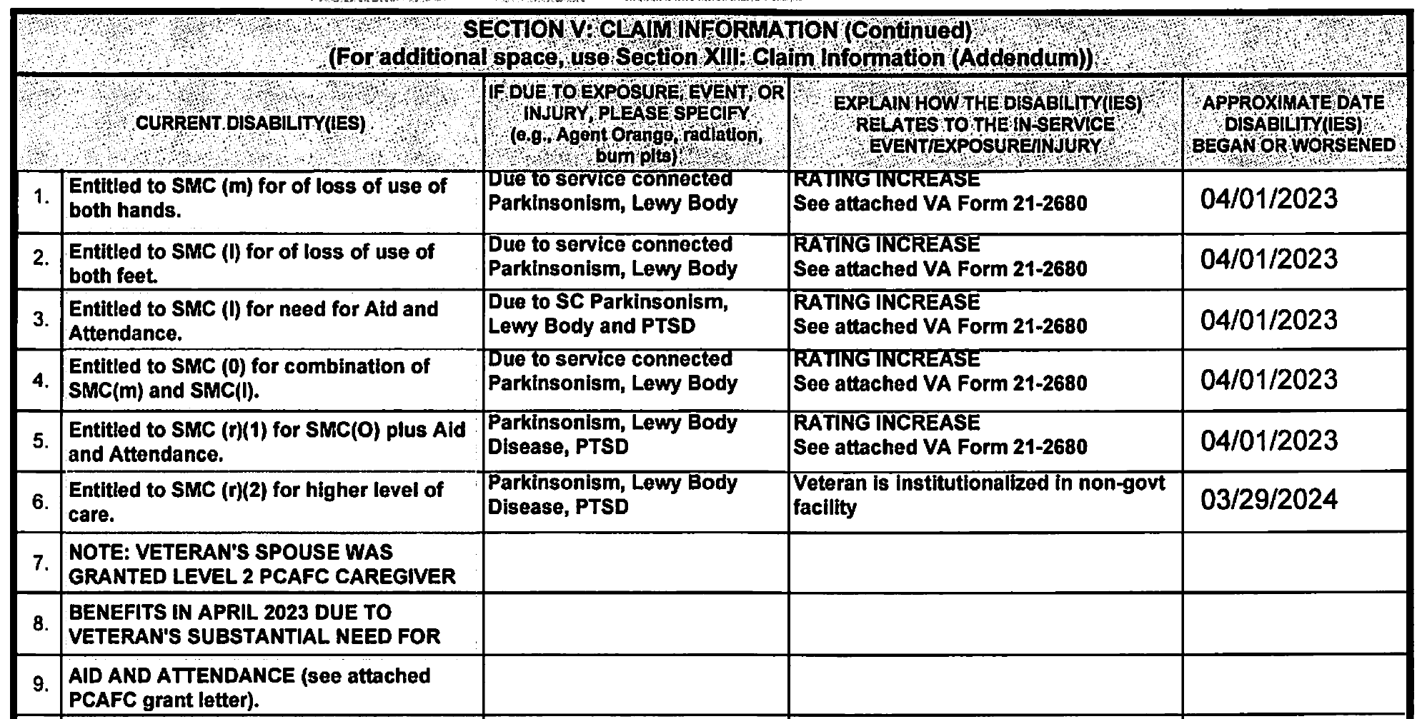
SMC Claim on 21-526EZ*
* This was a case where we were successful in getting a grant of SC for Parkinsonism and PTSD. At the time, veteran was reasonably self-sufficient. A few years later, veteran's spouse reached out to us and shared that her husband had to be institutionalized due to the severity of his conditions.
Our Strategy:
Break down each entitlement specifically and walk the adjudicator through the steps up to the SMC level we want.
Reference the supporting evidence (e.g., 21-2680).
Claim as an increase rather than as a new claim to obtain the earliest possible effective date.
Point to evidence showing earlier entitlement (e.g., in this case we noted spouse’s Caregiver grant).

Slide 92
SMC Final Thoughts
SMC, especially at the higher levels, is extraordinarily complex. As a result, VA raters often commit errors when determining a veteran’s accurate entitlement.
While VA’s SMC calculator is generally accurate, raters often fail to input all of the correct data which results in insufficient levels of SMC being assigned.
Since the authority to decide loss of use lies with the rater rather than the examining physician, VA frequently issues denials. Independent medical opinions are often essential to substantiate a finding of loss of use.
VA is very reluctant in granting A&A for separate conditions (e.g., physical and mental). Again, IMOs may be necessary to establish more than one entitlement.
SMC is a moving target and regularly litigated. Keep an eye on case law!

Slide 93
QUESTIONS?

Slide 94

More Questions?
Feel free to contact us about questions from this training or ANYTIME you have a question about a claim:
CACVSO@eagleveteranslaw.com
Join us for our weekly YouTube livestream where we break down veterans’ claims and appeals with clear, reliable, on‑point education: https://www.youtube.com/@RRCC-cjc/streams

